Slide 1
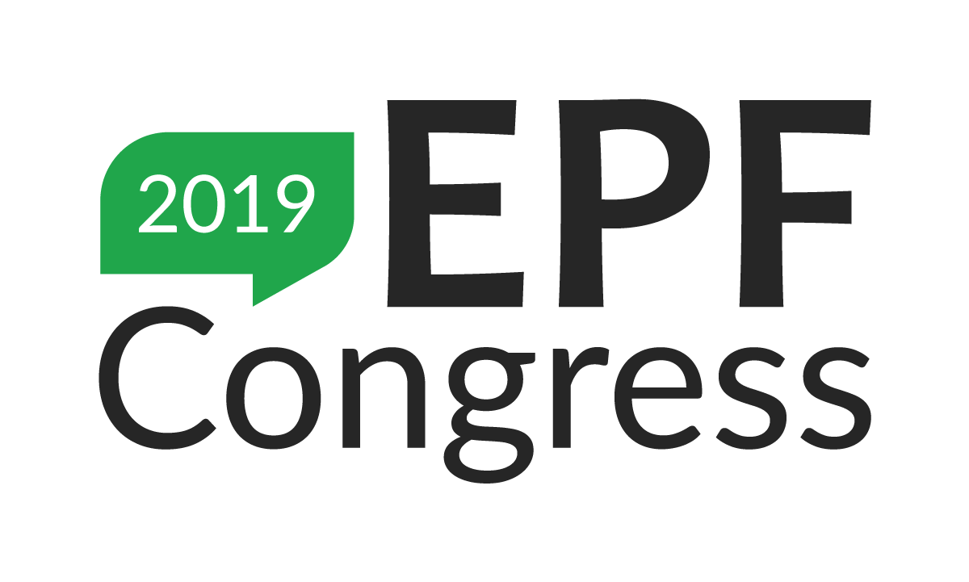

Slide 2
Ensuring equity, inclusivity and diversity of the patients’voice:
An introduction
Prof. em. Jan De Maeseneer, MD, PhD
Department of Public Health and Primary Care,Ghent University (Belgium)
Past President European Forum for Primary Care (EFPC) (2005-2017)
13/11/2019
#EPFCongress19

Slide 3
Nano
Micro
Meso
Macro

Slide 4
Ensuring equity, inclusivity and diversity of the patients’voice
Nano-level
Equity: access to quality services and providers
Inclusivity: nobody left behind
Diversity: human rights and ethno-sensitive approach
ROLE OF PATIENTS’ ORGANISATIONS

Slide 5
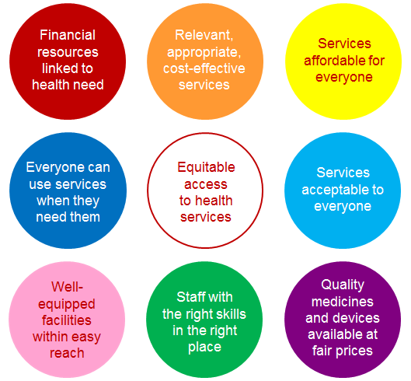
Coverage & affordability
Timely availability
Source:
EXPH-opinion:
Access to
Health Care
Services
Availability of services
Notes:
Checklist to remind policy makers of the multiple factors that need to be consideredwhen thinking about access to health services

Slide 6
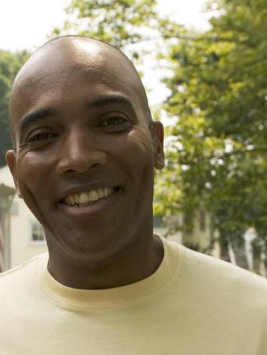
Mr. Onugu, Nigeria
Health care for undocumented residents
“illegal status”/’undocumented’
R.D. 12.12.96: “Access to urgent Medical care”
Payment through Public Centre for Social Welfare
No patient contribution
Notes:
premier tiret : on va y revenir
deuxième tiret : la CEAM ne couvre pas les cas où la personne s’est rendue dans un autre Etat membre avec le seul but d’y recevoir des soins médicaux. Donc, le titulaire d’une CEAM ne peut en principe pas exiger la prise en charge de soins qui vont au-delà de ce qui est médicalement nécessaire pendant la durée du séjour temporaire.
troisième tiret : et suivant ses tarifs ou son système de prestation en nature.
Quelles données se trouve-t-il sur la carte ? … [11]

Slide 7
Nano
Micro
Meso
Macro

Slide 8
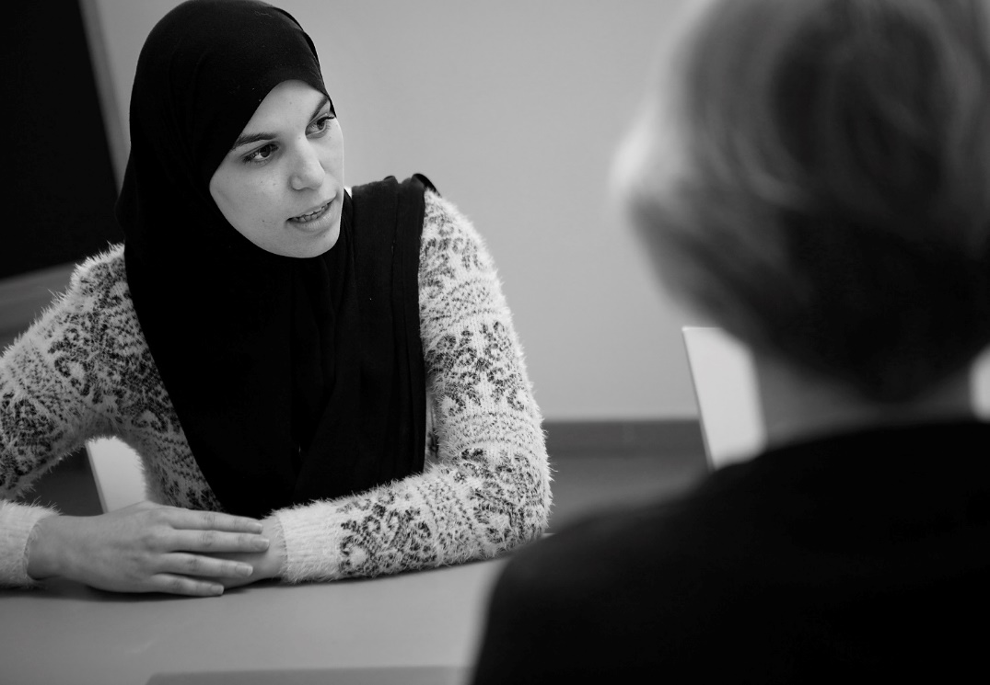
Characteristics of provider / patient encounters
Commitment - Connectedness
Clinical Competence
Cultural Competence
Context
Comprehensiveness
Complexity
Coordination
Continuity
Compassion ↔ Computer

Slide 9
Ensuring equity, inclusivity and diversity of the patients’voice
Nano-level
Equity: access to quality services and providers
Inclusivity: nobody left behind
Diversity: human rights and ethno-sensitive approach
ROLE OF PATIENTS’ ORGANISATIONS : - ADVOCACY
- HEALTH LITTERACY
- EMPOWERMENT
- NARRATIVE: PATIENTS’ EXPERIENCES

Slide 10
Nano
Micro
Meso
Macro

Slide 11
Ensuring equity, inclusivity and diversity of the patients’voice
Micro-level
Equity: access to integrated inter-professional primary care teams
Inclusivity and diversity: goal-oriented care
ROLE OF PATIENTS’ ORGANISATIONS

Slide 13
Opinion on Definition primary care – Definition
Core-definition
'The Expert Panel considers that primary care is the provision of universally accessible, integrated person-centered, comprehensive health and community services provided by a team of professionals accountable for addressing a large majority of personal health needs. These services are delivered in a sustained partnership with patients and informal caregivers, in the context of family and community, and play a central role in the overall coordination and continuity of people’s care
The professionals active in primary care teams include, among others, dentists, dieticians, general practitioners/family physicians, midwives, nurses, occupational therapists, optometrists, pharmacists, physiotherapists, psychologists and social workers.’

Slide 14
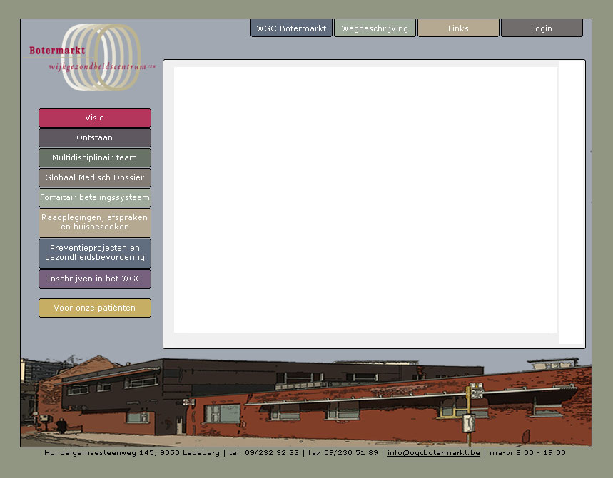
Community Health Centre:
General practitioners; nurses; dieticians; health promotors; dentists; social workers; psychologists;community health workers…
6200 patients; 95 nationalities
Integrated Needs-based Capitation; no co-payment
COPC-strategy

Slide 15
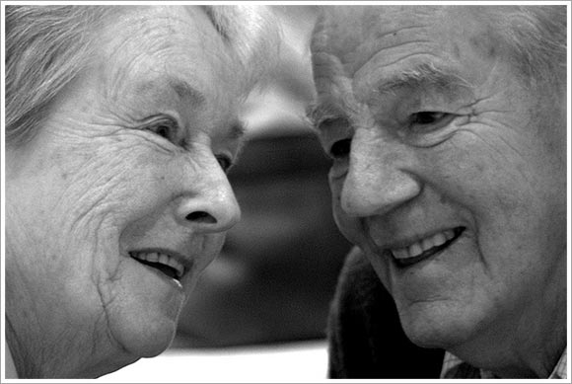
Challenges in patients with multimorbidity

Slide 16
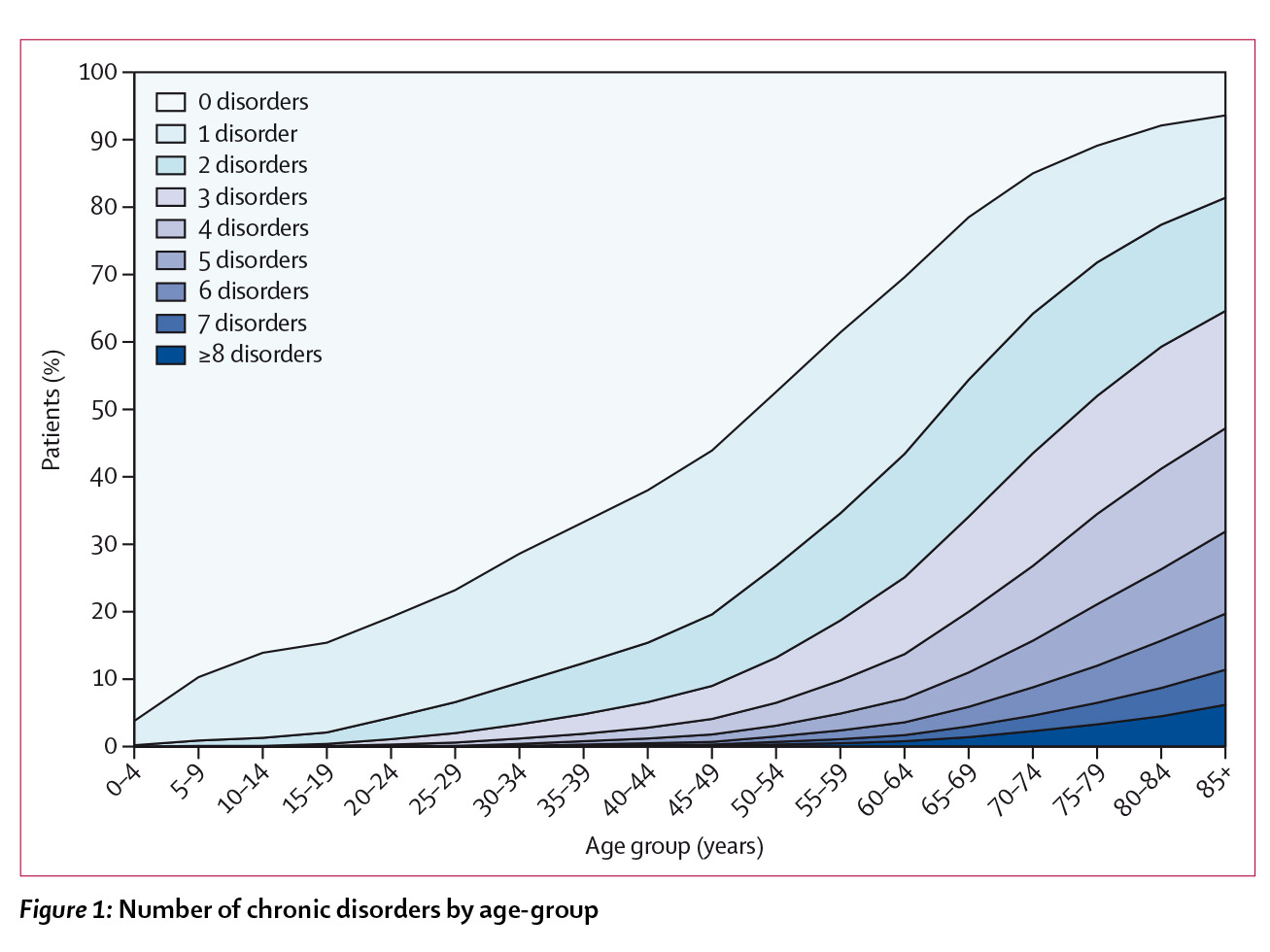

Slide 17
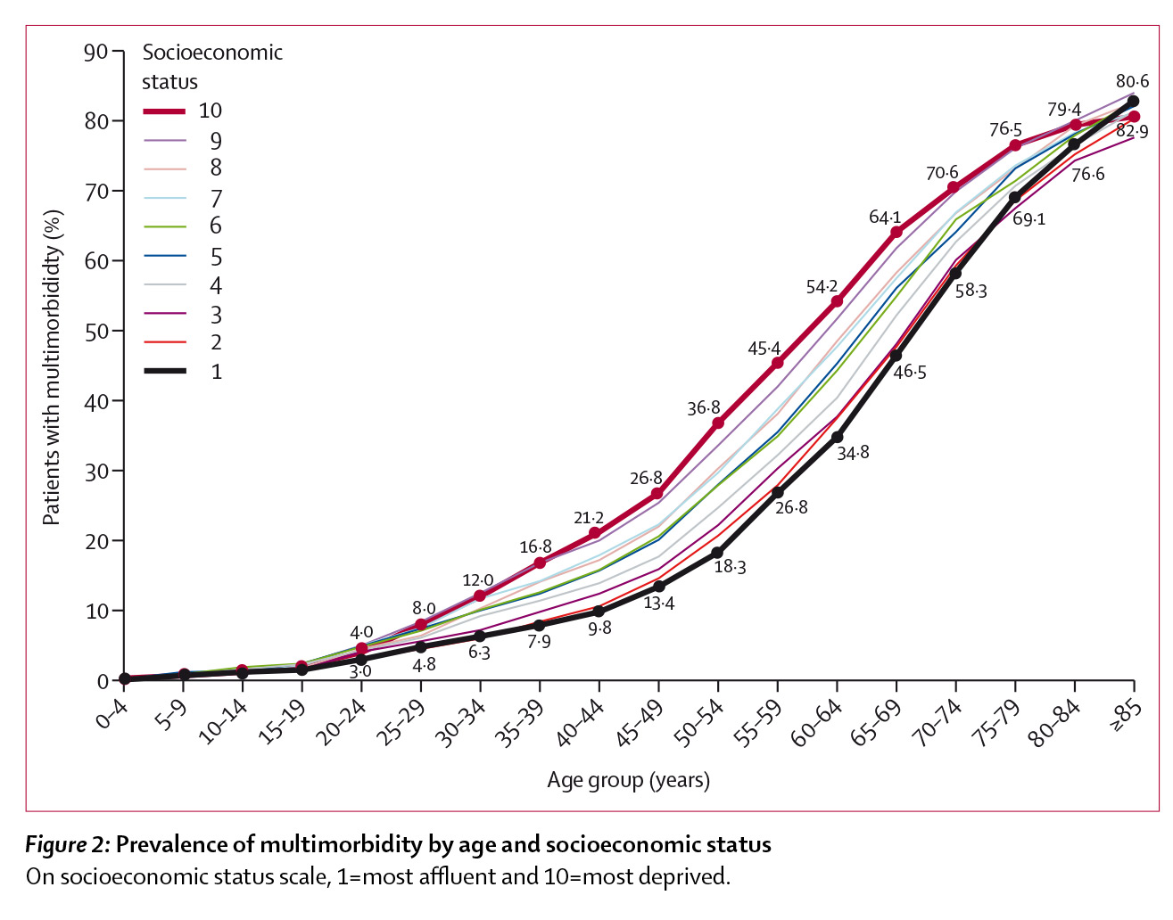

Slide 18
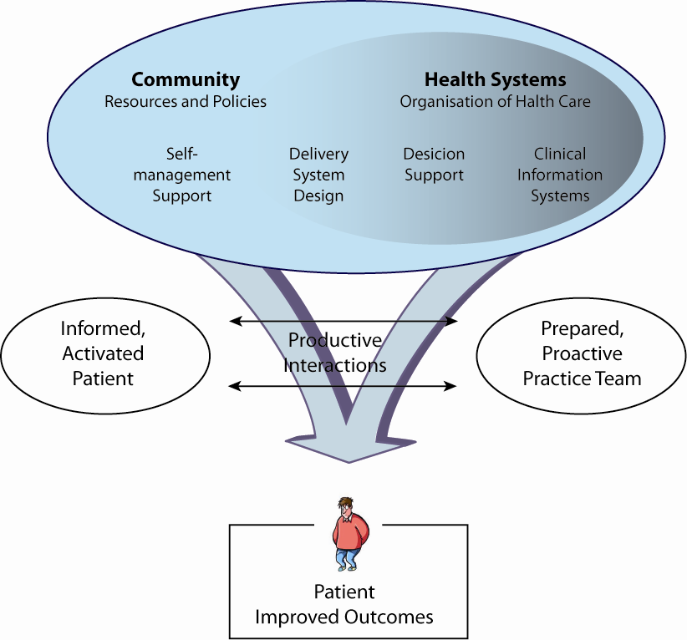
EMPOWERMENT
Notes:
18
Het CCM-model is een theoretisch model dat in 1998 ontwikkeld
is door Wagner op basis van de bestaande evidentie rond
zorgorganisatie voor chronisch zieken & in de meeste
onderzoeken rond zorgvernieuwing als onderbouwing wordt
gebruikt.
Centraal in goede zorgverlening staat de interactie tussen
een goed gestructureerd team en een geïnformeerde &
gemotiveerde patiënt.
6 elementen dragen er toe bij om dit te realiseren
Voldoende aandacht vanuit maatschappij en beleid voor de uitbouw van een chronisch zorgbeleid
Organisatie van de gezondheidszorg: doelstellingen voorop stellen, aangepaste financiering van de zorg (targets),
Aandacht voor zelfzorg: continue evaluatie zelfzorg, centrale rol van patiënt benadrukken,
Organisatie zorgverlening: taakafspraken, call/recall, afspraaksysteem,
Ondersteuning in medisch handelen: beschikken over aanbeveling, navorming, ondersteuning door de tweede lijn
Aangepaste informatietechnologie: ondersteuning bij registratie & feedback, gedeeld dossier, ..

Slide 19
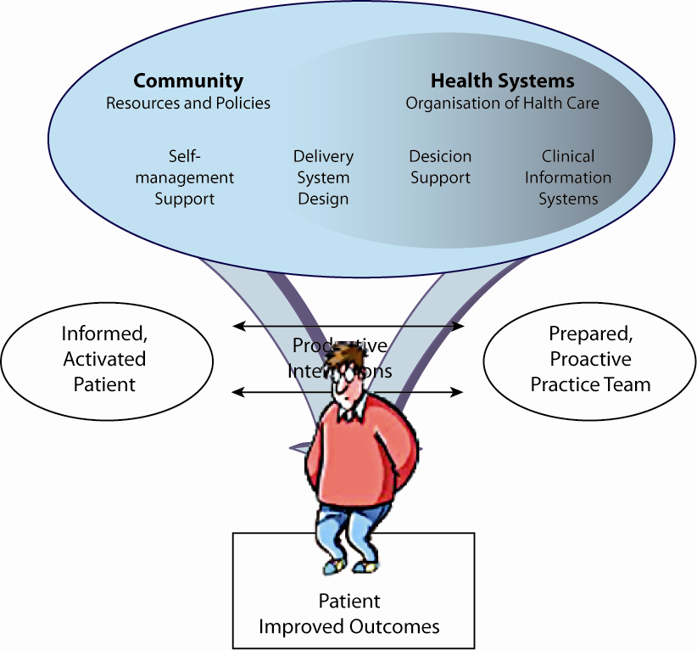

Slide 20
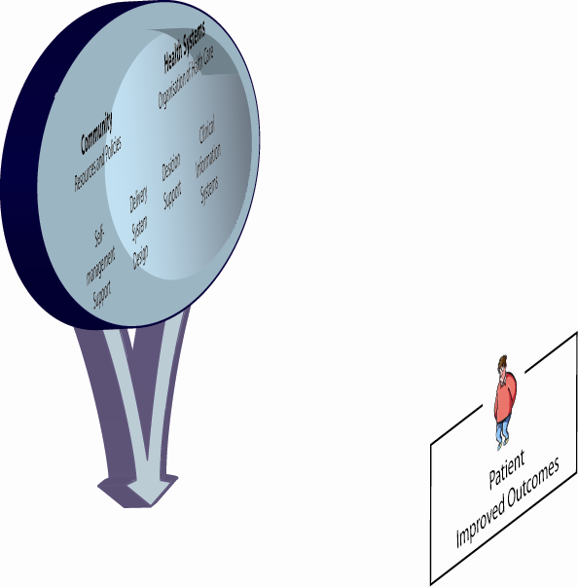
But…

Slide 21
Jennifer is 75 years old. Fifteen years ago she lost her husband. She is a patient in the practice for 15 years now. During these last 15 years she has been through a laborious medical history: operation for coxarthrosis with a hip prothesis, hypertension, diabetes type 2, COPD and osteoartritis. Moreover there is osteoporosis. She lives independently at her home, with some help from her youngest daughter Elisabeth. I visit her regularly and each time she starts saying: “Doctor, you must help me”. Then follows a succession of complaints and unwell feeling: sometimes it has to do with the heart, another time with the lungs, then the hip, …

Slide 22
Each time I suggest – according to the guidelines - all sorts of examinations that did not improve her condition. Her requests become more and more explicit, my feelings of powerlessness, insufficiency and spite, increase. Moreover, I have to cope with guidelines that are contradictory: for COPD she sometimes needs corticosteroids, which worsens her glycemic control.
The adaptation of the medication for the blood pressure (at one time too high, at another time too low), cannot meet with her approval, as does my interest in her HbA1C and lung function test-results.

Slide 23
After so many contacts Jennifer says: “Doctor, I want to tell you what really matters for me. On Tuesday and Thursday, I want to visit my friends in the neighbourhood and play cards with them. On Saturday, I want to go to the Supermarket with my daughter. And for the rest, I want to be left in peace, I don’t want to change continually the therapy anymore, … especially not having to do this and to do that”.
In the conversation that followed it became clear to me how Jennifer had formulated the goals for her life. And at the same time I felt challenged how the guidelines could contribute to the achievement of Jennifer’s goals. I visit Jennifer again with pleasure ever since: I know what she wants, and how much I can (merely) contribute to her life.

Slide 24
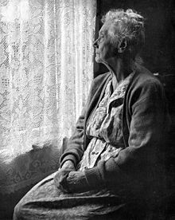
Sum of the guidelines
Time | Medications
7:00 AM | Ipratropium dose inhaler Alendronate 70 mg/wk
8:00 AM | Calcium 500 mg Vit D 200 IU Lisinopril 40mg Glyburide 10mg Aspirin 81mg Metformin 850 mg Naproxen 250 mg Omeprazol 20mg
1:00 PM | Ipratropium dose inhaler Calcium 500 mg Vit D 200 IU
7:00 PM | Ipratropium dose inhaler Metformin 850 mg Calcium 500 mg Vit D 200 IU Lovastatin 40 mg Naproxen 250 mg
11:00 PM | Ipratropium dose inhaler
As needed | Albuterol dose inhaler Paracetamol 1g
Patient tasks
Joint protection
Energy conservation
Self monitoring of blood glucose
Exercise
Non weight-bearing if severe foot disease is present and weight bearing for osteoporosis
Aerobic exercise for 30 min on most days
Muscle strenghtening
Range of motion
Avoid environmental exposures that might exacerbate COPD
Wear appropriate footwear
Limit intake of alcohol
Maintain normal body weight
Referrals
Physical therapy
Ophtalmologic examination
Pulmonary rehabilitati
Clinical tasks
Administer vaccine
Pneumonia
Influenza annually
Check blood pressure at all clinical visits and
sometimes at home
Evaluate self monitoring of blood glucose
Foot examination
Laboratory tests
Microalbuminuria annually if not present
Creatinine and electrolytes at least 1-2 times a year
Cholesterol levels annually
Liver function biannually
HbA1C biannually to quarterly
Patient education
Foot care
Oeseoartritis
COPD medication and delivery system training
Diabetes
Boyd et al. JAMA, 2005

Slide 25
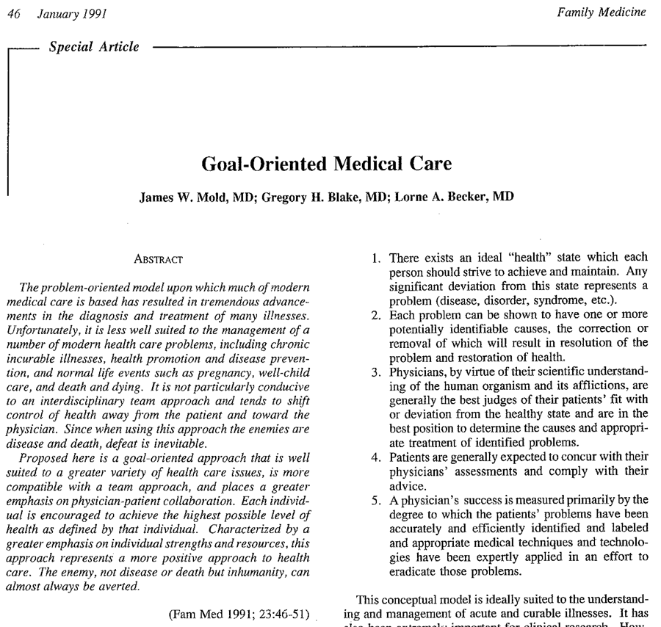

Slide 26
“Disease-oriented versus goal-oriented care”
 | Disease-oriented | Goal-oriented
Definition of Health | Absence of disease as defined by the health care system | Maximum desirable and achievable quality and/or quantity of life as defined by each individual

Slide 27
“Disease-oriented versus goal-oriented care”
 | Disease-oriented | Goal-oriented
Measures of success | Accuracy of diagnosis, appropriateness of treatment, eradication of disease, prevention of death | Achievement of individual goals

Slide 28
“Disease-oriented versus goal-oriented care”
 | Disease-oriented | Goal-oriented
Evaluator of success | Physician | Patient

Slide 29
What really matters for patients is
Functional status
Social participation

Slide 30
Evolution from ‘Chronic Disease Management’ towards ‘Participatory Patient Management’
Puts the patient centrally in the process.
Changes the perspective from ‘disease-oriented care’. towards ‘goal-oriented’ care.

Slide 31
F R A G M E N T A T I O N

Slide 32
Vertical Disease Oriented Approach
Mono-disease-programs? Or…
Integration in comprehensive PHC
HYPERCHOLESTEROL
HYPERTENSION
DIABETES
OBESITY
COPD
AIDS
OSTEOPOROSIS

Slide 33
The challenge: vertical disease- oriented programs and multi-morbidity
Create duplication
Lead to inefficient facility utilization
Lead to inequity between patients: “inequity by disease”

Slide 34
Resolution WHA62.12 “Primary Health Care, including health systems strengthening”
The World Health Assembly, urges member states: … (6) to encourage that vertical programmes, including disease-specific programmes, are developed, integrated and implemented in the context of integrated primary health care.

Slide 35
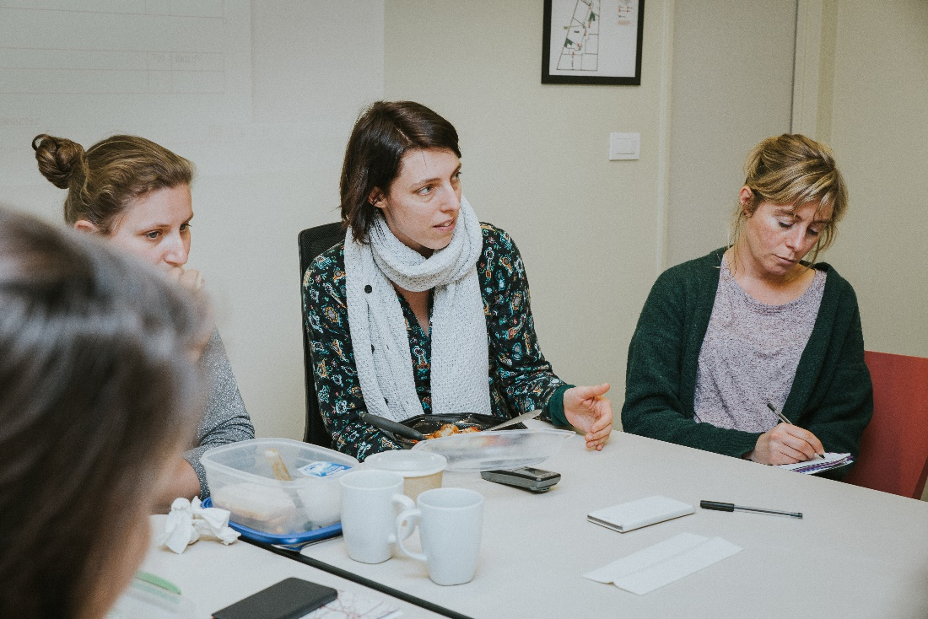
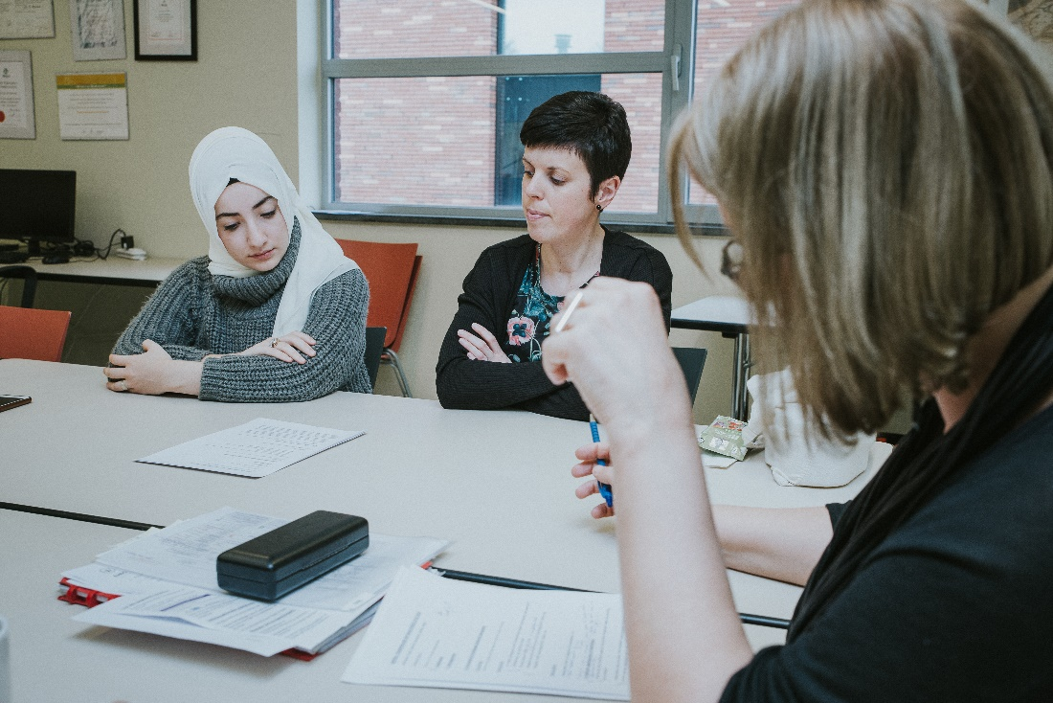
Patient
(representative)
participates in the inter-professional
discussion
INTERPROFESSIONAL DISCUSSION
NURSING TEAM: PLANNING MEETING

Slide 36
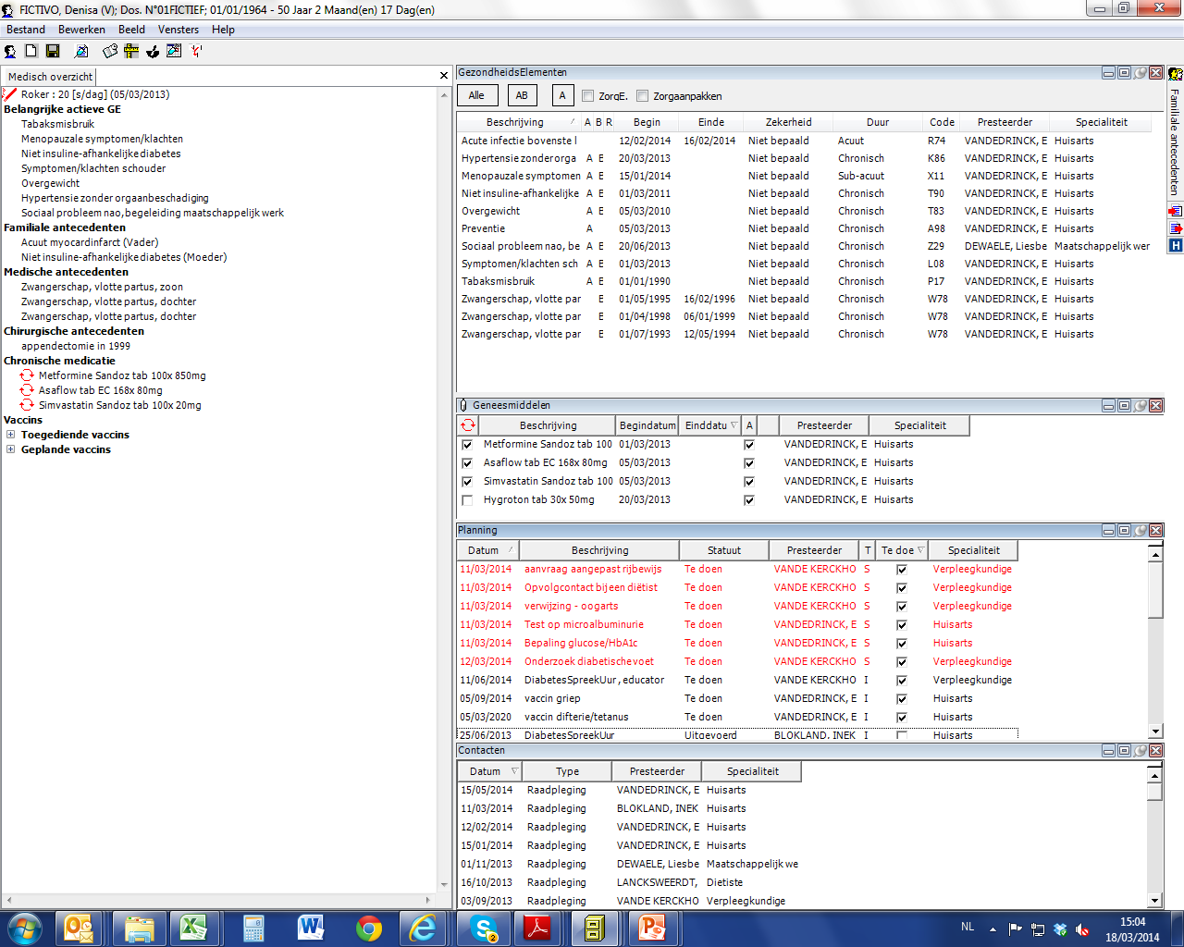
Shared Electronic Patient Record

Slide 37
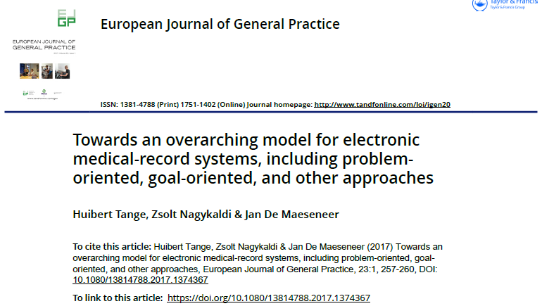

Slide 38
Context
Health Literacy
Relationships
Resources
I.C.F.
I.C.P.C.
I.C.D.
Aspirations
Patient Personal
Life Goals
Health
Problems
Medical
Diagnoses
Objective 1
Objective 2
Objective 3
- shared
- high priority
- shared
- high priority
- not shared
- low priority
- tools
- barriers
- facilitators
- tools
- barriers
- facilitators
Action
Plan
Action
Plan
observation
- tasks
- targets
- tasks
- targets
time

Slide 39
Ensuring equity, inclusivity and diversity of the patients’voice
Micro-level
Equity: access to integrated inter-professional primary care teams
Inclusivity and diversity: goal-oriented care
ROLE OF PATIENTS’ ORGANISATIONS : - Participation in Organisation of Care Process
- Advocate Outreach to vulnerable groups
- Patient in the driver’s seat: care coordination
- Mobilizing Citizens providing support in the Care
Process: Informal Care Givers
- Patient Participation in Board of local/primary care
services
- Advocate integration of information, horizontally
and vertically
- Avoid FRAGMENTATION AND “INEQUITY BY
DISEASE”

Slide 40
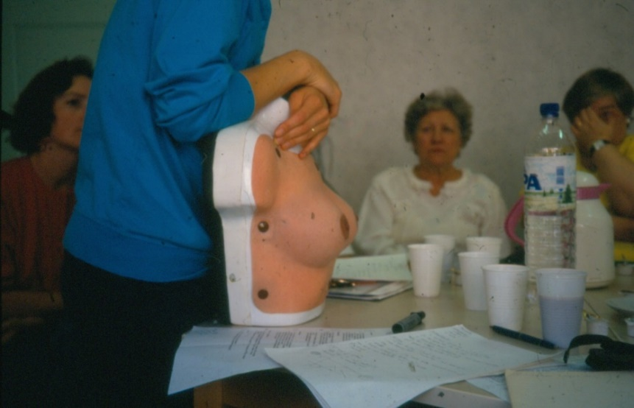
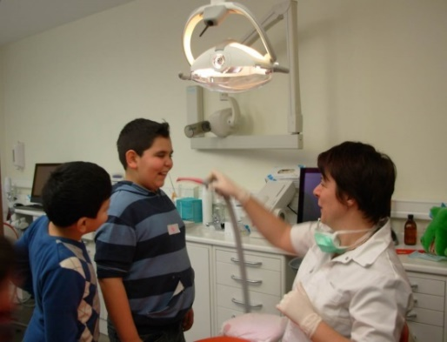
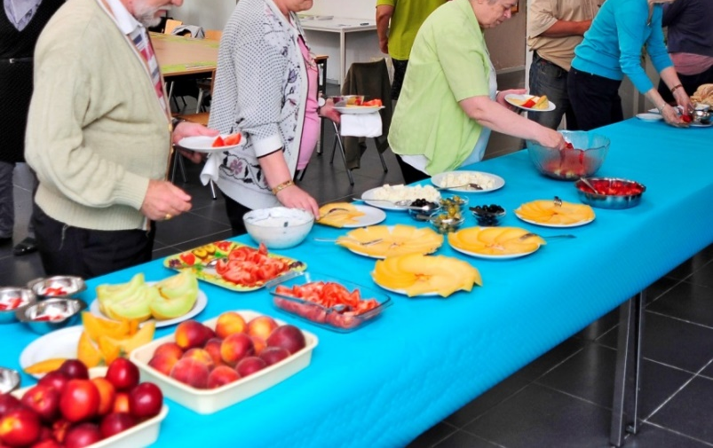
Role of PATIENTS’ ORGANISATIONS: Illness prevention & Health promotion
Individual illness prevention
Group-based illness prevention
Health promotion

Slide 41
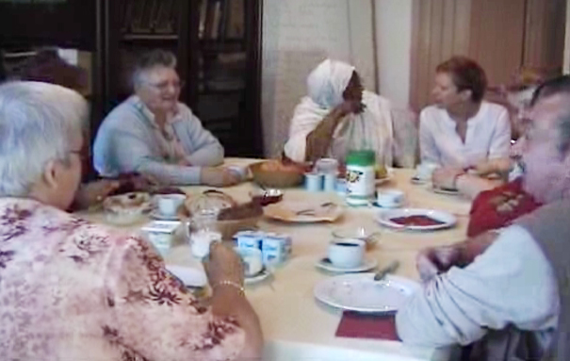
PATIENTS’ INITIATIVE:
Intercultural ‘Diabetes-breakfast’: connectedness

Slide 42
Nano
Micro
Meso
Macro

Slide 43
Ensuring equity, inclusivity and diversity of the patients’voice
Meso-level
Equity: system accountability for a defined population: PRIMARY CARE ZONES
Inclusivity: Community Oriented Primary Care and inter-sectoral action for health
Diversity: addressing Social Determinants of Health through ‘proportionate universalism’ (Sir Michael Marmot)
ROLE OF PATIENTS’ ORGANISATIONS

Slide 44
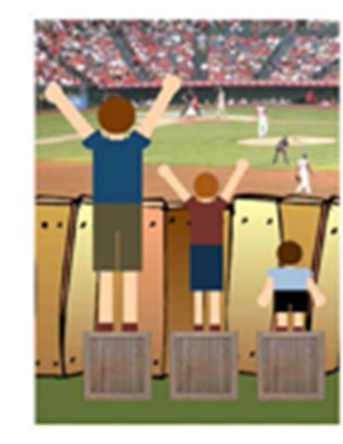
WhAT IS ‘PROPORTIONATE UNIVERSALISM’ ?
Notes:
In contrast: equity in health care means doing different things for different people.
Care should ….

Slide 45
“Organizing primary care in decentralized entities, for example, primary care zones (PCZs), can contribute to the visibility of primary care. Defining the population that accesses a certain group of services and providers in primary care, can contribute to the accountability of providers in terms of outcomes, access and quality of care.”
Everybody Counts!
No one should be left behind!

Slide 46
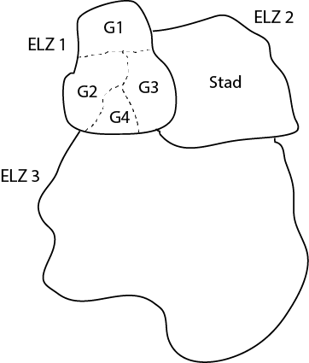
PRIMARY CARE ZONE: meso-LEVEL: 70.000-125.000 iNHABITANTS
Flemish Region of Belgium (2019)

Slide 47
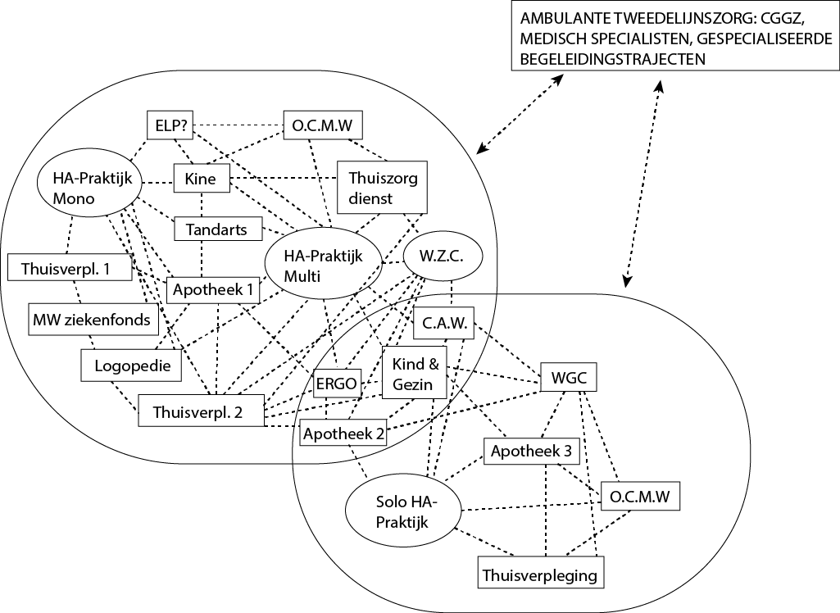
PRIMARY CARE NETWORKS: > 5.000 InHABITANTS (RURAL) > 10.000 INHABITANTS (URBAN)

Slide 48
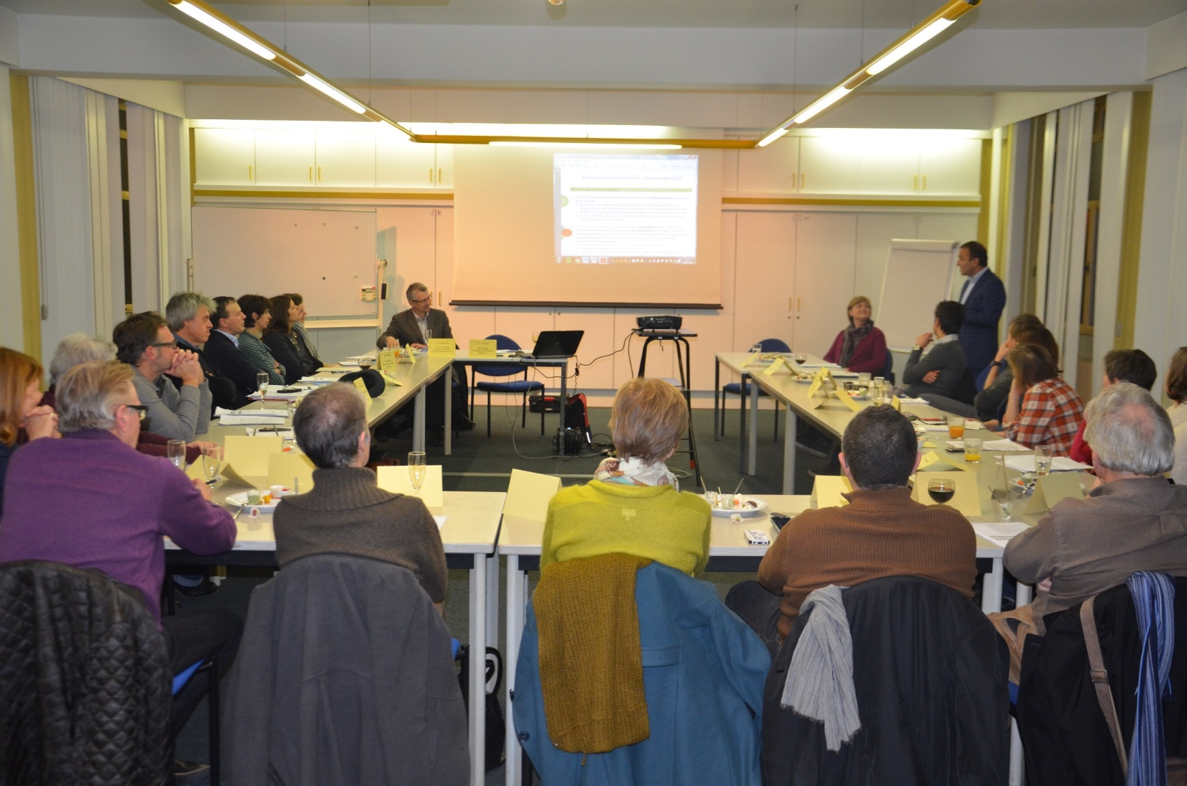
PRIMARY CARE ZONE (Flanders – Belgium): INTEGRATION PRIMARY CARE, PUBLIC HEALTH, SOCIAL SECTOR, PATIENT REPRESENTATION, LOCAL AUTHORITIES (9 out of 24)

Slide 50
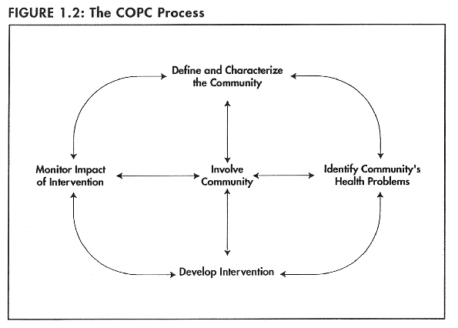

Slide 51
Ensuring equity, inclusivity and diversity of the patients’voice
Meso-level
Equity: system accountability for a defined population
Inclusivity: Community Oriented Primary Care and inter-sectoral action for health
Diversity: addressing Social Determinants of Health through ‘proportionate universalism’
ROLE OF PATIENTS’ ORGANISATIONS : - Voicing local needs of patients e.g.
access, quality
- Intersectoral cooperation
- Cooperation with Civil Society
Organization: Health in All Policies

Slide 52
Nano
Micro
Meso
Macro

Slide 53
Ensuring equity, inclusivity and diversity of the patients’voice
Macro-level
Equity/Inclusivity/Diversity in an integrated ‘Health in all Policies’ approach
Human rights/Advocacy/Solidarity & Social Justice/DEMOCRACY
Health is GLOBAL
ROLE OF PATIENTS’ ORGANISATIONS

Slide 54
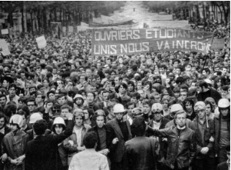
PATIENT PARTICIPATION IS A SPIN-OFF OF THE EMANCIPATORY MAY ‘68 MOVEMENT….
… IMPORTANT CHALLENGES REMAIN

Slide 55
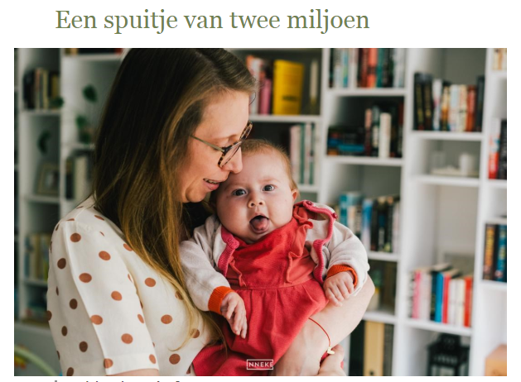
AFFORDABILITY OF PAYMENT FOR INNOVATIVE MEDICINES…..
OR CROWD-FUNDING ?

Slide 56
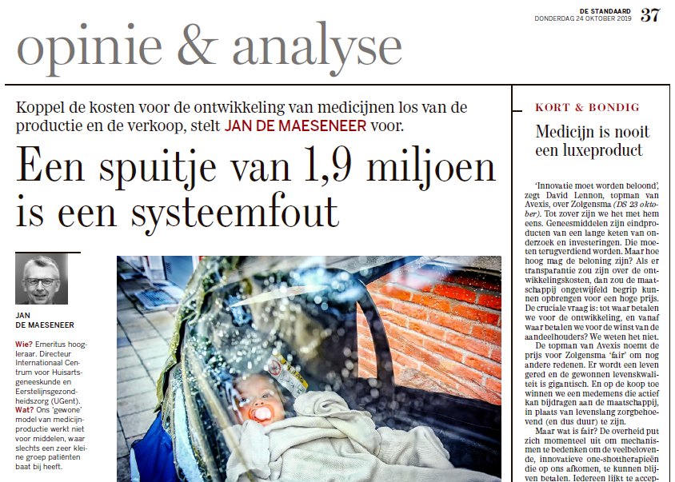
NEW ORIENTATIONS:
°DE-LINKAGE: Research & Development and Production & Sales
°PRICE-NEGOTIATIONS AT EU-level
°No or Fixed co-payment
°Re-think Managed Entry Agreements (MEA’s)
INVOLVE PATIENTS IN THE DEBATE

Slide 57
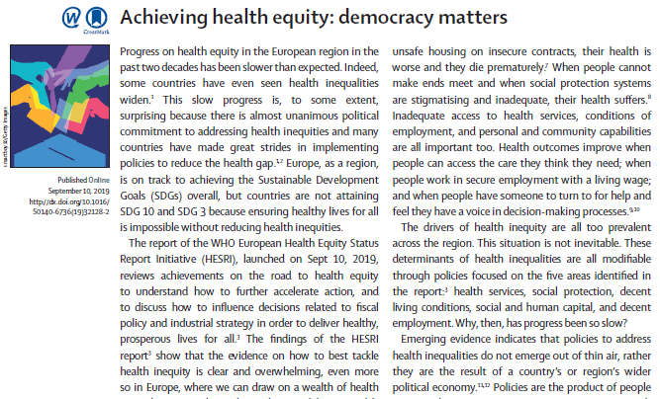
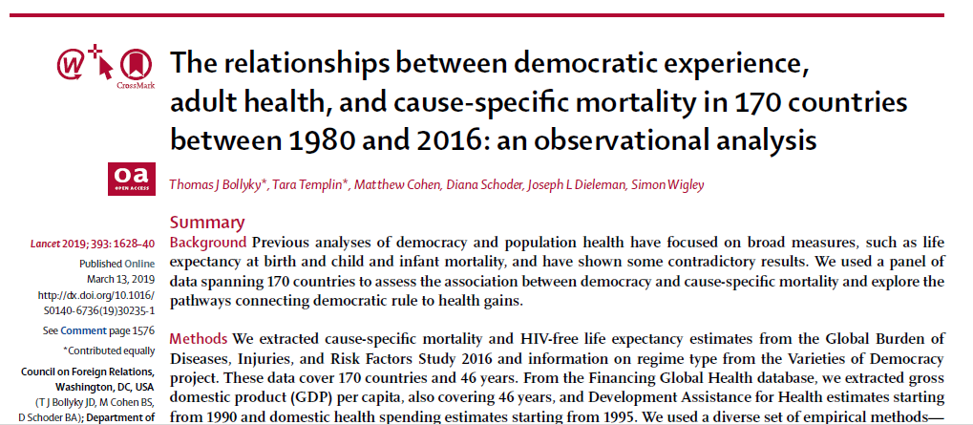
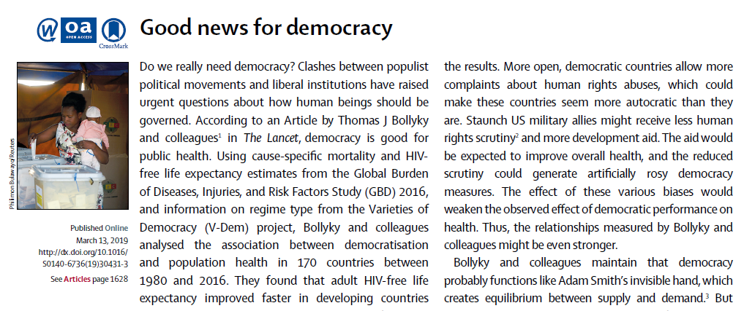
There is increasing evidence:
DEMOCRACY IS GOOD
FOR HEALTH!
(sources: Lancet 2019)

Slide 58
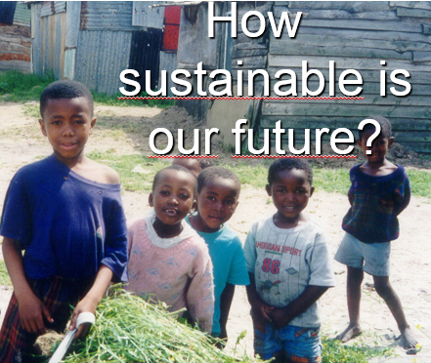
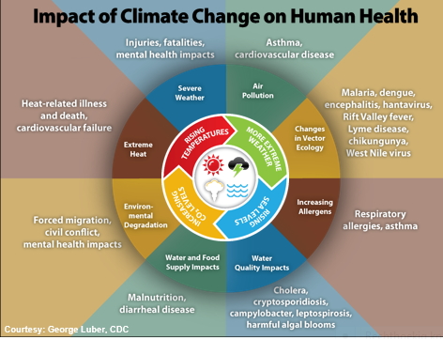
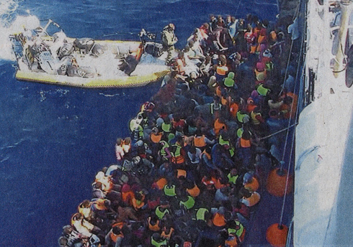
HEALTH IS GLOBAL…
EXPH: Reflection on priorities for the future of Health Care in EU_APRIL 2019

Slide 59
Ensuring equity, inclusivity and diversity of the patients’voice
Macro-level
Equity/Inclusivity/Diversity in an integrated ‘Health in all Policies’ approach
Human rights/Advocacy/Solidarity & Social Justice/DEMOCRACY
Health is GLOBAL
ROLE OF PATIENTS’ ORGANISATIONS : - POLICY PARTICIPATION : PATIENTS TOGETHER
WITH COMMITTED CRITICAL ACADEMICS AND
CIVIL SOCIETY ORGANISATIONS
- PATIENTS PARTICIPATE IN RESEARCH POLICY
DEVELOPMENT
- ADVOCACY FOR EQUITY
- STRENGTHEN DEMOCRACY
- GLOBAL PERSPECTIVE

Slide 60
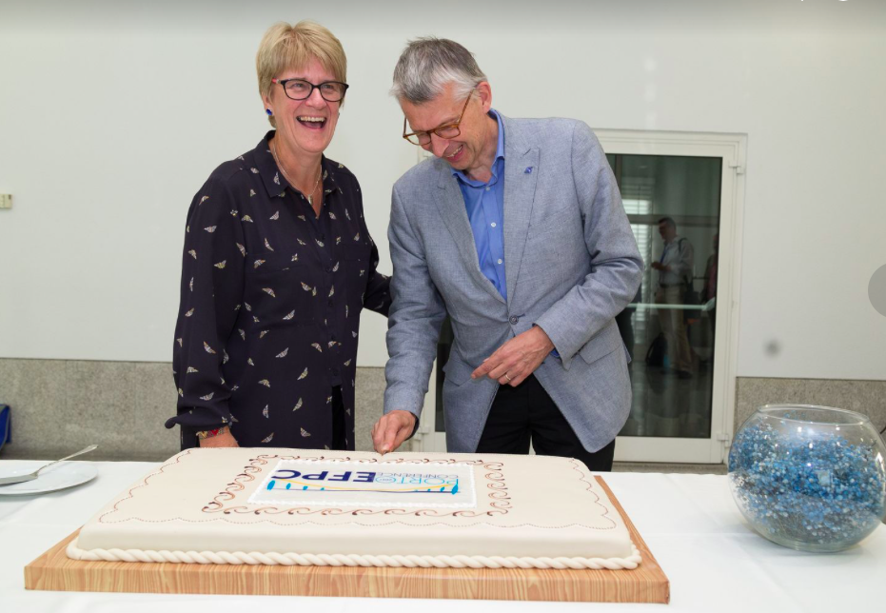
European Forum for Primary Care
Created In 2005 & Secretariat located at the NIVEL institute in the Netherlands.
Why the forum?
Strengthening PC within EU countries
Multi professional network
Citizen/Patient at the centre of care
Activities
Website & Two weekly Newsflash
Position Papers in development
Lunch-Webinars
Conferences/workshops
Ljubljana 27-29 Sept 2020
Advocacy (EU, National Governments, WHO)
Multi Country Study Visits
110 institutional & 60 individual members from 3 different levels (Policy, Research & practice)
*Actual Chair : Sally Kendall Professor of Community Nursing and Public Health & former Chair Prof. em. Jan De Maeseneer

Slide 61
EFPC on the Web
Web based database on European Primary Care: www.euprimarycare.org
LinkedIn discussion group:
“Primary Care Forum”
Currently 6500 members from all over the world
Twitter: @PrimaryCare4um
Currently >1925 followers
#EFPC
Facebook-page: Primary Care Forum
www.euprimarycare.org

Slide 63
Thank you… jan.demaeseneer@ugent.be
WHO
Collaborating
Centre on PHC

Slide 64
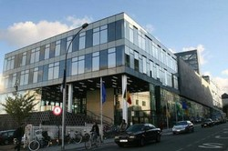
Jan.DeMaeseneer@ugent.be

Slide 65
Thank you!

