Slide 1
EPF Campaign for the 2014 EU Elections
[TEMPLATE PRESENTATION]

Slide 2
EPF Campaign Objectives
OBJECTIVE = create a sense of urgency & propose patients as part of the solution
Raise the voice of European Patients
  Patients’ perspective = experts ‘by experience’
  Important role of national POs
Raise awareness about EPF and our raison d’être
  Our ‘bridge” role
  Key interlocutor on cross-cutting health issues
Call for ‘active’ support of decision-makers
Notes:
2014 Elections = fresh opportunity for the European Patients’ Movement to encourage politicians and policy-makers to commit to a healthier Europe
OBJECTIVE = create a sense of urgency to address health inequalities & propose patients as part of the solution to drive sustainable, cost-effective and high-quality healthcare

Slide 3
Message House
Patients + Participation =
Our Vote for a Healthier Europe
Patients’ View matters
Empowered patients are an asset to society
Breaking down access barriers
Patient involvement = Healthier Europe
Engage patients collectively and pro-actively through Patient Organisations
Adopt an EU strategy on empowerment
Support an EU initiative on equitable access to healthcare for all European citizens
Develop a clear framework for patient involvement across the spectrum of health research
Ensure that patients’ rights is part of the next health Commissioner’s portfolio

Slide 4
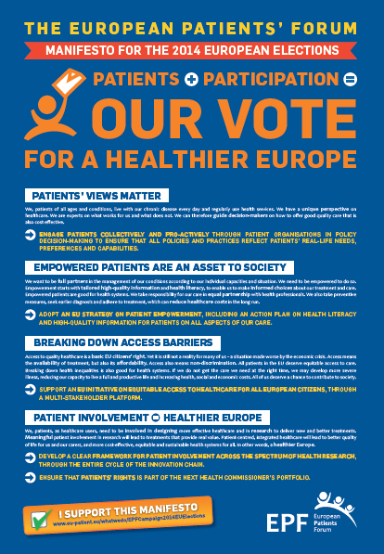

Manifesto
Notes:
More information:
Format = ballot paper when folded, poster when unfolded for decoration
“Our vote” = EPF is supported by our 61 members => Collectively we represent the interests of 150+ million people living with chronic diseases across the European Union and therefore represent a high proportion of voters for the next EU elections. We hope our voice will be heard by decision-makers and that they will add a patients’ perspective in their work.

Slide 5
More information about the campaign
Manifesto translated in all 24 languages to cascade the campaign at national level
More details about the campaign to be embedded in background papers
National patients’ organisations will receive a guidance (toolkit & webinar) on how to support the campaign
Possibility to support the Manifesto (online form)
Make the campaign alive on Twitter #patientsvote #epf2014 @eupatientsforum

Slide 6



Some campaign images

Slide 7
Important links
Website section: http://www.eu-patient.eu/whatwedo/EPFCampaign2014Elections/
Online form: http://www.eu-patient.eu/whatwedo/EPFCampaign2014Elections/I-support-EPF-Campaign/
All 24 language versions of the Manifesto: http://www.eu-patient.eu/library/Manifesto-all-languages/
Our Facebook page: https://www.facebook.com/EuropeanPatientsForum
Our Twitter account: https://twitter.com/eupatientsforum
Our YouTube Channel: http://www.youtube.com/eupatient
Our blog: http://www.eu-patient.org/blog/
Contact:
  Nicola Bedlington, EPF Director, nicola.bedlington@eu-patient.eu
  Cynthia Bonsignore, EPF Communication Officer cynthia.bonsignore@eu-patient.eu
  Kaisa Immonen-Charalambous, EPF Senior Policy Adviser, kaisa.immonen.charalambous@eu-patient.eu

