Slide 1
EPF 2017 Access campaign
‘universal health coverage for all’
Name
Job title
Date
Place
@eupatientsforum
#Access2030

Slide 2
UN SDGs - The road to universal access in the EU by 2030
Goal 3: Ensure healthy lives and promote well-being for all at all ages
Key target: achieve universal health coverage by 2030, including financial risk protection, access to quality essential health-care services and access to safe, effective, quality and affordable essential medicines and vaccines for all
However we still have some way to go… whether it is: the population covered, the type of services, or the proportion of costs that patients’ pay. Many unmet needs and unequal experiences still exist.
Notes:
1. Patients’ access to healthcare is a long standing priority for EPF and its membership, and is at the heart of the vision of the organisation.
Based on the work EPF has done in previous years – including defining access and recommendations on access indicators and a survey for patients on access to healthcare, this year sees a patient led campaign on access.
2. According to the UN sustainable development goals, EU member states need to achieve …

Slide 3
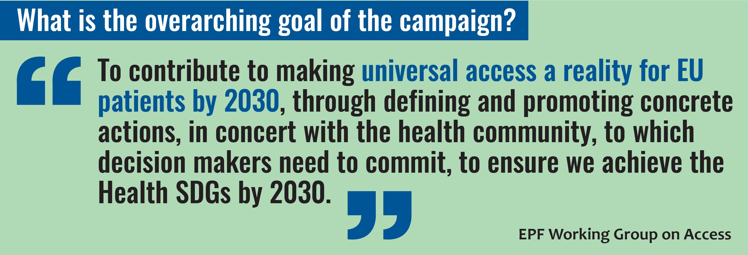
The campaign strategic objective

Slide 4
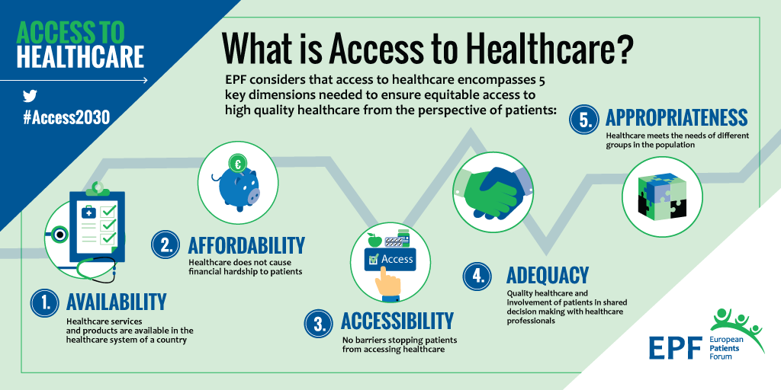
EPF Access definition
Notes:
In 2015, EPF adopted a definition of access to healthcare in consultation with our membership:
Availability – whether an healthcare service or product is provided in the first place
Affordable – whether seeking healthcare cause financial hardship to patients.
Accessible – Whether there are barriers that stop patients from accessing healthcare
Adequacy – the quality of healthcare
Appropriate – whether healthcare meet the need of different groups in the population
This definition is not only about access to medicine, but health and social care services in general.
We also developed recommendations to improve indicators on access

Slide 5
Main policy areas for recommendation

