Slide 1

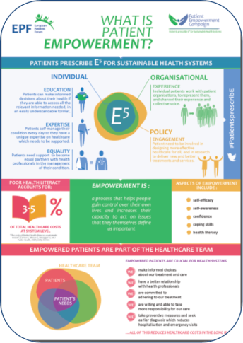
Campaign on Patient Empowerment
One-year patient-led campaign
Why? To promote a common understanding and call for an EU strategy on Patient Empowerment
Who? EU health Stakeholders & decision-makers
When?
  May 2015: major launch conference
  November 2015: development of a Roadmap & Charter to advocate at the EP
  June 2016: Exhibition at the European Parliament
Notes:
This campaign has two main objectives
Everyone understands what is patient empowerment but we understand it differently. This campaign needs to promote an understanding about what lies behind the concepts of health literacy, patient empowerment and patient involvement to make them more concrete;
A lot has been happening around patient empowerment: we mentioned over the two-days the EMPATHiE study, the Hello healthcare campaign, the patient academy in Bulgaria, etc. which shows the importance of patient empowerment but still there is no strategy at EU level on this. With this campaign and as a result of this event, we want to call for active engagement of decision-makers and health professionals towards patient empowerment.
Timeline
At the conference in May we took the first steps in formulating a powerful charter on patient empowerment and a compelling roadmap outlining the critical journey we will embark upon.
Charter: we will further consult our members to agree on a common definition of patient empowerment.
Roadmap: we will work in concert with health professionals to build EPF arguments and propose concrete actions to be taken by European policy-makers and health stakeholders to enable patient empowerment.

Slide 2



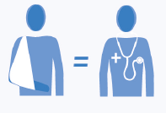


Campaign on Patient Empowerment
Campaign messages
Education
Expertise
Equality
Experience
Engagement
→ Patients prescribe E⁵ for Better Health Systems!
Notes:
The five “E” of Empowerment stand for:
Education: patients can make informed decisions about their health if they are able to access all the relevant information, in an easily understandable format.
Expertise: patients self-manage their condition every day so they have a unique expertise on healthcare which needs to be supported.
Equality: patients need support to become equal partners with health professionals in the management of their condition.
Experience: individual patients work with patient organisations to represent them, and channel their experience and collective voice.
Engagement: patients need to be involved in designing more effective healthcare for all, and in research to deliver new and better treatments and services.
“Patients prescribe E5 for sustainable health systems” is the tagline of the EPF campaign to demonstrate that this time patients are not asking others to do something for us but we are active, prescribing the solution for better healthcare – and what we prescribe is the 5E.

Slide 3
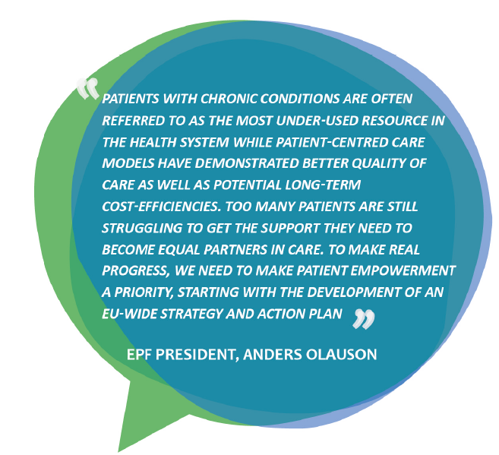

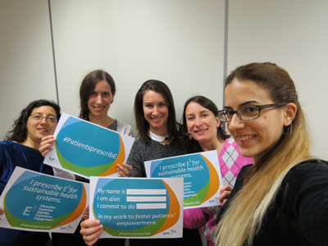
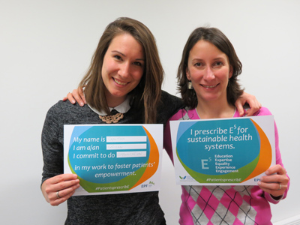


Campaign on Patient Empowerment
Want to get involved?
Show your support to the campaign
Spread the word!
Share good practices
Share your testimonial
www.eu-patient.eu/campaign/PatientsprescribE/
#PatientsprescribE

