Slide 1

European Patient’s Forum
Annual General Meeting
2017
10/04/17
@eupatientsforum
EPF Annual General Meeting

Slide 2
1. Opening
10/04/17
@eupatientsforum
EPF Annual General Meeting

Slide 3
2. Apologies
10/04/17
@eupatientsforum
EPF Annual General Meeting

Slide 4
3. Approval of the minutes of the last AGM
10/04/17
@eupatientsforum
EPF Annual General Meeting

Slide 5
4. The year in review:
Highlights from EPF
Nicola Bedlington
EPF Secretary General
10/04/17
@eupatientsforum
EPF Annual General Meeting

Slide 6
Empowerment

Slide 7
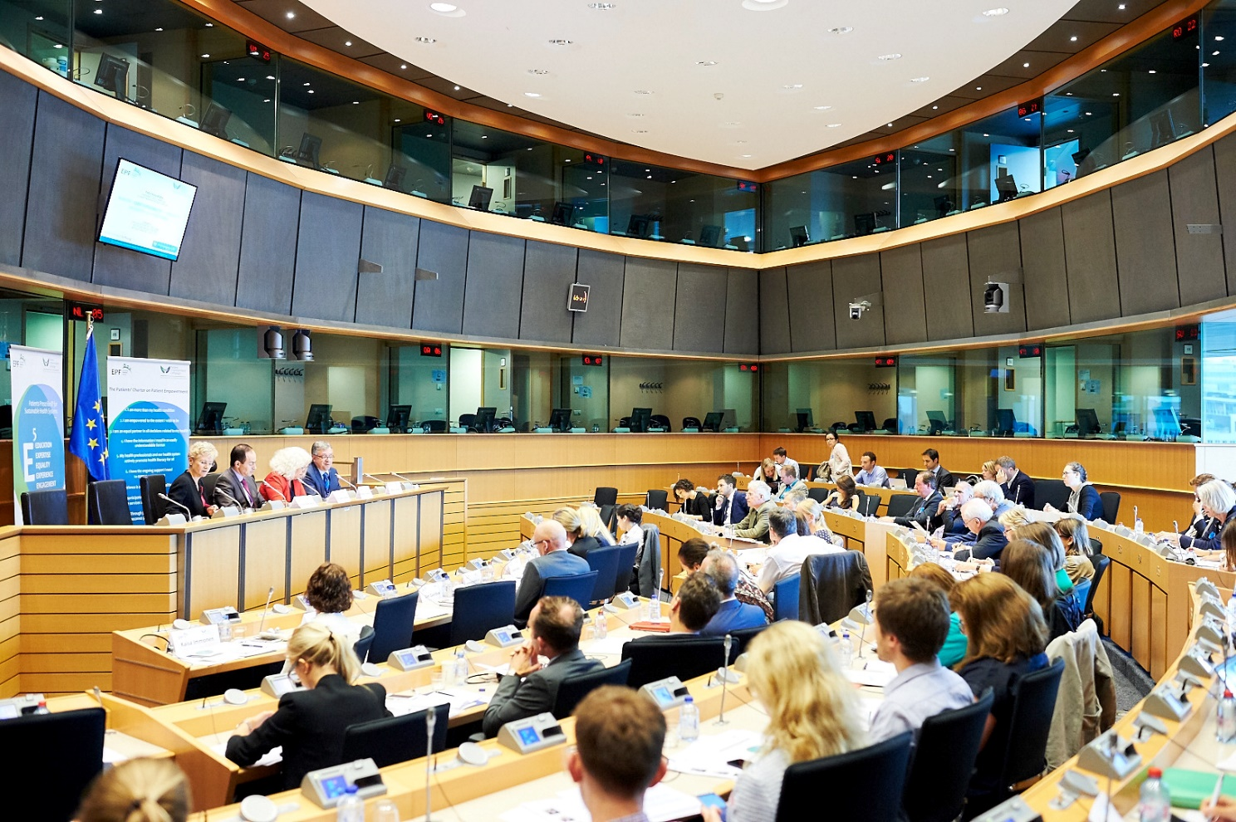
Patient Empowerment Campaign
Officially closed by a high-level policy roundtable in June 16, the campaign helped promoting the awareness of policies and strategies that empower patients to be involved in the management of their condition and in health policy that affects their lives.

Slide 8
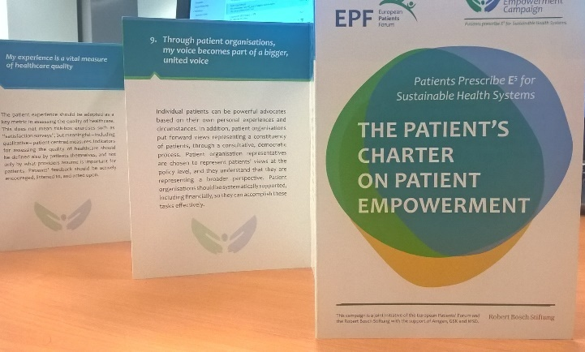

Charter & Roadmap
With the support of the Empowerment Working Group, two main documents were produced during the campaign:
The Charter on Patient Empowerment defines the fundamental principles of patient empowerment from the patients' perspective
The Roadmap for Action turns the Charter’s principles into eight priority action areas that need to be addressed at different levels in order to apply the principles in policy and practice.
Cascaded by our members at local level
9 languages
Notes:
EPF aims to work further with patient communities across the EU to increase visibility and ownership of the Charter and Roadmap, and to engage with a wide range of health stakeholders to ensure concrete commitment and actions to support empowerment.

Slide 9

Empowerment Working Group
2016 work plan focused on:
Patients’ Rights And Responsibilities
Paper on patients’ rights and responsibilities which will serve as a basis for further reflection with the membership.
Healthcare Quality Indicators For
Patient-centeredness
Meeting with OECD expert to discuss further work

Slide 10




Policy Dossiers & Projects
Clinical Trials
Pisce
EMA
ProStep
Health Literacy
JA CHRODIS
Data Protection
EUPATI
Notes:
Clinical Trials: Informed consent paper + Task force on EU guidelines for lay summaries
EMA: Enhancing our collaboration + New representatives
Health Literacy: Updated consensus paper + EPF Survey on Core Quality Principles
Data Protection: Guide to the New EU Regulation
PISCE: Tender on self-care for minor conditions + Final conference in March 2017.
PROSTEP: self-management in chronic conditions, set up a platform of experts in self-care and develop recommendations to support patients’ self-care
JA-CHRODIS: EPF facilitated the integration of patients’ views in the definition of quality criteria for the selection of good practices on patient empowerment, diabetes and multi-morbidity.
EUPATI: Moving forward, see next slide!

Slide 11
The EUPATI Journey so Far
What have we achieved after 5 years?
A trusted and credible public-private partnership between patient organisations, science and industry
The Patient Expert Training Course, 97 Fellows trained in 58 disease areas
Deployed EUPATI Toolbox and EUPATI Library in 10 languages:
120,000 visitors to date
Released EUPATI material under “Creative Commons”
Established EUPATI National Platforms in 18 countries
Developed guidance documents on patient Involvement with regulators, HTA bodies, industry, ethics committees;
identified best practices and next steps
Established EUPATI as quality brand for patient education about the entire medicines R&D process

Slide 12
Access & Inequalities

Slide 13

Access Working Group
Very active in 2016, the group supported the set up of EPF’s survey on patients’ access to healthcare. Published at the end of year, the survey provides important insight on health inequalities and access barriers met by patients with chronic and long-term diseases in the EU.
60% of respondents reported financial hardship as a result of healthcare spending
The working group took part in the preparatory work for the 2017 campaign on access and universal health coverage

Slide 14
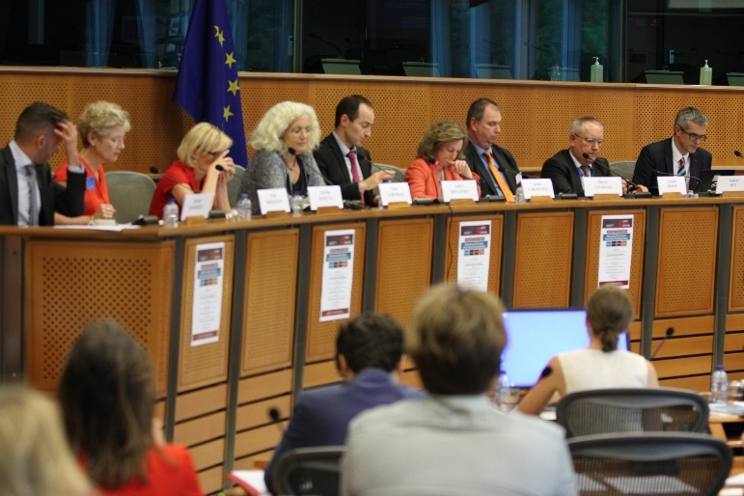
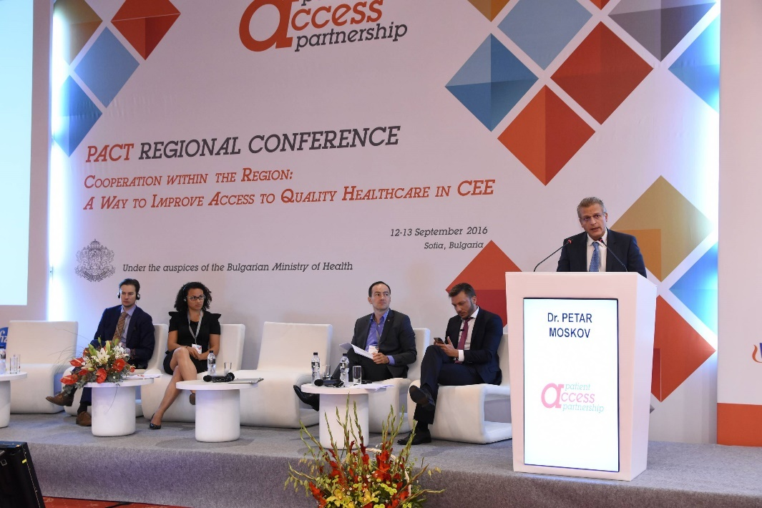
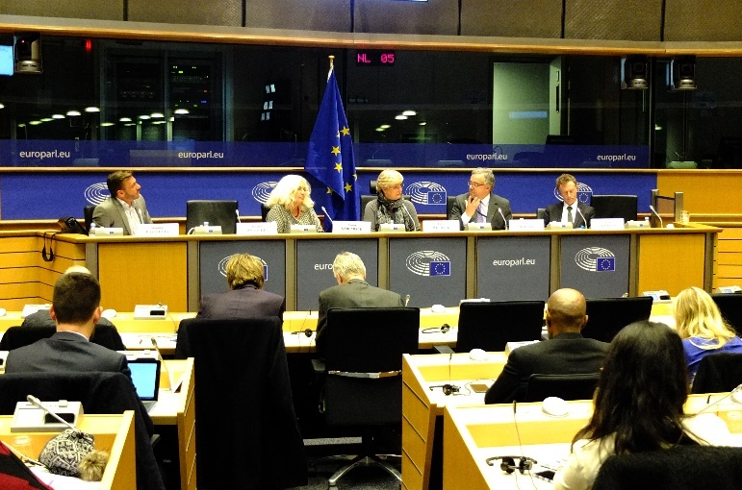
Patient Access Partnership - PACT
Founding member of the Patient Access Partnership (PACT), a patient-led multi-stakeholder network, and contributed to setting up the European Parliament Interest Group on Patient Access to Healthcare.
2 events at the European Parliament
1 major regional conference

Slide 15

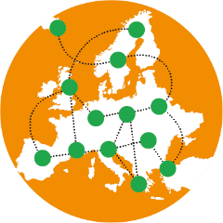


Policy Dossiers & Projects
Patient Safety
PASQ
Cross-Border HC
SmartCare
Discrimination
AdaptSmart
Pricing
Notes:
Patient Safety: A major conference on “Patient and family empowerment for better patient safety” was held in November 2016.
CBHC: EPF published a position statement on the implementation of the Directive, picturing a very uneven situation across the EU + we established an informal network of EU patient representatives to review progress achieved, together with National contact points, policy-makers, health professionals and other relevant stakeholders.
Discrimination: 2016 saw increased efforts on working with vulnerable groups (Roadmap on how to integrate perspective of vulnerable groups
+ EPF Partner of EU Agency OSHA campaign on healthy workplaces for all)
Pricing: Statement on Value & Pricing of Innovative Medicines
PASQ: 500 good practices for the empowerment and involvement of patients
SmartCare: Ended in July 2016 with a final conference where partners presented the conclusions from their work streams and the guidelines for the implementation of integrated e-care services.
AdaptSmart: EPF contributes a patient perspective on critical aspects such as appropriate use, patients’ perceptions of risk and uncertainties, communications, and ethical and legal issues.

Slide 16
A Vibrant Network

Slide 17
EPF Capacity Building in 2016
At national level: thematic trainings
Fundraising
Strategic Communications

Slide 18
EPF Capacity Building in 2016
Useful & hands-on tips
At European level: Ethics & Transparency
3-day training
11 participating organisations
Mutual respect
Independence
Legitimacy
Absolute priority and essential pillar for patient organisations

Slide 19
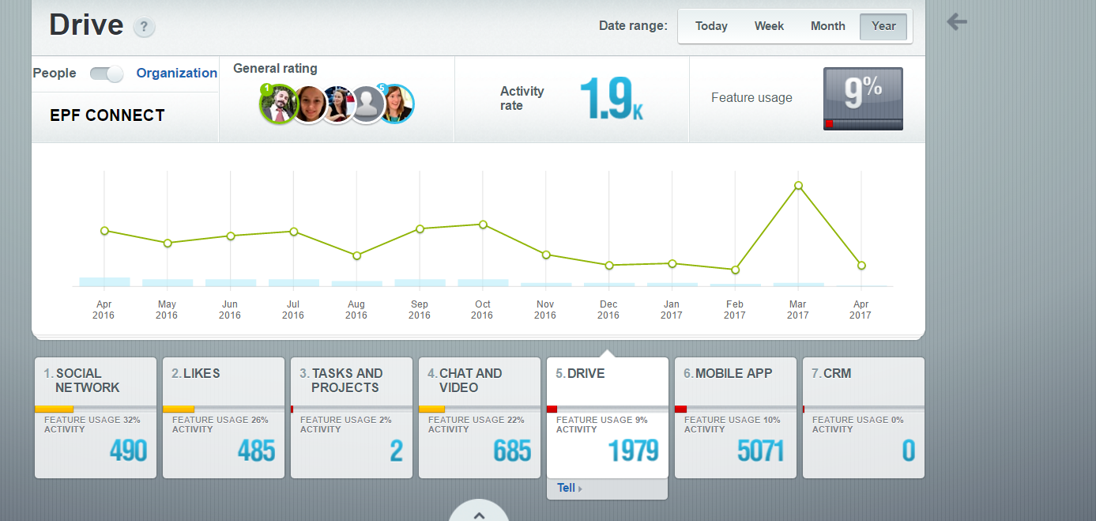


Membership
+4 members
103 new users on EPF CONNECT
8200 Interactions on EPF CONNECT
46 Weekly Coffees with EPF

Slide 20

National Coalition Building
Toolkit on Building National Coalitions of PO’s
Step-by-step guide
For national, regional and local patient organisations
A Reference for existing national coalitions

Slide 21
Communications

Slide 22

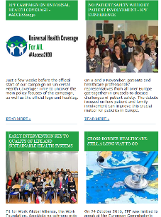

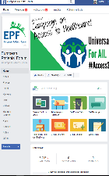
EPF Communications in Numbers
4000 readers subscribe to our newsletter.
7.385 likes on Facebook
3.730 followers on Twitter
1.200.000 impressions on social media
40.000 unique visitors to EPF website.
3 Policy Factsheets
1 Video

Slide 23
5. Campaign on Universal Access
#Access2030
Katie Gallagher
Policy Adviser
Laurent Louette
Communications Officer
@eupatientsforum
10/04/17
EPF Annual General Meeting

Slide 24
Why is EPF doing a Campaign on Access?

Slide 25
EPF’s Strategic Goals 2014-2020
GOAL 2: Healthcare Access and Quality
“To contribute to improvements in health systems that enable equitable access to sustainable and high-quality healthcare designed and delivered to meet patients’ and informal carers’ needs at all levels of care, embracing innovation in all its forms”
GOAL 6: Non Discrimination
“To promote the development of EU and national policies that tackle discrimination faced by patients
in health and social care…”
Notes:
First and foremost, Patients’ access to healthcare is a long standing priority for EPF and its membership, and is at the heart of the vision of the organisation.
Additionally, all EPF members have voiced on many occasions how important this topic is to your organisations and that this is a priority for all of you.
Further to EPF’s vision, Two of EPF’s goals clearly describe our priorities in this area.
(EPF Vision: All patients with chronic and/ or lifelong conditions in the EU have access to high quality, patient-centred equitable health and social care.)
The first aims to: contribute to improvements in health systems that enable equitable access to sustainable and high-quality healthcare
And the second: to promote the development of EU and national policies that tackle discrimination faced by patients in health and social care

Slide 26

Working Group on Access - 3 Year Plan
Definition of access & recommendations on indicators
Survey for patients on access to healthcare
Campaign on access to health and social services
Notes:
EPF’s working group on access has been instrumental in the development of EPF’s work on access and this campaign.
The working group aims to focus EPF’s work on the priorities set by members.
We currently have 11 committed members who have been working together for 3 years.
Based on the work EPF has done in previous years – including defining access and recommendations on access indicators and a survey for patients on access to healthcare, this year sees a patient led campaign on access.
In 2015 – worked on defining access and recommendations on access indicators
In 2016 – we worked on a survey for patients on access to healthcare to provide strong evidence of patients’ current situation across the EU
And 2017 will see a patient led campaign on access

Slide 27


Why a Patient-Led Campaign on Access ?
Huge disparities across the EU and within countries, austerity measures have widened the gap and increased health inequalities
Patients face multiple, concrete barriers to access, yet the European approach is focusing on health determinants
Health is not a priority for the current EU Commission - need to raise the profile of health at EU and MS level and call for cooperation across policies
Economic imperatives are overshadowing the costs of health inequalities, which are both financial and human
Notes:
An analysis of the challenges and situation reinforces the need and ‘raison d’être’ of this patient led campaign on access.
Health is not necessarily a current priority for the EU – and so with this campaign as well as many other initiatives, we hope to place it back on the political agenda of the EU and MS
With this campaign, we are also calling for cooperation across policy areas (finance, economy, health, social affairs..) to ensure the right to health is a priority across sectors.
Real political commitment, will and thinking is needed to achieve the SDGs.
Disparities in access to healthcare predate the financial crisis in Europe, but against a background of austerity measures and falling healthcare spending in many Member States since 2009, inequalities have been made worse. At the same time, healthcare systems are facing increasing demands as a result of demographic change.
2. The need for more action to achieve universal health coverage in the EU has only been partially recognized. In 2014, in its communication on effective, accessible and resilient health systems the European Commission noted that “Healthcare coverage is universal or almost universal in all Member States; however, some people from disadvantaged backgrounds are still excluded from adequate health coverage.” Universal healthcare coverage in the EU is unfortunately not yet a reality and with this campaign we aim to raise awareness about the barriers patients face in accessing healthcare.
3. EU health policies that aim at tackling health inequalities are mostly geared towards addressing health determinants, and focusing on prevention. As chronic conditions are considered a key challenge for all EU healthcare systems, more indicators geared toward measuring access to quality chronic disease care and management are needed. (For further information, please see EPF’s position statement on Defining and Measuring Access to Healthcare: the Patients’ Perspective)
4. Health inequalities carry a significant economic as well as personal cost. In the current policy debate, the economic argument “health is wealth” is now widely accepted. Investment in health is an investment in the EU’s fundamental values, in social cohesion, and in economic development. Reducing health inequalities is crucial for the overall health and wealth of society.

Slide 28
What is the Campaign about?

Slide 29



UN SDGs - The Road to Universal Access in the EU by 2030
Goal 3: Ensure healthy lives and promote well-being for all at all ages
Key target: achieve universal health coverage by 2030, including financial risk protection, access to quality essential health-care services and access to safe, effective, quality and affordable essential medicines and vaccines for all
However we still have some way to go… whether it is: the population covered, the type of services, or the proportion of costs that patients’ pay. Many unmet needs and unequal experiences still exist.
Notes:
1. Patients’ access to healthcare is a long standing priority for EPF and its membership, and is at the heart of the vision of the organisation.
The campaign refers to the UN SDG on health as a leverage to raise the profile of health at EU and MS level.
2. According to the UN sustainable development goals, EU member states need to achieve …
Similarly the European Commission has also committed to supporting MS in this task.(reference)

Slide 30

Campaign’s Strategic Objective
Campaign’s strategic objective: The EPF Access campaign will contribute to making universal access a reality for EU patients by 2030, through defining and promoting concrete actions, in concert with the health community, to which decision makers need to commit, to ensure we achieve the Health SDG by 2030
Notes:
1. In this context, EPF’s campaign aims to contribute to making universal access a reality for all EU patients by 2030.
Under the tagline…
(Finish: The campaign has been framed following this overarching strategic objective, which has been developed by EPF’s working group on access.(

Slide 31







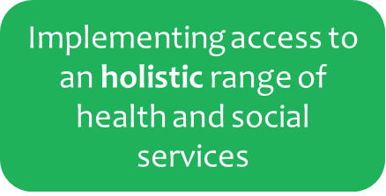
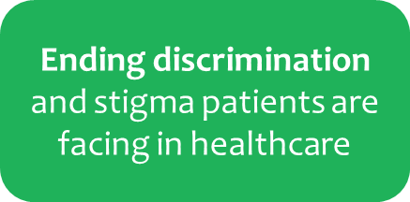
5 Areas for Action
Providing access to quality of care
Notes:
EPF’s access campaign is a thematic one and encompasses 5 areas for action
The access study report will very much inform our take and work in the respect of these 5 areas for action.
For example:

Slide 32
Campaign’s Opportunities
Under the tagline ‘Universal Health Coverage For All’, The campaign is an opportunity to:
raise awareness about the barriers patients face in accessing healthcare
to build on current political momentum, including the UN sustainable development goal for health
to foster more EU cooperation on access to healthcare
to overturn the current trends and change the focus of politicians from short sighted cuts and decisions on investment to a real commitment to a long term vision where equity of access is a reality

Slide 33
Which stakeholders are we targeting?

Slide 34
Stakeholders
European Parliament
European Commission
Member State representatives
Policy makers, politicians, HCPs
Aim to work with a range of stakeholders
Most importantly, we need your help!
Notes:
1. With the aim of achieving cooperation across policy areas
2. Pact as a cascade

Slide 35
How can Members contribute to the Campaign and how can you use it to reinforce your own initiatives?

Slide 36
This is your Campaign
Increasing the effectiveness of the Campaign
  Engage in your own context – emphasis on national parliamentary meetings
  EPF Connect – member feedback and input to feed the content of the campaign’s policy-related initiatives and final political document. For example: contributing patients evidence of gaps, barriers and what has improved access in a range of formats (anecdotal, experience, qualitative data, collecting narratives (members’ platform and feature in the blog)
  Questions to members via the weekly insider and facebook to feed the content of the campaign and final political document
  Joint statements and press releases
  Get involved in various events where the campaign will be featured
Notes:
This campaign belongs to you. The effectiveness of the campaign will increase substantially if you, national patient coalitions and european disease specific organisations take ownership of it and use it to support your own work and activities. (can’t afford to spread ourselves too thin and members can focus in on what is of importance to them) (will only work if resonated at a national level)
Laurent will soon go over the communication tools at your disposal as well as additional campaign activities that you can get involved in. However, I wanted to speak to you about the campaign’s policy related initiatives where your engagement and input is and will be extremely valuable and crucial to enable to success of this campaign. (why your engagement is important and to what extent how your contributions are valuable.)
Go through the various initiatives..
In this respect, I’d like to start this exchanging by asking you to share your (contribution or engagement) intentions or examples of initiatives that you have already initiated or have planned.
For example, are there members that would like to share how they may have or plan to use the epf campaign as an additional hook for their own work and activities or where you have engaged with the campaign in your own context – whether at national level or disease-specific level?
Are there any members that already have or are planning to organise and event or meeting on access to healthcare where they will use epf campaign tools or make a link to the campaign?
I think there is a great opportunity to exchange on how we will capitalise on this together – see access wg points
(So far, we have received little feedback in terms of your activities linked to the campaign)
In the next months, I hope to have an exchange with all EPF members on this subject, what is your focus, how is this campaign meaningful to you and I am very much looking forward to working with you and invite you to get in touch.
This is your campaign - ownership

Slide 37
What are the expected outcomes of the Campaign? And what needs to be achieved for the Campaign to be a success?

Slide 38

Targets of the Campaign
A political document to contribute to shaping an EU action plan towards achieving universal health coverage by 2030
Raising awareness on gaps and barriers to universal health coverage from the patients’ perspective
Contributing evidence towards the economic and human value of access to healthcare and the cost of non-access
Defining short term, medium and long term political actions necessary to reach the goal
Promoting awareness of the critical importance of collective patient involvement
Calling for cooperation across policy areas
Ensuring the inclusion of all health stakeholders, including vulnerable or marginalised groups
Notes:
In terms of targets of the campaign
Together, we hope to…
raising awareness of decision makers and stakeholders on current gaps and barriers to universal health coverage from the patients’ perspective and the consequences of these gaps for patient, society and the economy,
contributing evidence towards the economic and human value of access to healthcare and the cost of non-access both for individual patients and society,
defining short term, medium and long term political actions necessary to reach the goal of universal health coverage by 2030 for patients with chronic and long term conditions,
promoting awareness of the critical importance of collective patient involvement to ensure high quality health and social care services are accessible for all.
calling for cooperation across policy areas (finance and economy, health and social policies etc.…) to ensure the right to health is a priority across sectors.
ensuring the inclusion of all health stakeholders, including patients’ organisations, in discussions on health system performance assessment and access to healthcare, whether at EU or Member State level,
and promoting the inclusion of potentially vulnerable or marginalised groups in discussions and decisions on access to health and social care.

Slide 39
Final Political Document
A comprehensive document which will identify and propose key political steps, actions and recommendations that EU decision makers and member states need to take in order to achieve or tend to universal health coverage for all patients in the EU.
The EPF working group on access will have a leading role in the reflection process and drafting of the roadmap.
Notes:
The 2017 EPF operating grant work plan refers to a roadmap/ a final political document as a key deliverable of the campaign
The work plan states that..

Slide 40

Comms & Public Affairs
-a means to achieve objectives
-membership and stakeholder involvement

Slide 41

Achieve Political Commitment
Pledge Signature
Bilateral Meetings
5 Champion MEPs

Slide 42
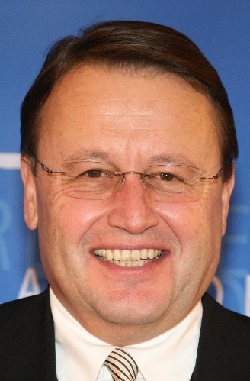

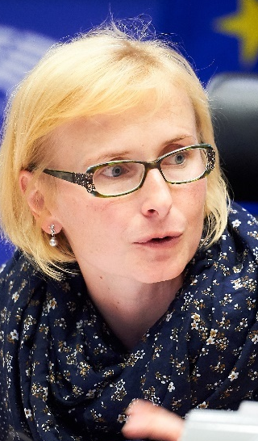

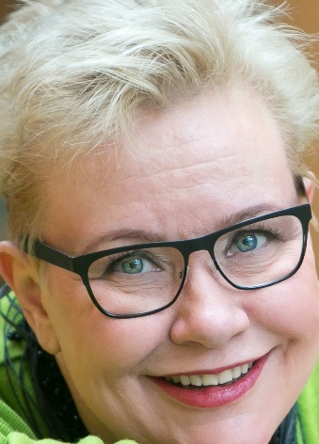
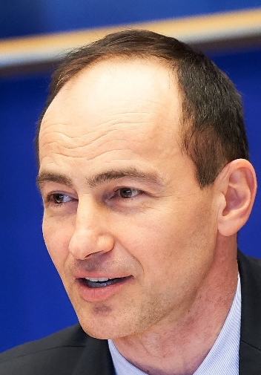


5 Champion MEPs
Paul Rübig, EPP, Austria
Miriam Dalli, S&D, Malta
Katerina Konecna, GUE-NGL, Czech Republic
Sirpa Pietikainen, EPP, Finland
Andrey Kovatchev, EPP, Bulgaria

Slide 43

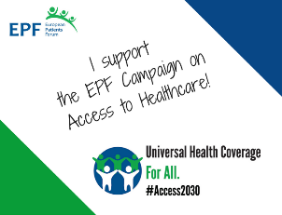
Involvement & Social Engagement
Membership
Stakeholders
Public

Slide 44
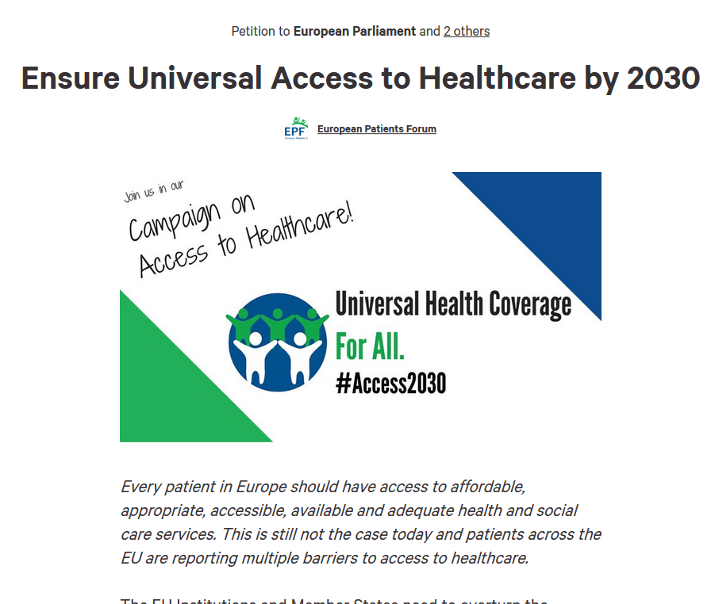
Involvement & Social Engagement
Sign here!
Online petition: the more the better!
Testimonies
Add societal weight to our policy asks

Slide 45
6. Finance
Radu Ganescu
EPF Treasurer
@eupatientsforum
10/04/17
EPF Annual General Meeting

Slide 46
2016 Balance Sheet: ASSET
1 – Fixed Assets | 2015 | 2016
Leasehold | 44,438.00 | 40,402.00
Furniture, ICT | 21,802.00 | 18,730.00
Equipment guarantee | 50.00 | 50.00
TOTAL | 66,290.00 | 59,182.00
2 – Current Assets | 2015 | 2016
Accounts receivable | 784,079.00 | 811,277.00
Cash in bank | 669,073.00 | 852,994.00
Prepaid expenses | 5,235.00 | 38,614.00
TOTAL | 1,458,387.00 | 1,702,885.00

Slide 47
2016 Balance Sheet: LIABILITIES
1 – Reserves | 2015 | 2016
Funds brought forward | 392,620.00 | 505,507.00
Surplus/Deficit | 112,887.00 | 80,000.00
TOTAL | 505,507.00 | 585,507.00
2 – Current Liabilities | 2015 | 2016
Account payable | 76,551.00 | 141,057.00
Deferred income | 753,224.00 | 452,165.00
Income to be allocated to project partners | 189,395.00 | 553,405.00
TOTAL | 1,019,170.00 | 1,146,627.00

Slide 48
Evolution EPF Budget 2012-2017

Slide 49
2016 Expenditures: Budget vs. Actuals
Budget line | 2016 Budget | 2016 Actuals
Operating Grant | 938,617 | 916,453
EU project (including EUPATI) | 579,3540 | 562,741
Capacity Building Programme and Empowerment Campaign | 276,033 | 226,010
Project development | 30,485 | 63,467
Other costs | 10.000 | 10.494
TOTAL | 1.834.489 | 1.778.671

Slide 50
2016 Income
Funding from public Sector | 2015 | 2016
Operational Work programme | 728,212.00 | 731,835.98
EU projects | 97,060.59 | 149,507.36
EUPATI | 262,397.62 | 309,753.53
TOTAL | 1,087,670.21 | 1,190,096.87
Funding from Private sector | 2015 | 2016
Operational Work programme | 171,000.00 | 172,450.00
Co-funding to EPF projects | 49,595.65 | 37,577.93
Project development & other costs | 548,011.24 | 104,361.09
Capacity-building programme | 141,282.34 | 237,786.76
Contribution to EPF campaigns | 34,586.61 | 42,273.73
EFPIA contribution within EUPATI | 60,856.11 | 62,709.74
TOTAL | 1,005,331.95 | 657,159.25
Foundations & Membership fees | 2015 | 2016
Bosch Foundation | 125,000.00 | 20,000.00
Memb. fees contribution to Operational work programme | 11,000.00 | 12,000.00
Membership fees contribution to EU project | 4,132.31 | 5,950.00
Interests & Other income | 18,070.02 | 30,516.86
TOTAL | 158,202.33 | 68,466.86

Slide 51
2016 Expenditures
EVENTS | 2015 | 2016
Annual General Meeting (AGM) | 41,664.34 | 172,450.00
Regional Advocacy Seminar | 35,909.49 | 33,730.55
Youth meetings | 13,759.07 | 17,985.76
Patients Evidence Workshop | - | 9,183.58
Capacity Building programme (Training modules) | 105,773.27 | 106,364.18
Cross-border healthcare regional events | 79,089.36 | 65,639.35
Other costs of Operations & new projects | 235,856.16 | 193.585,16
EPF Campaigns | 112,841.21 | 20,415.26
Bank & Financial Charges | 645.55 | 1,622.83
Foundations & Membership fees | 2015 | 2016
Staff costs (including EUPATI) | 966,587.13 | 1,033,791.00
Office & Administration costs | 176,220.78 | 197,888.72
Depreciation | 14,239.39 | 15,168.53
Travel & Subsistence | 58,645.98 | 67,325.56

Slide 52
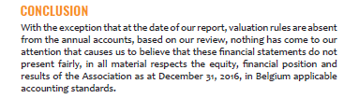
Auditor’s Report
Contractual auditor's report for the year ended December 31, 2016
Based on our review, nothing has come to our attention that causes us to believe that these financial statements do no represent fairly the equity, financial position and results of the Association as at 31/12/16

Slide 53
7. Vote on Reports and Discharge of the Board and Auditors
@eupatientsforum
10/04/17
EPF Annual General Meeting

Slide 54
8. EPF Membership
Camille Bullot
Director of Operations & Engagement
@eupatientsforum
10/04/17
EPF Annual General Meeting

Slide 55




Candidate Organisations
Applications for Full Membership
AGORA – Platform of organisations of people with rheumatic diseases in Southern Europe (Europe)
BAG Selbsthilfe – Bundesarbeitsgemeinschaft Selbsthilfe von Menschen mit Behinderung und chronischer Erkrankung und ihren Angehörigen e.V./ Federal Association of Self-Help Organisations for people with disabilities and chronic diseases and their relatives (Germany)
ECHDO – European Congenital Heart Disease Organisation (Europe)
HSO – Handikappförbunden / Swedish Disability Federation (Sweden)
LuCE – Lung Cancer Europe
NCDP – National Confederation of Disabled People (Greece)

Slide 56
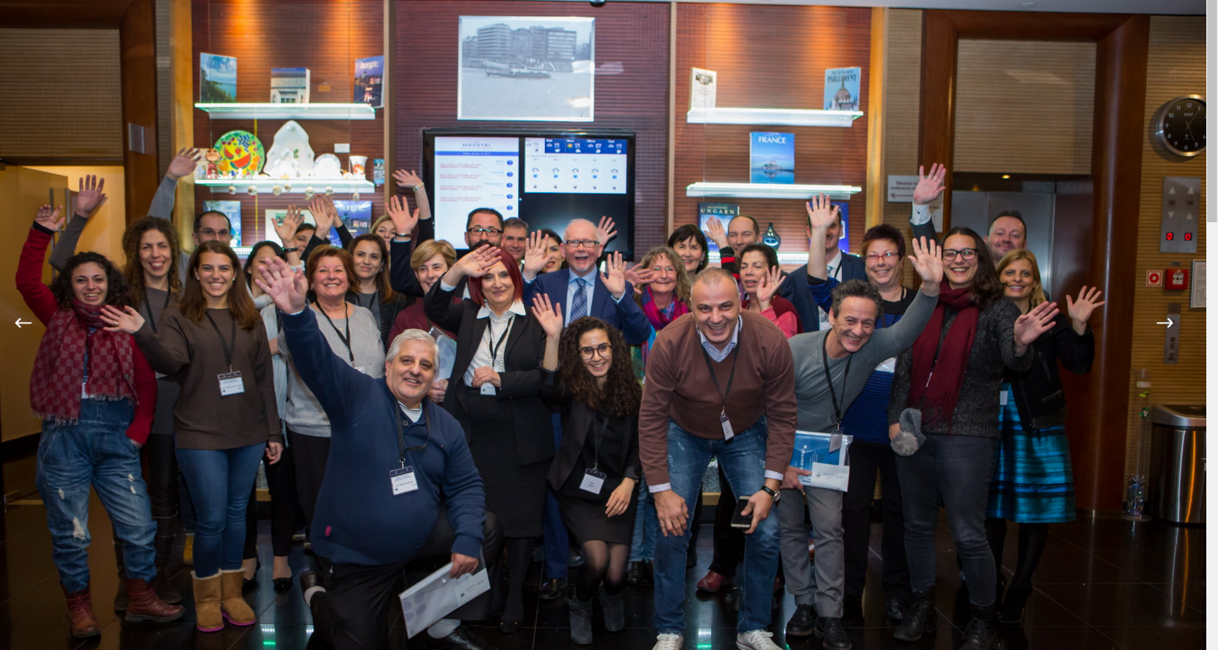
AGORA
Applied for: Full membership
Recommendation from the Board: Associate membership
Explanation: Geographical scope is south Europe
http://www.agora-platform.eu/

Slide 57

BAG Selbsthilfe
Applied for: Full membership
Recommendation from the Board: Full membership
http://www.bag-selbsthilfe.de/

Slide 58

European Congenital Heart Disease Organisation
Applied for: Full membership
Recommendation from the Board: Full membership
http://echdo.eu

Slide 59

HSO – Handikappförbunden
Applied for: Full membership
Recommendation from the Board: Full membership
http://www.hso.se/

Slide 60
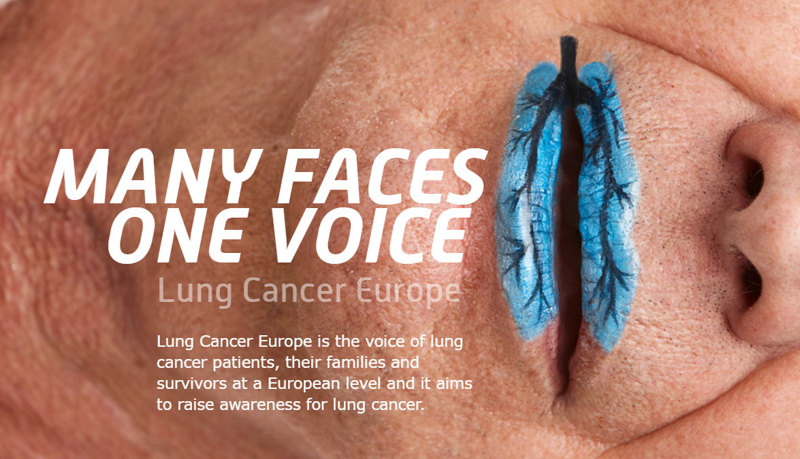
LuCE – Lung Cancer Europe
Applied for: Full membership
Recommendation from the Board: Associate membership
Explanation: includes professionals’ organisations
http://www.lungcancereurope.eu/

Slide 61
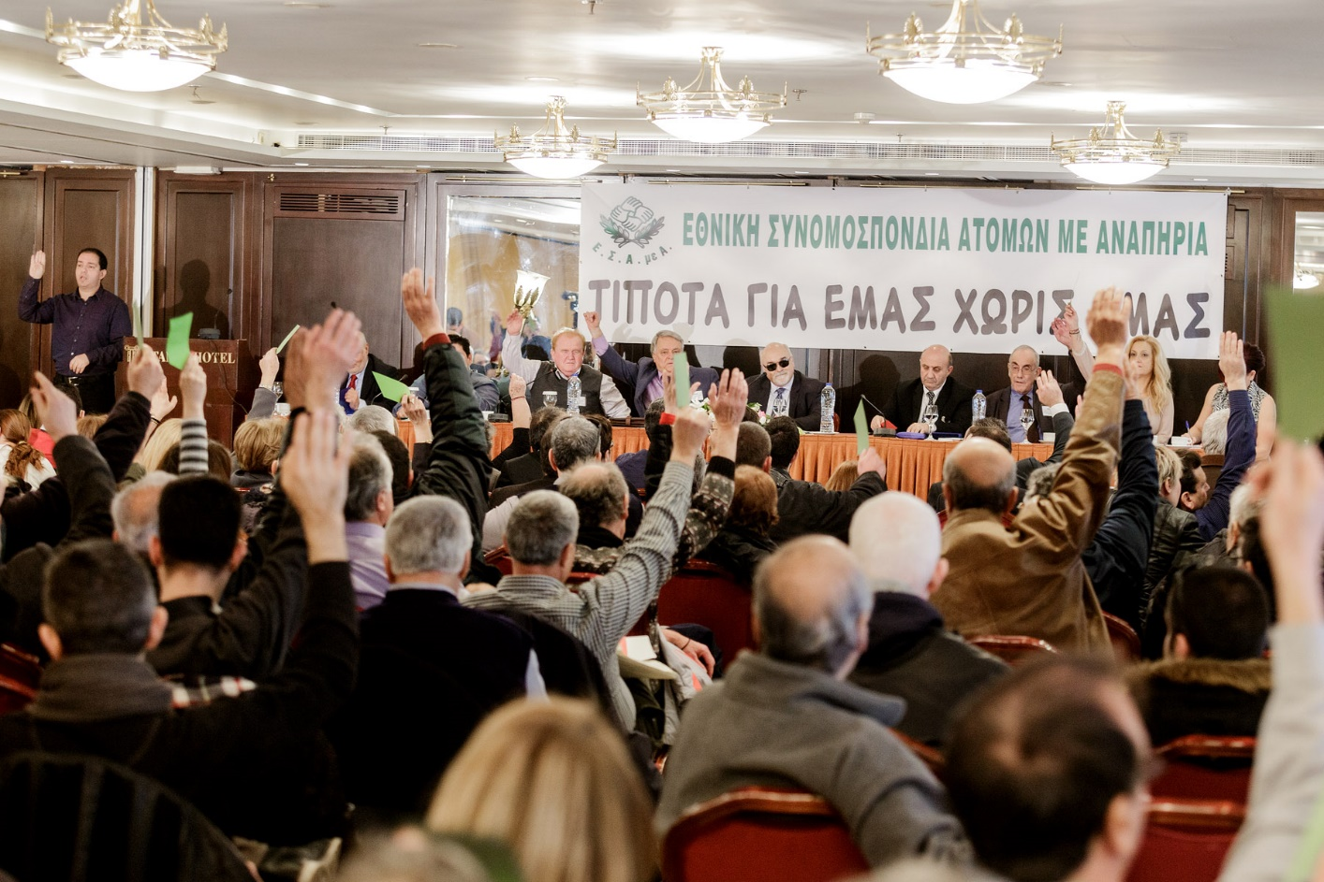
NCDP – National Confederation of Disabled People
Applied for: Full membership
Recommendation from the Board: Full membership
http://www.esaea.gr/

Slide 62
EPF Transparency
Guidelines

Slide 63
EPF Transparency Guidelines
A key work piece for 2016-2017
Communications
Objectives:
To provide guidance to patient organisations in becoming more transparent;
To ensure the highest possible standards for our network;
To increase the level of trust from other stakeholders in patient cooperation
Advocacy
Membership
Governance
Finances & Fundraising
Cooperation
with industry

Slide 64
9. Board Elections
Camille Bullot
Director of Operations & Engagement
@eupatientsforum
10/04/17
EPF Annual General Meeting

Slide 65
10. The year ahead:
2017 Work Plan
Nicola Bedlington
EPF Secretary General
10/04/17
EPF Annual General Meeting
@eupatientsforum

Slide 66

Key Operational Objectives 2017
To feed the needs & perspectives of our membership into the EU health policy discourses.
To promote the development and implementation of policies and strategies that maximise access and reduce health inequalities across the EU.
To advance the patient-centred agenda
To promote the development and implementation of policies and strategies that foster patient empowerment
To reinforce the capacity of patients and patient organisations to contribute effectively to better health and social care for all patients in the EU.

Slide 67
Empowerment

Slide 68
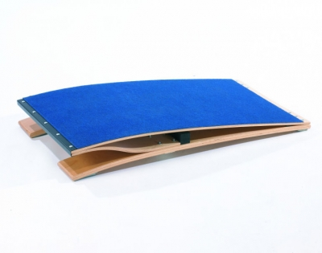
Empowerment Campaign
Going Forward
keep this as a priority in all policy areas
continue to engage with different stakeholders in implementing different areas of the roadmap
identify and work with individuals and organisations who wish to champion patient empowerment in their own practice
Use the campaign as a springboard

Slide 69


Clinical Trials
Monitor the implementation of recent EU CT Regulation
Working with EMA: EU database accessibility, transparency policy, other issues
Develop information resources for the patient community as needed
Implementation of lay summaries in CT results
Key outcome: position on sharing patient-level data

Slide 70

New Technologies and Big Data
Ensure that new technologies actually contribute positively to patients' empowerment and access to healthcare
eHealth stakeholder group, engaging members (webinar & info)
Big Data: briefing for members to start a dialogue on “principles for a patient-centred approach”
Impact of EU Data Protection Regulation on research – monitoring from a patient perspective

Slide 71

Health Literacy & Information
Position statement on information to patients on food and nutrition
building on the work of the EIP-AHA A3 action group
engaging with other public health NGOs as relevant

Slide 72
EMA, HSPA, CBHC
Active involvement in the more understandable medicines package information leaflets
EMA :
Policy recommendations on integrated care and indicators for patients’ experience
HSPA :
Event + Questionnaire on implementation of Directive
CHBC :

Slide 73

Mainstreaming EUPATI
In the Short-Term 2017-2019
EPF-led, permanent programme
Coordination and management in the PPP spirit
Optimising use of the EUPATI Toolbox in all languages
Toolbox-based “Mini-Course Starter Kits” for community-run, practical training/capacity building
Content updates (~10 Toolbox elements updated p.a.)
IT platform (Toolbox, e-learning system, project tools)
Course – to kick off in September – new cohort of 50
Futures Group –looking at long-term sustainability
IMI Call 1:
not funded
2-stage
application,
consortium
building
EUPATI IMI Project 2012-2016:
patient-led PPP of patients, academia, NGOs and industry
EUPATI
Programme
2010
2011
2012
2013
2014
2015
2016
2017
2018

Slide 74
Other Projects running in 2017
Projects running in 2017
PRO STEP study on self-management in chronic conditions
PISCE study on self care in minor conditions
PREFER on elicitation of patients’ preferences in benefit risks assessment (IMI) starting in October 2016
Notes:
Pro Step: looks at self-management practices and their cost-effectiveness in 6 chronic conditions. Its aim is to identify good practices and make proposals for methods for promoting self-management as well as scaling-up and transferability of good practices. We have set up a platform of 20 experts, divided in 5 core groups working on analysis of barriers, policies, communication tools, innovative approaches and future scenarios. A final conference will be held in Brussels on 12 and 13 October 2017.
Prefer: The main objective of the project is to strengthen patient-centric decision making on benefit-risk assessment throughout the life cycle of medicinal products by developing evidence-based recommendations to guide industry, Regulatory Authorities, HTA bodies, reimbursement agencies, academia, and health care professionals on how and when patient-preference studies should be performed and the results used to support and inform decision making

Slide 75
Prospective Project
IMI Call Topic- The patient voice in the life cycle of medicines
EPF has led a public consortium to submit a stage 1 proposal - focussing on frameworks tools and metrics to ensure a systematic and structured approach to patient engagement in the life cycles of medicines
We have built in maximum synergies from EUPATI and also built in a ‘cashpot’ to involve EPF members to bring their expertise
Decision on the competing proposals to be made in June
Notes:
Valentina: Shall we indicate CHRODIS PLUS?

Slide 76
Access & Inequalities

Slide 77
Campaign on Universal Access
At the heart of EPF's vision – long-standing priority
Grasp political momentum on UN sustainable development goals
Build on EPF's “5 A’s of Access“ Position paper, engagement in PACT and EPF’s own survey on access (2016)
Main objectives:
  contribute evidence of access barriers from patients’ perspective by collecting good practices and testimonies
  highlight importance of patients’ involvement in identifying gaps & solutions

Slide 78
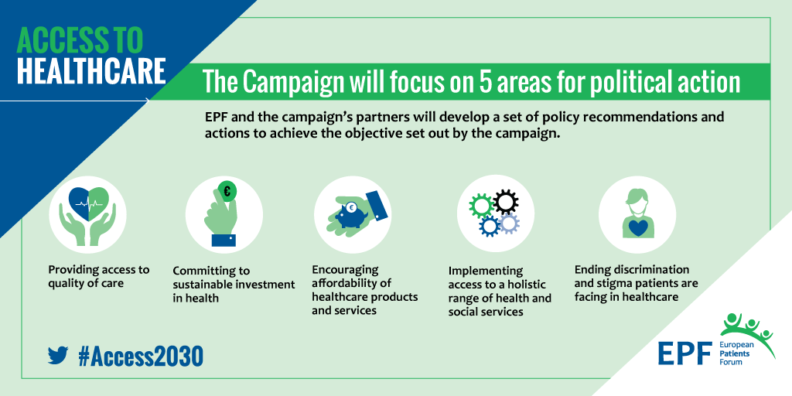
Campaign on Universal Access
5 areas of actions, identified by our members and championed by 5 high-profile MEPs

Slide 79

Ending Discrimination
Deepen our collaboration with organisations representing vulnerable groups
Collect good practices from PO’s
Develop a set of tools to promote inclusion at the workplace
Contribute to the EC European Pillar of Social Rights
Ensure it responds to patients’ challenges

Slide 80
Patient Safety & Quality of Care
Set of core competencies to empower patient and families (multi-stakeholders taskforce)
A position paper on quality of care will be developed to support our engagement on health system performance assessment and work on indicators to measure the patient experience (PREMs), outcome measures (PROMs) and safety incidents (PRIMs)
Continuing commitment to patient safety as a priority at EU level
Building and sharing expertise

Slide 81

PACT Key Activities 2017
Improving awareness on available mechanisms and innovative approaches for improving access at the national level
  Country round-tables
Explore new approaches for improving access across the EU-27
  PACT Expert Group on universal access to healthcare
  Advance the measurement tool (5As of Access)
Promoting the work of PACT by applying for a Pilot Project
  Submit a tender proposal for an access measurement tool
Supporting the efforts in maintaining access high on the agenda
  Support the work of the MEP Interest Group (events, etc)
ACCESS

Slide 82


Relevant Projects
Identify gaps, barriers, and critical points of transition or engagement for the cooperation of adaptive pathways (MAPPs).
Establish a permanent scheme with agreed methodologies for collaboration on HTA in the EU
Notes:
Adapt Smart: Its key objective is to investigate the conceptual and practical frameworks that could be used in applying MAPPs in the development of medicines, including the required tools and methodologies, and incorporating the viewpoints of all stakeholders. The concept of MAPPs has been highly debated but there is growing interest in the results gathered by the consortium.
EUnetHTA JA3: EPF is not an official partner. Nevertheless we are cooperating to ensure a meaning patient involvement in HTA.

Slide 83
A Vibrant Network

Slide 84

Capacity Building in 2017
National Level
EPF will continue to offer thematic training modules in Bulgaria, Slovakia, Hungary, Romania
Launch of a first module in Poland
Conducting an analysis of the situation in the Western Balkans (Slovenia, Croatia, Bosnia-Herzegovina, Serbia, Montenegro, Kosovo, and Albania)
EU Level
Summer Young Advocates Leadership Programme
Grow!

Slide 85

Reinforcing EPF Membership
Report on added value of patient organisations – targeted at health stakeholders and policymakers, promote recognition of the role and contribution of patient organisations to public health debates and their role as key policy partners
Breakfast Briefings: live web-streamed videos for EPF members to get updates on policy developments at European level and discuss potential common actions for the patient community.
Transparency guidelines: monitor adherence to EPF membership criteria and ensuring the highest possible standards for our network.

Slide 86
Looking Ahead

Slide 87

Mid-Term Review and Planning
Mid-term review of our strategic plan 2014-2020 and planning for strategic planning process 2021-2028
Preparation of the new 4 year framework partnership agreement with the EC (core programme)
EPF to lead a consortium responding to upcoming IMI call on patient engagement

Slide 88
EPF Budget 2017
Radu Ganescu
EPF Treasurer
10/04/17
EPF Annual General Meeting
@eupatientsforum

Slide 89
EPF 2017 Budget: Main Features
EPF continues to receive an Operating Grant
(3rd year under the Framework Partnership Agreement with the EC)
= 38% of our budget = EUR 928.469
The funding structure is the same as previous years:
  80% EC funds
  19% Corporate Sponsorships
  1% membership fees
What does the Operating Grant cover?
  Policy & advocacy work
  Costs linked to administration, operations, IT and finances – related costs
  Communication and membership
  External representation
  Core events (AGM, Regional Advocacy Seminar, Patient Safety Conference, Internal meetings - PAG, Working Groups, Access Campaign)
  Youth Group activities

Slide 90
EPF 2017 Budget: Main Features
EUR 287.000 carry over from 2016
  Capacity Building Programme
  ProStep
EPF staff in 2017 :
  Staff 12.98 Full Time Equivalents (FTE)
  14 people in the Brussels Secretariat (of which three are currently being recruited) + 1 Youth Intern
  Secretary General
  EUPATI Coordinator

Slide 91
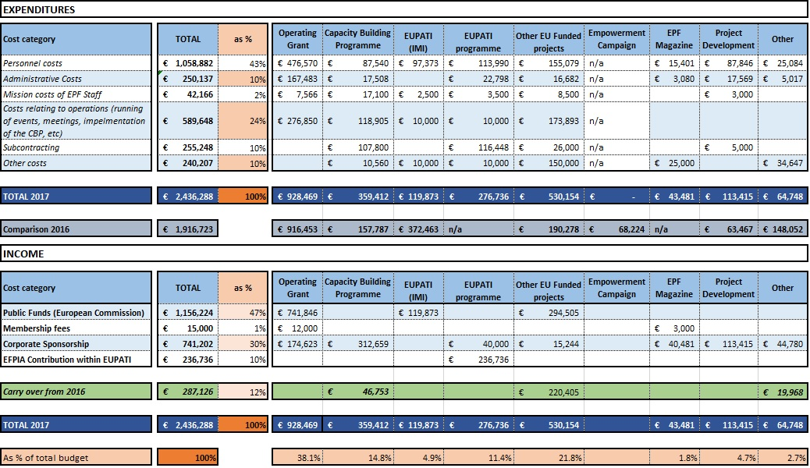
EPF Budget 2017 - Overview

Slide 92
EPF Income 2017

Slide 93

New EUPATI Programme
The five-year EUPATI project funded under the Innovative Medicines Initiative (IMI) ended in January 2017
“New” EUPATI programme moving forward under the direction of EPF
  “Bridging model”;
  Focusing on the project’s core tasks;
  Substantially reduced annual budget;
➔ This approach ensures the continuity of EUPATI as a hugely successful project and a trusted brand for patient education in R&D while facing the realities of a post-EU-funded project period and seeking longer term sustainability

Slide 94
EPF Income 2017: Public Funds

Slide 95
2017 Expenditures: Overview

Slide 96
2017 Expenditures by Type

Slide 97
Operating Grant 2017 Expenditures

Slide 98
11. Improving synergies in 2017
Cluster approach
Marco Greco
EPF President
10/04/17
EPF Annual General Meeting
@eupatientsforum

Slide 99
12. EPF and Wider europe
Nicola Bedlington
EPF Secretary General
10/04/17
EPF Annual General Meeting
@eupatientsforum

Slide 100
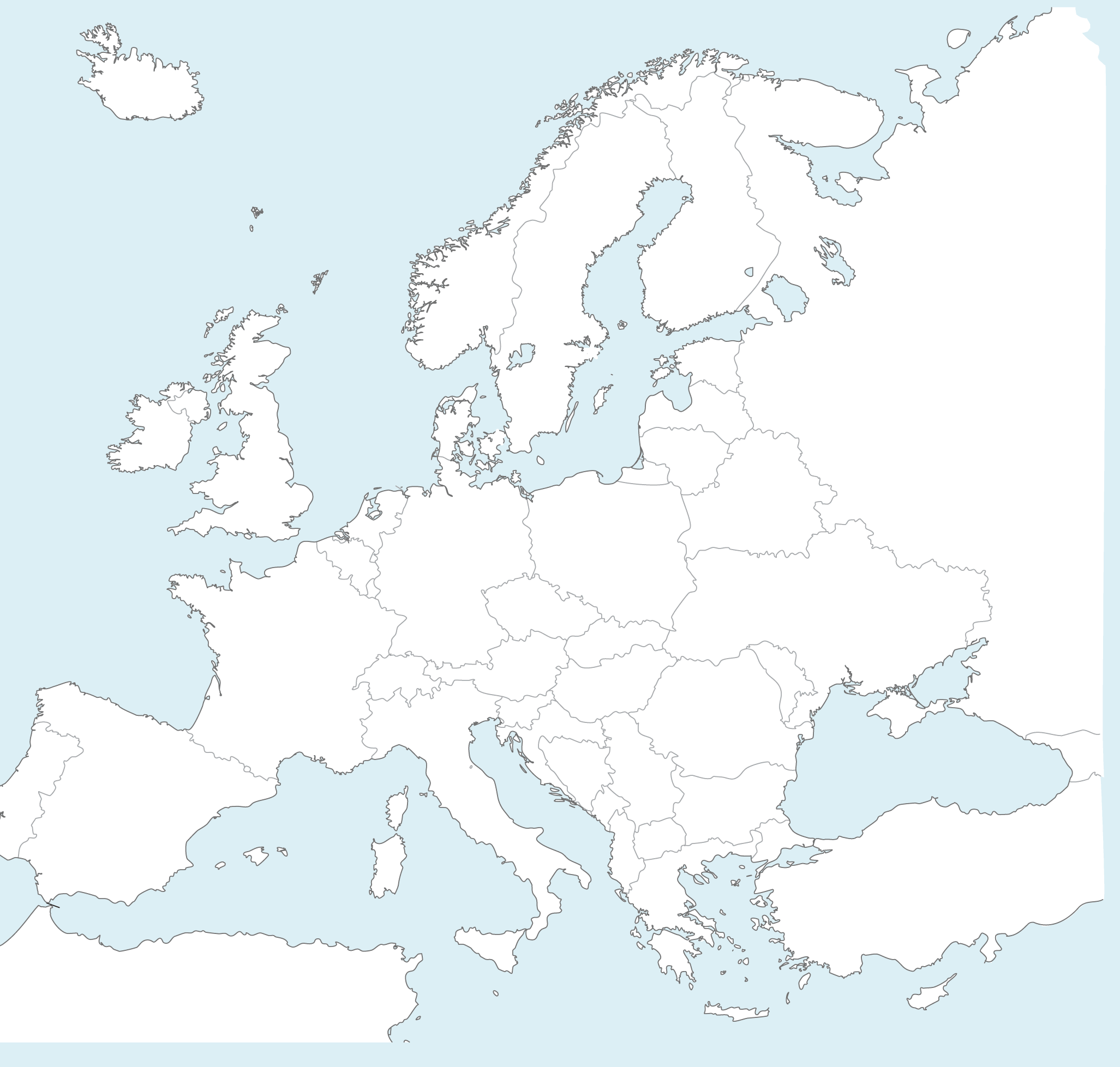
Presentation Outline
EPF’s current geographic remit
The implications of Brexit
EEA Countries
IAPO
Board’s proposed approach
Thoughts – views from you as members

Slide 101

Current Status
EPF: set up as an EU organisation although our European disease specific members have a Europe wide remit
Our role = key interlocuter with the EU Institutions
Constitutional change 2010 to welcome eligible organisations from EU Candidate countries as associate members

Slide 102

Implications of Brexit
The UK leaving the EU
Three member organisations from the UK:
  National Voices (full member)
  The Scottish Alliance for Health and Social Care (associate)
  The Association of Medical Research Charities, AMRC (associate)
Discussions indicate their desire to continue to be part of the EPF membership and to contribute
This requires a constitutional change

Slide 103
European Economic Area
EPF has good links in Norway, Iceland, Switzerland
Frequent participation at meetings, projects
(EUPATI Platform in Switzerland)
Currently national coalitions from these countries are not eligible for membership

Slide 104
IAPO and their Role in Europe
EPF has a strong relationship with IAPO based on an MoU signed in 2006.
IAPO wishes to focus more on other regions of the world and collaborate with EPF on addressing the cross cutting needs of patients from the wider Europe
EPF – focus on EU neighbouring countries, IAPO on central Asian countries who form part of the WHO Europe
Both EPF and IAPO are active within WHO EUROPE

Slide 105
Board’s Proposed Process
Impact Assessment Process 2017 and consultation with IAPO, WHO Europe, Council of Europe , the European Commission, potential members from non EU countries
Analysis and proposal to the EPF board early 2018
Report back to the EPF AGM 2018, and agreement for constitutional change
Setting up dedicated Constitutional Reform Committee
Proposal revised Constitution to AGM 2019 for incorporation in new Strategic Plan 2020 + beyond.

Slide 106
EnglargING OUR REMIT iNTO WIDER EUROPE
Thoughts from you as members

Slide 107
European Patient’s Forum
Annual General Meeting
2017
10-11/04/17
Brussels
@eupatientsforum

