Slide 1

European Patient’s Forum
Leadership Meeting
2017
11/04/17
Brussels
@eupatientsforum

Slide 2
Epf in a changing health and social policy development
@eupatientsforum
11/04/17
EPF Leadership Meeting

Slide 3
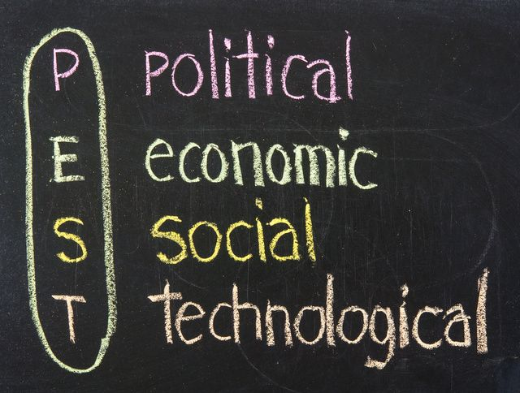
A Changing Health & Social Policy Development
Discussion on the development of the external environment, including economic, political, technological and socio-cultural factors that shapes the current and future activities of EPF.
Karolina Hanslik, Policy Officer, DG SANTE, European Commission
Lieven Annemans, Professor of Health Economics, Ghent University
Nick Guldemond, Associate Professor Integrated Care and Technology, Institute of Health Policy & Management
Moderated by Nicola Bedlington, EPF Secretary General

Slide 4
Preparing for the future -
Breakout sessions
@eupatientsforum
11/04/17
EPF Leadership Meeting

Slide 5
Preparing for the Future
Empowerment
Access & Inequalities
Sustainable
Patient organisations
Governance

Slide 6
European Patient’s Forum
Leadership Meeting
2017
11/04/17
Brussels
@eupatientsforum

