Slide 1
Transnational healthcare in Europe Challenges for patients
Tomas Mainil
(Breda University of Applied Sciences, Netherlands)
Sabina Stan
(Dublin City University)
Notes:
First, I want to thank the European Patient Forum for inviting us to speak at this Round Table.
I’m Tomas Mainil from Breda University in the Netherlands and, together with my colleague Sabina Stan from Dublin City University, we’d like to turn the discussion
-from this very informative mapping of patients’ rights in the Directive,
-to the challenges for Cross-border Directive patients that result from the transnational dimensions of European healthcare.

Slide 2
Cross-Border Directive participates in the transnationalisation of healthcare
The challenge: transnational healthcare leads to private-public mixes in coverage and provision
Implications for patients
Notes:
Our argument in this presentation is
that the Directive participates in a process of transnationalisation of healthcare in Europe
and that the latter has contributed to increase the complexity of healthcare accross the EU, most notably in terms of public/private mixes in coverage and provision,
thus enhancing the challenge for patients of navigating these complex combinations
We will draw in conclusion some implications that transnational healthcare has for Cross-Border Directive patients.

Slide 3
What is transnationalism in healthcare?
Transnationalism: sustained linkages between people, places & institutions across borders (Faist 2010).
Transnational healthcare: border crossing policies, provision and patients.
Notes:
Transnationalism refers to sustained linkages between people, places & institutions across borders of nation states (Faist 2010).
In healthcare, transnationalism refers to linkages fostered through border crossing policies, provision and patients.
For example, when a patient is transcending the national health system and its borders, a transnational action is performed. This has wide implications: if the health system of Romania is of lesser perceived quality than its Hungarian counterpart, the resulting patient mobility will change the lives of cross-border patients, but also have a transformative impact on both health systems.

Slide 4
The Cross-Border Care Directive
Directive‘s challenge to patients‘ rights
From its implementation in national contexts
To its role in transnational healthcare
Notes:
So, keeping this transnational dimension in healthcare in our minds,
we’d like to move the discussion on the Directive’s challenge to patients’ rights
from the perspective of its implementation in national contexts, which we agree is crucial,
to nevertheless a complementary and less discussed perspective of challenges that follow from the Directive’s role in transnational healthcare in Europe.
This is appropriate as the Directive itself participates in transnationalisation as it contributes to extend patient access to the EU transnational scale.

Slide 5
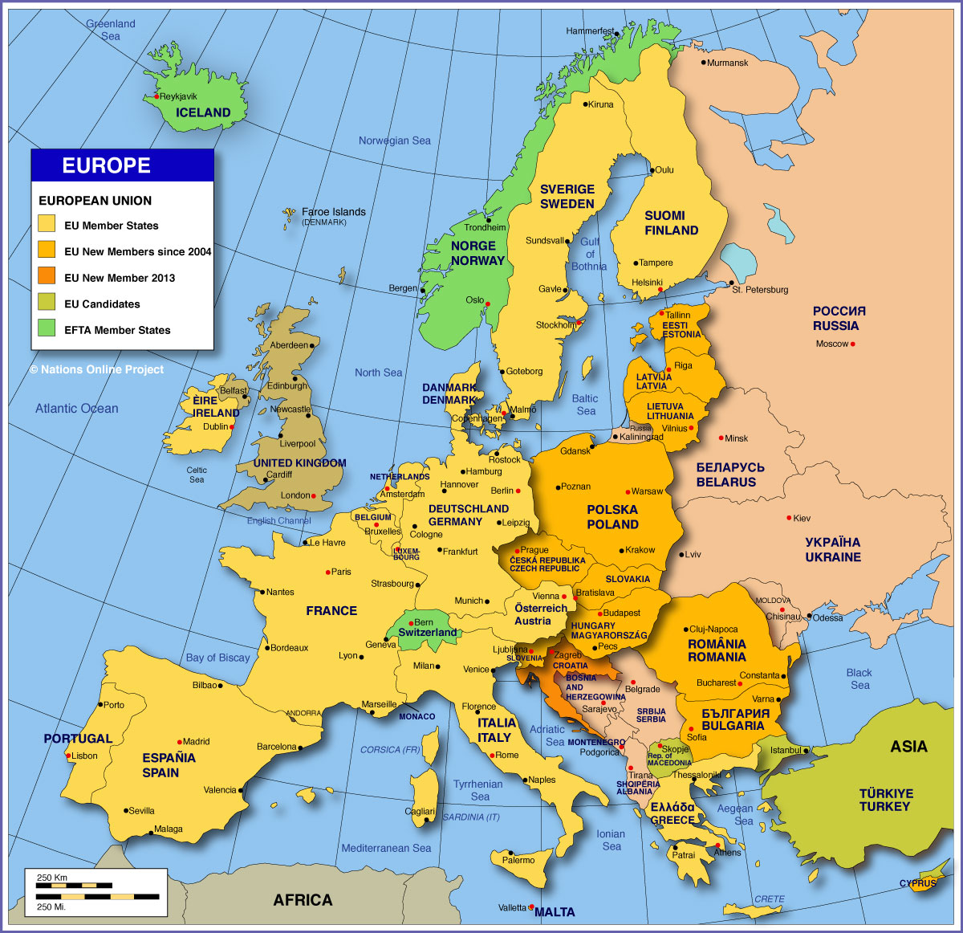
Transnational healthcare in Europe
Border crossing:
healthcare policies
healthcare provision
patients
Notes:
Healthcare in Europe has traditionally been seen as a national matter, and it is certainly so in a number of very important ways.
However, more and more in the last years we have all been compelled to think of
European healthcare as being transnational, as it has been affected by the crossing of borders of healthcare policies, provision, and patients.

Slide 6

1) Border crossing healthcare policies
Diffusion of policies of marketisation & commercialisation of healthcare
EU interventions to embed fiscal sustainability in national health policies
Challenge: navigating public-private mixes in coverage and provision
Notes:
So if we first look at policies, we see that, while in Europe a variety of health policies have crossed borders for quite some time (think of sanitation measures in the 19th century), closer to us, and especially since the 90s we have witnessed the diffusion throughout Europe and beyond of policies seeking to marketise and commercialise healthcare – for example, policies to introduce new public management in public health services, to outsource ancillary services in hospitals to private cleaning & catering companies or again to privatise healthcare delivery and encourage the rise of private hospitals and clinics.
In addition to these, more recently the European Semester led to EU interventions that have sought to embed fiscal sustainability in national health policies – more precisely by cutting down or containing public health expenditure.
All these processes have led accross Europe to increasingly mixed, public/private, health services, and thus to increased challenges for patients as to how to navigate these mixes in coverage and provision of services.

Slide 7




2) Border crossing healthcare provision
Healthcare multinationals
Notes:
In the same time, in the last decades we have also seen the rise of ‘healthcare multinationals’ active across the EU not only in ancillary services (like cleaning and catering) but also in high tech diagnostic and treatment services as well as in more ‘core’ medical and care services (with names such as Medicover, Capio, or Ramsay and many others now part of the healthcare landscape in several member states).
Some of these healthcare multinationals, as well as moe local private healthcare providers, started in the last few years to increasingly look for international accreditation of quality standards with a view of opening their services to global markets through medical tourism.
Both these phenomena have contributed to increase public-private mixes in coverage and provision and thus to enhance the already seen challenge for patients of navigating these mixes.

Slide 8

Patients and mixed healthcare systems
Increased choice & better quality services
Bureaucracy, uncertainty & barriers re:
  quality & continuity of care
  rights of access and coverage
Notes:
Now looking more closely at these challenges for patients, what we can say is that in these increasingly complex & mixed healthcare systems, so even before crossing borders, patients may now
- sometimes, at least some of them, avail of increased choice and better quality services,
but also other times (and as already mentioned in the EPF‘s position paper on the Directive) patients may
-face bureaucracy & uncertainty & even barriers regarding
- quality & continuity of care
- rights of access and coverage.
This is the case in some European member states (RO, PO, IE etc.), where patients sometimes face a veritable maze of options & combinations of care.
In these countries care is not only delivered by both public and private providers, but through various types of coverage inside each type of provider - leading to complex combinations and navigation by patients through the system.

Slide 9
The maze
Patient X chooses private clinic (speedy access).
Is treatment covered by public or private funds?
X is then admitted to public hospital (sole provider)
Is her stay covered by public or private funds?
‘Choice’ is enhanced, but not necessarily in the same manner for everyone.
Notes:
For example, a patient may choose to attend a private clinic to speed up procedures and skip waiting lines in public clinics, but here she may either pay from her own pocket for services or have them covered from the NHF. Then she may be admitted to a public hospital, but there again as either a public (non paying) patient or a private, fee paying one.
Choices at each stage depend on the means available to the patient and lead to various levels of quality and speed of care depending on these means.

Slide 10
Patient routes are complex even in national settings…
Public coverage
Public services
Public providers
Private providers
Private services
Private coverage
Notes:
So we see with this example that patient routes even in national settings are complex …
with ‘public’ and ‘private’ services now being distinct in terms of coverage, but overlapping in terms of provision, as both may be provided in either public or private setting.

Slide 11
…but even more so if we add cross-border contexts
Public coverage
Regulation route
Public services
Public providers
Directive route
Private providers
Private services
Medical tourism
Private coverage
Notes:
This complexity in national settings increases exponentially if we add cross-border contexts,
where we have
- At one end, the Regulation route (based on the Regulations for the coordination of social security) that relies on coverage and provision that are both public,
at the other end, Medical tourism (where patients accessing health services abroad pay privately for them) that relies on coverage and provision that are both private,
and in between, the Directive route that combines public coverage with either public or private provision.
So a very complex system…

Slide 12
3) Border crossing patients: three routes
Longer national waiting lists increase demand for
Directive route.
Restricted ‚baskets of national public services‘ increase demand for Medical tourism.
Notes:
Now, if we look more closely at the cross-border context,
Still incomplete available data seem to indicate that the older Regulation route is dominant, followed by ‚Medical tourism‘ and only then bythe newer Directive Route, which is still but possibily bound to rise in importance in the future.
Beyond their actual size, what is highly relevant to note is that the three routes are connected to each other as well as to the size of domestic public and private care. Thus, for example,
If national waiting lists increase, the availability of timely services at national level decreases. This leads to increased attraction of exit options and thus also potentially raise demand for the Directive route.
- In the same manner, more restricted ‚baskets of national public services‘ curtail the possibility of taking publicly covered cross-border routes for services excluded from these baskets and potentially increase demand for Medical tourism.

Slide 13
Two scenarios for the Directive route in Europe
Transnational healthcare growth
Transnational healthcare vitality
Source: adapted from Mainil et al 2017
Notes:
So we would like to end with two hypothetical scenarios for the Directive route and transnational healthcare more generally in Europe, what I have called in a recent report on Health tourism in the EU, the transnational healthcare growth and the transnational healthcare vitality scenarios.
I‘d like you to keep in mind that, while the two scenarios include aspects that can already be observed in European healthcare, they are better understood as extreme ideal types rather than approximations of reality, with probable course of development taking place somewhere between the two.

Slide 14
Scenario 1: Transnational healthcare growth
EU focus: economic growth of transnational care
Cuts to public health expenditure lead to reduced ‘baskets of services’ & longer access times
The Directive route and other policies are used as a tool to foster EU leadership in the global medical tourism market
Patient access to health services is segmented
Notes:
In the first, ‘growth’ scenario,
EU policies mainly aim for economic growth, including of transnational healthcare.
In the same time, fiscal sustainability and resulting cuts to public health expenditure lead to reduced ‘baskets of services’ & longer access times in national public health systems
The Directive route and other policies (private & public investment in medical tourism and deregulation of trade in healthcare) are used as a tool to foster Europe as leader in the global medical tourism market.
This leads to a segmented patient access to health services, going from:
-Well-off patients availing of top private and public care both nationally and abroad, to
- Medium-income patients increasingly exiting public healthcare for private care both nationally and abroad, and to
-Patients from poorer backgrounds and vulnerable groups accessing limited public healthcare or no care at all.

Slide 15
Scenario 2: Transnational healthcare vitality
EU Social Pillar: ’Everyone has the right to timely access to affordable … health care of good quality’
The Directive becomes a springboard to implement EU social pillar rights by
adequately funding National Contact Points
reinforcing national public provision of quality & timely care
regulating medical tourism industry
Patient access to health services is inclusive
Notes:
But there is a less gloom and doom alternative second scenario, in which the EU enforces its EU Social Pillar and EU citizens’ rights to ‘timely access to affordable … healthcare of good quality’
and the Directive also becomes a springboard to implement these rights, more notably by
- adequately funding National Contact Points
- reinforcing national public provision of quality & timely care
- regulating medical tourism industry
In this scenario, patient access to health services is maximally inclusive rather than segmented among various groups.
We will leave you with these considerations hoping they provide some food for thought as to the challenges the Directive poses to patients’ rights in a transnational Europe.

Slide 16
References
Mainil, T. and Stan, S. forthcoming. Transnational health care. In Furman, R., Winnett, R., Epps, D. and Lamphear, G. (eds.) Health Care Social Work: A Global Perspective. Oxford: Oxford University Press.
Mainil, T., Eijgelaar, E, Klijs, J, Nawijn, J, Peeters, P. 2017. Research for TRAN Committee – Health Tourism in the EU: A General Investigation. Brussels: European Parliament, Policy Department for Structural and Cohesion Policies.
Stan, S. Cross-border patient mobility, consumer citizenship and the uneven European healthcare space, under review with Journal of Ethnic and Migration Studies, special issue on ‘Transnational medical mobilities: Care, commodification, counting and citizenship’ N. Lunt and M. Ormond (eds.).
Notes:
Here you can find some of the work we have published on the topics of transnationalism, health tourism and patient mobility

Slide 17
Thank you!
mainil.t@nhtv.nl
sabina.stan@dcu.ie
Notes:
As well as our email addresses if you wish to contact us. Thank you!

