Slide 1

Implementation of the Patient Directive in Finland
Pia Blomqvist
International Affairs Counsellor
Contact Point for Cross-Border Health Care
Social Insurance Institution of Finland
pia.blomqvist@kela.fi
Twitter: @piamabl / @rajayhteyspiste

Slide 2
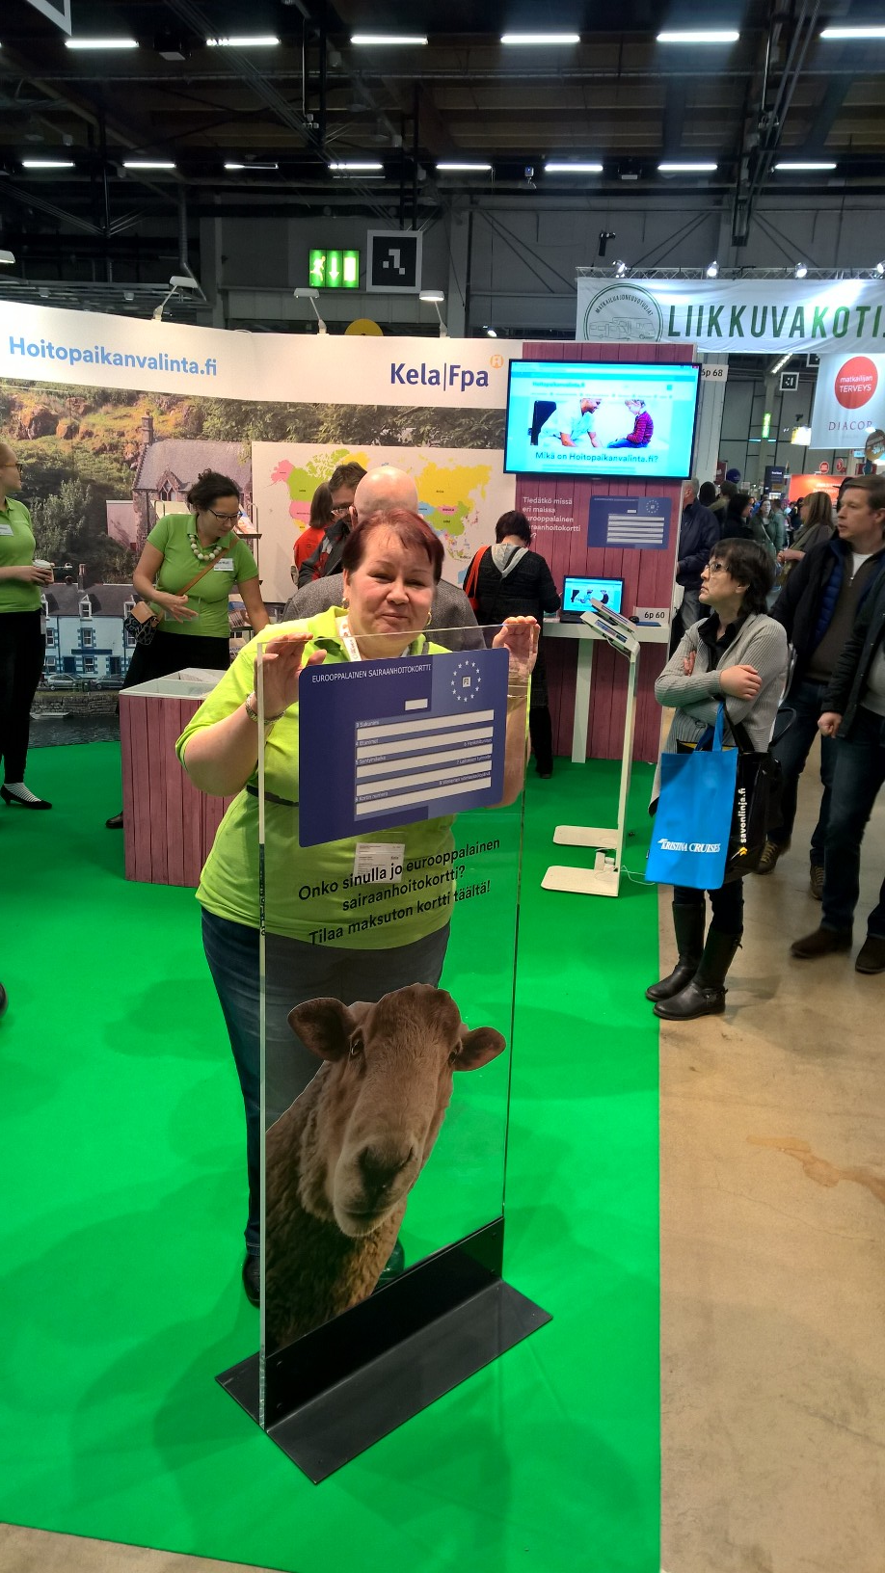

Contents
Finnish NCP: how is it organised and how do we serve?
How is Patient Directive implemented in Finland?
Knowing our customers
What are we going to do?
#crossborderhealth #Patients4CBHC
@piamabl @rajayhteyspiste

Slide 3
Finnish NCP is sited in Kela
NCPs are established to provide information about various issues conserning the right for health care services and how to use them within EU.
NCP’s tasks are statutory
  Act on Cross-Border Health Care (in Finnish)
  Directive 2011/24/EU on the application of patients’ rights in cross-border healthcare (article 6)
The Finnish NCP has operated since 1.1.2014. It’s sited in Kela (the Social Insurance Institution) with separate funding from the Ministry of Social Affairs and Health.
The staff in total is 4: head of unit, two international affairs counsellors and a communications counsellor
#crossborderhealth #Patients4CBHC
@piamabl @rajayhteyspiste

Slide 4
Finnish NCP: How do we serve?
www.choosehealthcare.fi is our main channel, which provides information about
  freedom of choice in health care within Finland
  Patients’ rights and right for health care services in different international situations
  Finnish health care system and how to seek care in Finland
  information about using health care services in other countries.
The site is in Finnish, Swedish, English, Sami and sign language
The site is primarily targeted to the public but also to the healthcare personnel
The site is provided by the NCP in cooperation with the Ministry of Social Affairs and Health, the National Institute for Health and Welfare and Kela.
We also answer around 300-400 inquiries per year via e-mail
#crossborderhealth #Patients4CBHC
@piamabl @rajayhteyspiste

Slide 5
Patient Directive in Finland
1. Patients are free to seek and use healthcare services abroad
They don’t need to notify Kela or other authorities in advance of the matter.
Kela reimburses the costs of treatment given in an EU or EEA country or in Switzerland afterwards.
Kela reimburses the costs on the same basis as private healthcare services in Finland. The treatment in question must be included in the range of services available in Finnish healthcare system
The reimbursement rates are not high
2. Another possibility is to apply for prior authorisation (based on Regulation)
If it’s granted, the patient pays only the same customer fee as local patient would pay in equivalent circumstances. This is much more cheaper for the patient
There are conditions under which the prior authorisation is granted.
It’s not really common in Finland: in 2016 only 126 out of 246 applications of prior authorisations were granted
3. Patients who are covered by health insurance in another EU country can freely seek treatment in Finlands public or private healthcare
#crossborderhealth #Patients4CBHC
@piamabl @rajayhteyspiste

Slide 6
Knowing our customers
How do we get information about our customers?
Direct contacts via e-mail
Feedback from our webpage
Events
Questionnaire
In summer 2017 we made a webropol survey about cross-border health care. We wanted to know what kind of information needs Finnish people have.
How well do they know their rights?
In what kind of situations they need the information?
What kind of attitudes and expectations do they have about using healthcare services?
From where do they search for the information?
During two weeks, we reached 96 respondents via Facebook and Twitter.
#crossborderhealth #Patients4CBHC
@piamabl @rajayhteyspiste

Slide 7
What did we find out?
(Read more here)
Issues concerning cross-border healthcare are not well known
  Only 24% regarded their knowledge of the use of healthcare services abroad as good or very good, whereas 65% considered their knowledge average or worse than average.
Yet the information is needed
  37% of the respondents said that they or their family member had used healthcare services abroad.
  40% of the respondents had needed or looked for information for the treatment of their own or their family member’s illness abroad.
Those heading abroad are interested in places of treatment, costs and medicines
  Information is searched for and found online
  We have this information in our webpage, but it’s not yet well known (only 15 % have visited our website)
#crossborderhealth #Patients4CBHC
@piamabl @rajayhteyspiste

Slide 8

What are we going to do?
We are going to
Market our website and services in search engines and events etc.
Communicate via Twitter and our website
Collaborate with our partners and find more partners
Make our website more user-friendly (understandable messages, graphics etc)
Is there something that you would
expect from us?
#crossborderhealth #Patients4CBHC
@piamabl @rajayhteyspiste

Slide 9
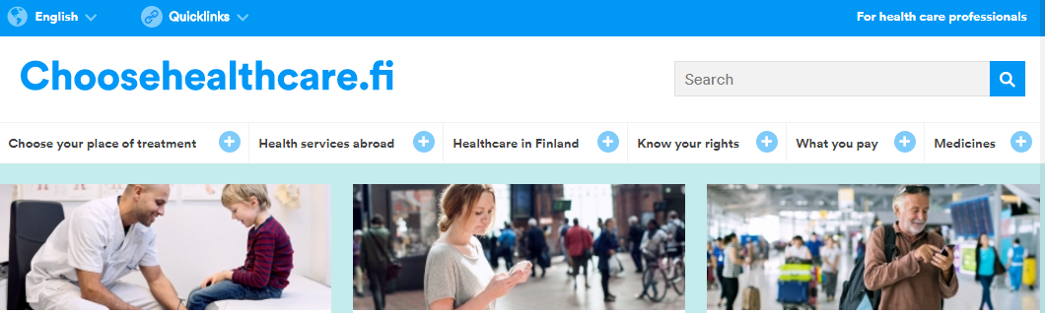
Thank you!
Check out our website: www.choosehealthcare.fi
Follow us on Twitter: @rajayhteyspiste
Contact us by e-mail: yhteyspiste@kela.fi
#crossborderhealth #Patients4CBHC
@piamabl @rajayhteyspiste

