Slide 1

EPF Roundtable
On the Implementation of Patients’ Rights in Cross-border Healthcare
4 December 2017, THON EU Hotel, Brussels
#crossborderhealth
#Patients4CBHC
The patient’s experience – Philippe Pakter

Slide 2
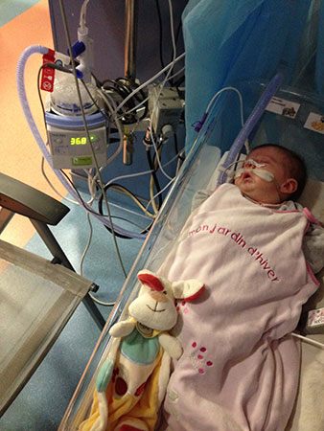
Introduction – my daughter Lysiane
Dangerous, difficult birth
Diagnosed with a rare disease, Pierre Robin Sequence
Neonatal Resuscitation ward, then Intensive Care ward
Connected to a ventilator machine
No scheduled release date from the hospital, even after 5 weeks of nonstop intensive care

Slide 3
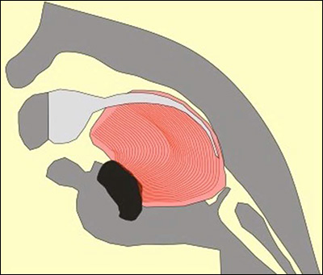
The medical problems associated with this rare disease
Upper airway obstruction
Breathing difficulties
Feeding difficulties

Slide 4
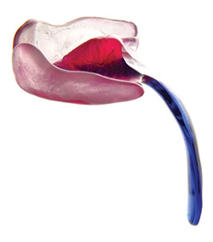
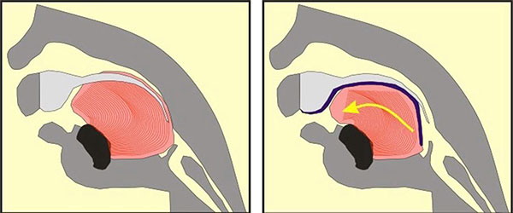
A breakthrough solution
A safe and non-surgical medical device which instantly eliminates the baby’s torturous breathing difficulties

Slide 5
The Tübingen Palatal Plate, “TPP”
Developed at the Tübingen University Hospital in Tübingen, Germany; currently available only in Germany
A safe, highly effective treatment
Medically proven; peer reviewed medical studies over 10 years
Corrects the underlying anatomical problem – unblocks the throat – without surgery
Liberates the baby from the ventilator machine, permanently
Improves feeding
Minimizes hospitalisation, which…
  Allows the baby to finally leave the hospital and come home to Mom
  Reduces the baby’s exposure to hospital borne illnesses
  Reduces national healthcare costs

Slide 6
We as parents take action
We visited Tübingen, saw the treatment in action, met with the doctors, met with parents… we are convinced
Back home in France, we seek a medical certificate for our S2 application; delays
We submit our application for prior authorization
We transfer our daughter Lysiane from France to Germany to receive the TPP treatment
France’s national health insurance fund rejects our S2 application
We are now appealing the rejection

Slide 7
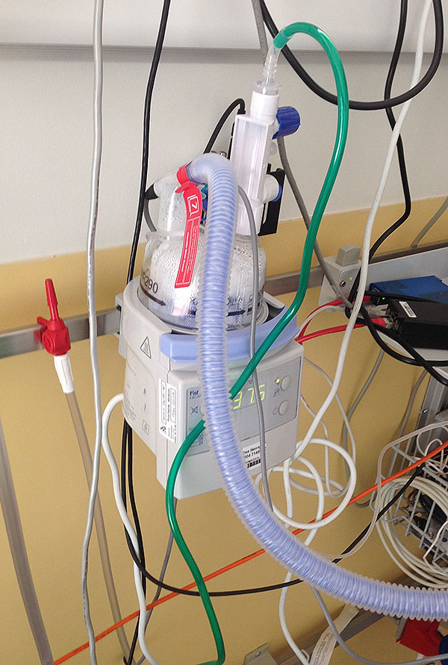
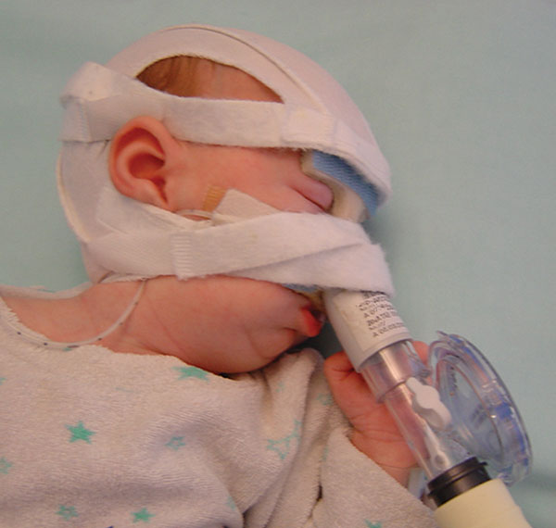
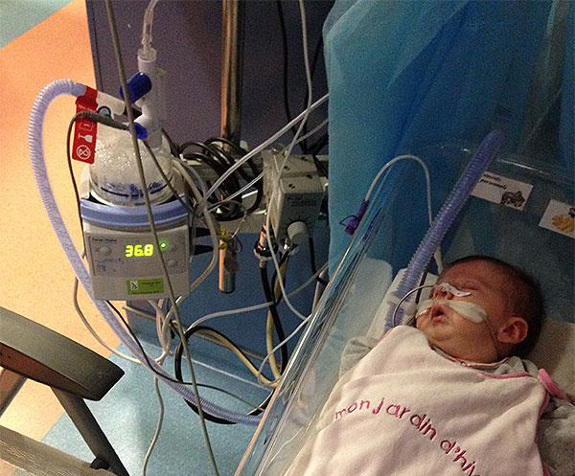
The basis of the rejection: these treatments are “the same or equally effective”
=

Slide 8
The “same or equally effective”?
No objective and impartial medical comparison can reasonably conclude that these treatments are “the same or equally effective”
A bold violation of the 2011 Directive, Regulation (EC) No 883, and the fundamental principle of the freedom to provide and receive services under Article 56 of the TFEU
An example of the kind of arbitrary, irrational, and unreasonable exercise of national discretion which the European Court of Justice has repeatedly struck down
Cannot be justified on any public policy grounds
Neither necessary nor proportionate

Slide 9
Planned cross-border healthcare in the EU
The European Commission has explained:
  “Patients prefer to receive healthcare in their own country. That is why the demand for cross-border healthcare represents only around 1% of public spending on healthcare, which is currently around €10 billion. This estimate includes cross-border healthcare which patients had not planned in advance (such as emergency care for tourists). This means that, at present, considerably less of that 1% of the expenditure and movement of patients is for planned cross-border healthcare, like hip and knee operations or cataract surgery.”
Planned cross-border healthcare in the EU: in theory, it is possible; in practice, it is avoided
Our horrible experience seeking cross-border healthcare for our baby, who suffers from a rare disease, may help to explain these very low figures

Slide 10



Creating a coalition to get Lysiane her S2
SOLVIT, the EU network which assists EU citizens whose rights under EU law have been violated
  Agrees with our legal assessment
EURORDIS, the European Organisation for Rare Diseases
  Have written to France’s national health insurance fund; prepared to accompany us in court, all the way up to the European Court of Justice
A member of French Parliament
  The député representing our district
  Particularly sensitive to children suffering from rare disease

Slide 11
Our continuing struggle to get Lysiane her S2 raises an issue of wider principle which matters to all Europeans, and which affects their daily lives:
If a newborn baby suffering from a rare disease, immobilized in an intensive care ward and connected to a ventilator machine, doesn’t have the right to obtain a highly specialised, medically proven and cost effective treatment for her rare disease in another EU Member State – then who does have the right to obtain cross-border medical care?

Slide 12
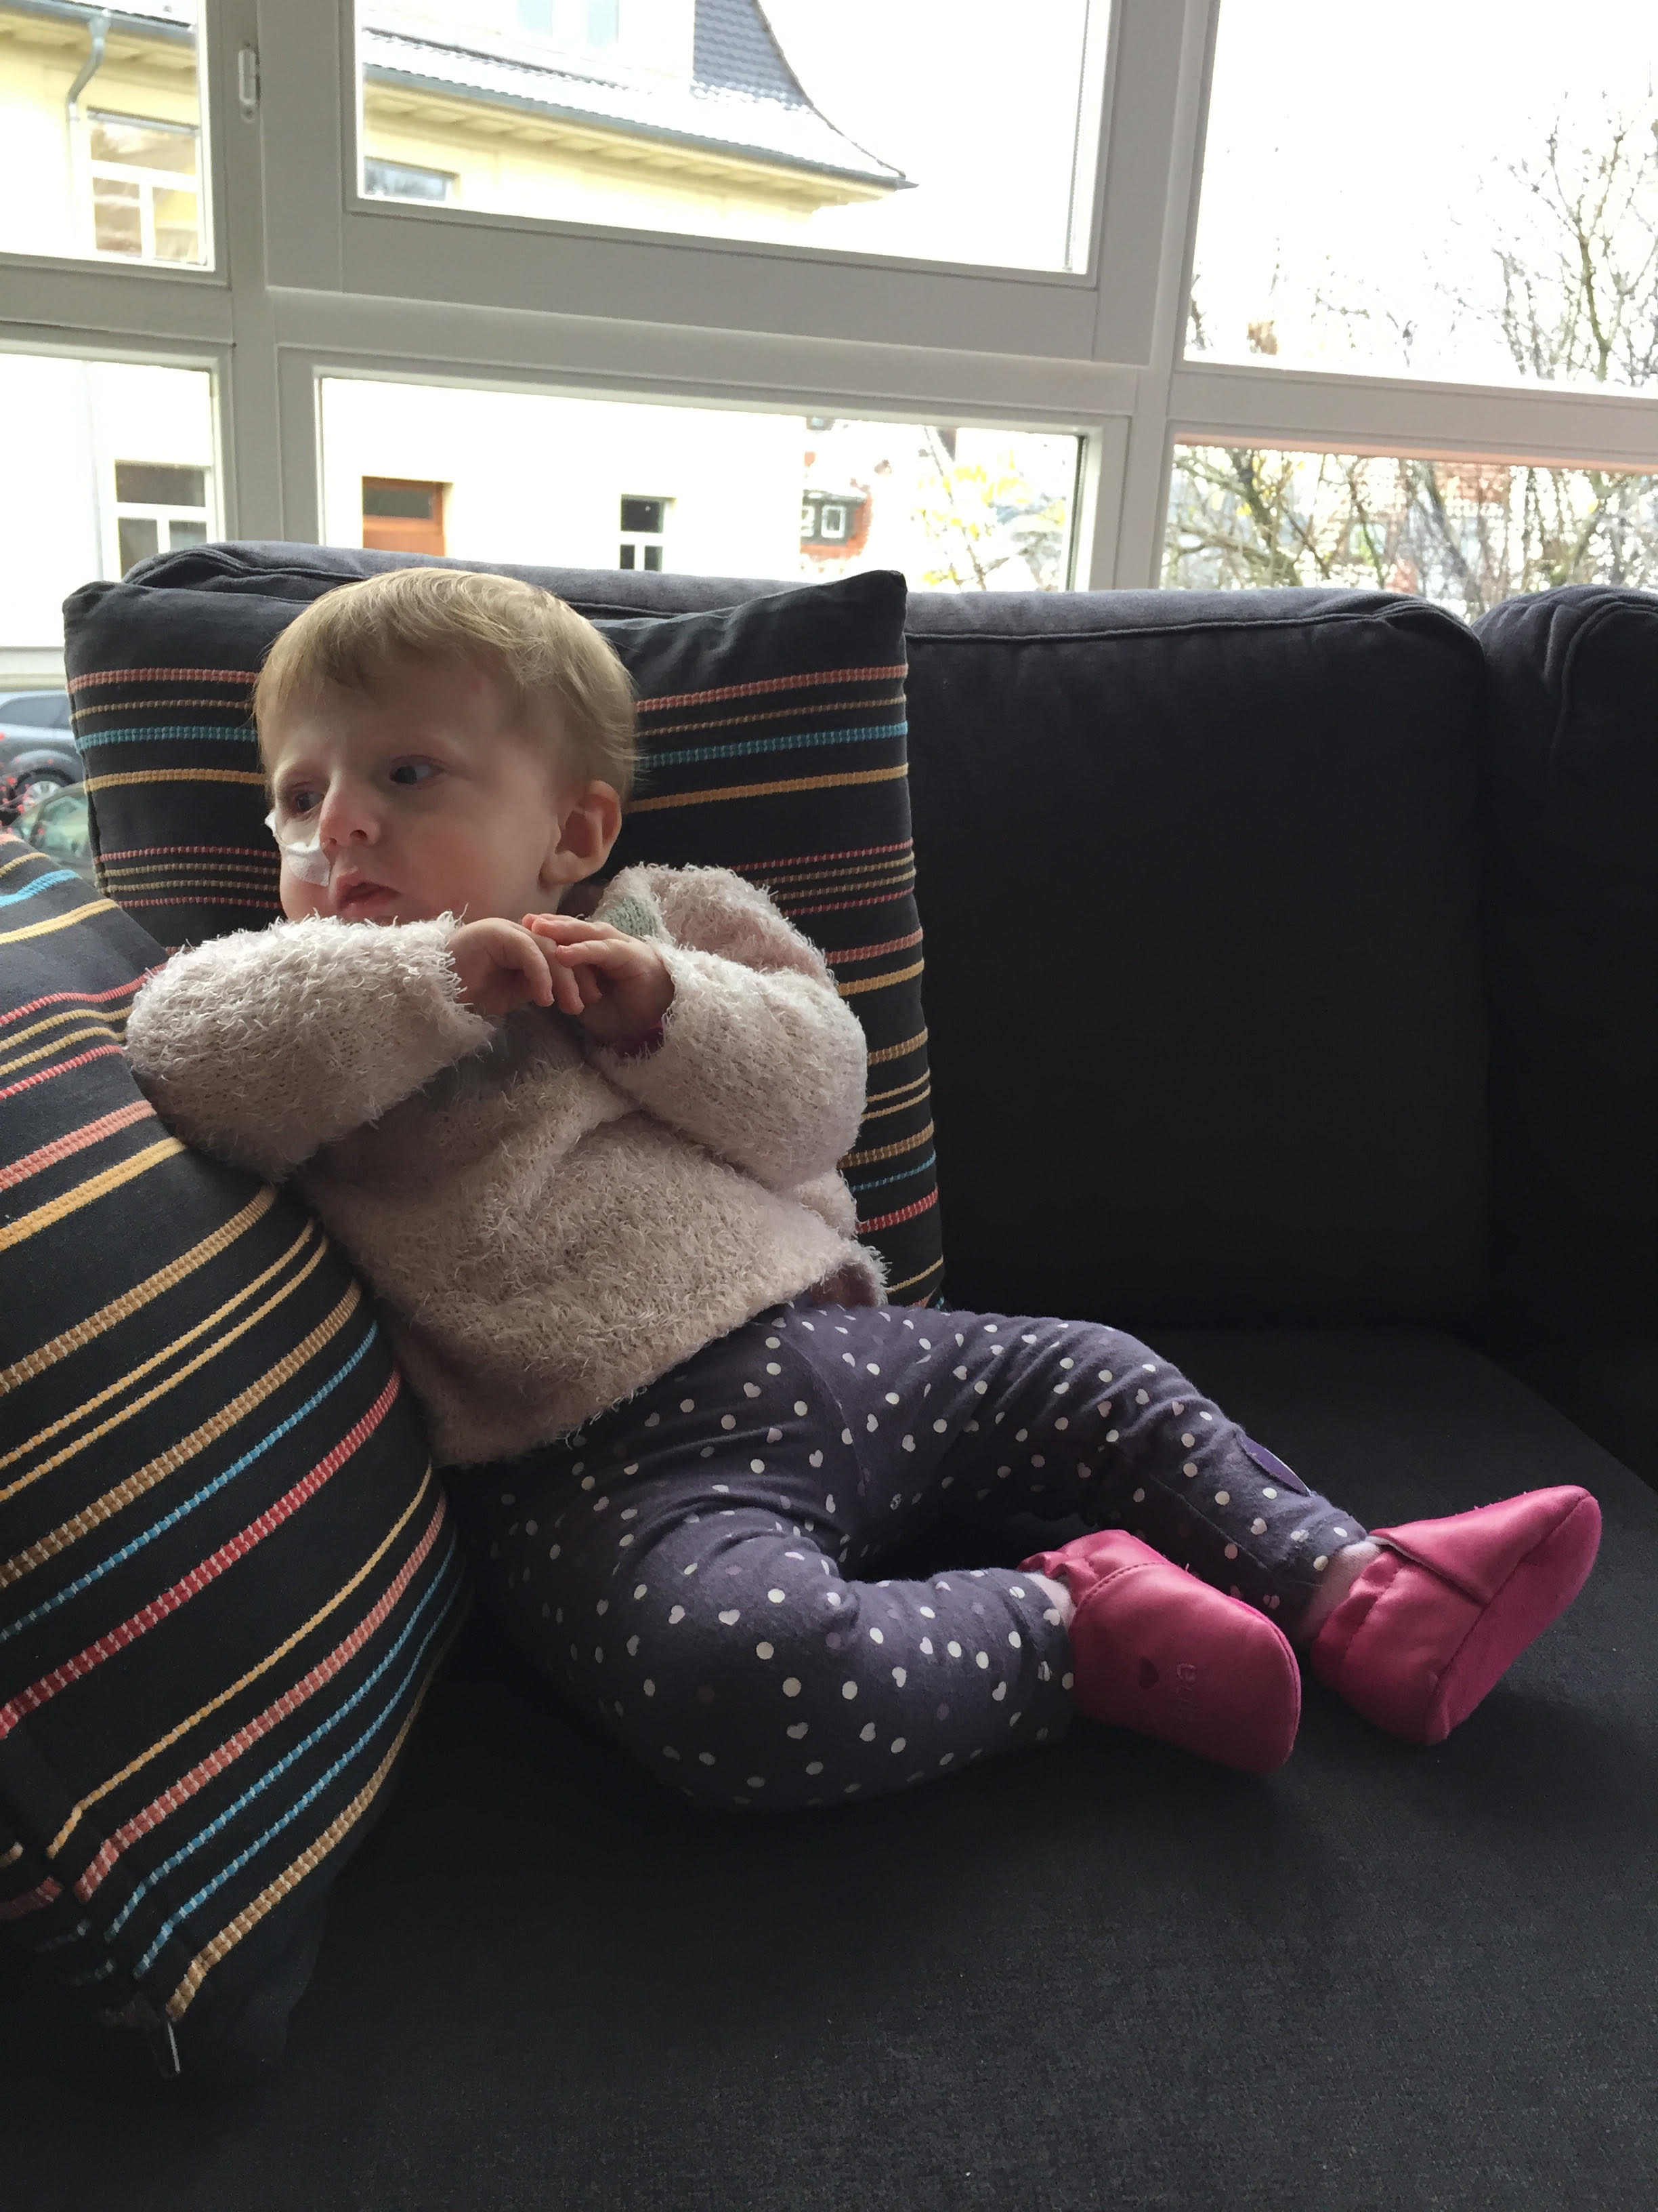
Thank you for your time
Philippe Pakter
Email: philippe@pakterlaw.com
Twitter: @philippepakter

Slide 13
Annex: EPF Position Statement, April 2016; possible topics for discussion
“We recommend that there should be a European-wide framework for monitoring and implementing patients’ rights. In particular, there should be a mechanism to address complaints in cases where patients feel their rights have been violated. A patients’ Ombudsman could be set up at EU level with a network of ombudsmen in all Member States – some of which already have established patient ombudsman offices.”

Slide 14
EPF Position Statement, April 2016
“Lack of clear information is a deterrent to many patients to seeking healthcare. The situation undermines the Directive’s original objective, which was to create clarity on patients’ rights and entitlements and enable patients to make informed choices.”
  “Member States should ensure that accurate and easily understandable information on exactly which treatments are subject to prior authorisation and which are not is available on the NCP website, including information on the criteria applied and the application procedure for prior authorisation.”
  “Increasing transparency, including about what healthcare is covered in the ‘benefits basket’ in different Member States, will lead to a greater awareness in the patient communities of gaps and inequalities. This could be an opportunity to advocate for improved access and quality of care.”

Slide 15
EPF Position Statement, April 2016
“Patients with (suspected) rare diseases and their families are in a particularly vulnerable position. A global lack of expertise is the major reason for patients with rare diseases having to seek cross-border healthcare. Time is a particular concern, as patients often undergo a number of consultations before being diagnosed correctly.”
“For patients affected by rare diseases, the actual process of prior authorisation may be an obstacle. Such authorisation usually involves a clinical evaluation by doctor(s) designated by national authorities, who often lack the necessary expertise on the specific diseases. Expertise on rare diseases is scarce by definition and concentrated in a few centres… The authorities should do everything they can to facilitate those patients’ access to expert diagnosis and treatment.”

Slide 16
EPF Position Statement, April 2016
  “The Commission should work closely with patient groups to raise awareness of European Reference Networks and specialised centres, and to ensure that they function in a patient centred way.”
  “Patients’ organisations should monitor the Directive as far as is feasible within their resources, and provide information to EPF on good and bad practices, for example through the EPF ‘Network of patient representatives on cross-border healthcare’.”
  “Frameworks and methodologies should be developed to systematically incorporate and encourage patient input to HTAs, including rapid HTA/relative effectiveness assessment.”

