Slide 1


Patients’ rights in the European Union: from recognition to implementation
Focus on rights relevant to the cross-border care Directive
Willy Palm, Senior Advisor

Slide 2
























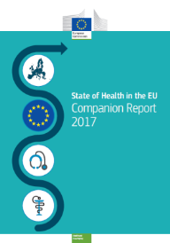







Slide 3


Patients’ Rights in the European Union
Mapping eXcercise (PRE-MaX - 2015)
Rationale:
“a mapping exercise of existing patients’ rights in 30 countries (EU28 + Norway and Iceland). This study provides an overview of the various legal frameworks as well as other policy tools and mechanisms in place (or in the making) to define, implement and enforce patients’ rights”
Potential of developing a comprehensive list of useful and achievable patients’ rights?
Funded by the European Commission in the frame of the EU Health Programme 2014-2020

Slide 4
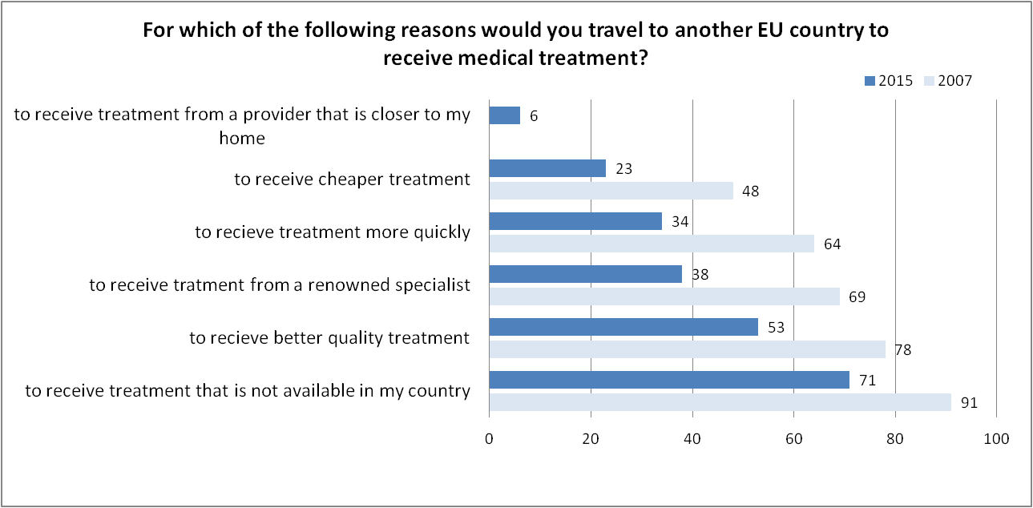
Cross-border care and patients’ rights?
Source: Eurobarometer 2015 and 2007

Slide 5

Patients’ rights development
Stumbling blocks
Low sensitivity
Poor knowledge
Paternalistic doctor-patient model
Resistance from the medical profession
  fear for rise in legal disputes and liability claims, also leading to increased costs due to defensive medicine
Enablers
Human rights’ movement
Development of health law as a discipline
Political transition and civil society
International framework
Increased media attention
Increased attention for patient involvement and empowerment, quality and safety, medical liability

Slide 6


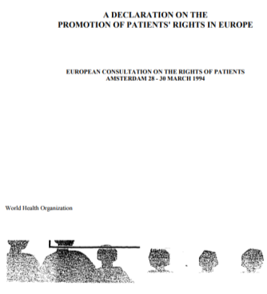




International framework promoting the development of (general) patients’ rights
 | WHO (1994) | CoE (1997) | ACN ( 2002) | EU (2011)
Respect, dignity, integrity | X | X | X
Non-discrimination | X |  |  | X
Privacy, data protection | X | X | X | X
Self-determination, informed consent | X | X | X
Informed choice |  |  | X | X
Access | X | X | X | X
Quality | X | X | X | X
Complaint and remedy |  | X | X | X
Representation | X |  | X

Slide 7
National codification of patients’ rights
 | Legal (horizontal) |  | Quasi-legal | Moral
 | “Sui generis” private contracts | Generic private contracts | Vertical/public
Special | Netherlands (1994) Estonia (2001) Lithuania (2001) Slovakia (2004) | Hungary (1997) Belgium (2002) Spain (2002) Poland (2009) Latvia (2010) Czech Republic (2011) Germany (2013) Luxembourg (2014) | Finland (1992) Iceland (1997) Norway (1999) France (2002) Romania (2003) Croatia (2004) Greece (2005) Slovenia (2008) Cyprus (2005) Portugal (2014) Denmark (2014) Sweden (2015) |  | Austria (2002) United Kingdom (2009) Ireland (2012) Malta (2016)
Split | Bulgaria - Italy
Updated - Based on H Nys and T Goffin (2010)

Slide 8

Enforcement: the weak link!
From declared principles to enforceable rights!
a toothless tiger?
Enforcement = information +
monitoring + dispute settlement
  Better knowledge and awareness
  Increased (compliance) monitoring
    Internationally
    Nationally
  Dispute settlement: Often effective
  sanctions are lacking for breaches of patients’ rights
    medical liability often still the main instrument to enforce patients’ rights

Slide 9
Patients’ rights strands
How do they apply in a cross-border care context?
Basic
Informed consent
Social
Access to health care
Consumer-orienteed
Shared decision making
Privacy and confidentiality
Access to medical record
Equal treatment
Information
Complain and redress
Provider choice
Second opinion
Information
Complain and redress
Complain and redress
Quality and safety
Life - Health - Dignity - Integrity - Self-determination – Equity - Transparency
Notes:
Increased vulnerability of the cross-border patient?
Language and cultural barriers
Unfamiliarity with legislation and health system
Absence of social network
Continuity of care (follow-up)

Slide 10



Directive 2011/24/EU on the application of patients’ rights in cross-border health care
What patients’ rights types do we find in the Directive?
Legal certainty about rights and entitlements to care in another Member State
Prior authorisation (scope, undue delay, administrative procedures)
Guarantees of information and equal treatment (prices)
Access to safe and high-quality cross-border healthcare
Information on applicable quality and safety standards and on available providers
Cooperation on healthcare between Member States
Basic duty of mutual assistance and cooperation
Areas of cooperation:European reference networks, Rare diseases, e-health , Health technology assessment , border regions
Conditions for reimbursement of cross-border health care (benefit basket, level, formalities)
Access to medical record
Guarantees of non-discrimination, complaints and compensation, professional liability, data protection
Mutual recognition of medical prescriptions
National
Contact
Points
Notes:
In the directive focus seems to be on social en consumer PRs but in fact also classic PRs (e.g. informed consent) are there in the sense that they equally apply to XB patients, however question is are they in the same position to enforce them or do they need special assistance?
? What is the role of the NCPs?
NCPs expected to increase awareness and information on all types of patients' rights (certainty around flanking measures)

Slide 11
Dual system for reimbursement of XB-care
Procedure | Directive 24/11 | Regulation 883/04
Reimbursement level and conditions | MS of affiliation (MSoA) | MS of treatment (MSoT)
Prior authorisation (PA) | (exception) (necessary + proportional) hospital and highly specialised care (art. 8) | (rule) All treatments, except care during stay (EHIC)
PA cannot be refused | When undue delay | When undue delay (*)
Qualifying providers | All providers | Only public or statutorily contracted providers
Third party payer system | No (optional) | Yes
Based on R. Baeten, OSE
(*) Priority if conditions are met
unless patient requests otherwise

Slide 12
Conditions for reimbursement under Directive 2011/24/EU
Prior authorisation |  |  |  | Lower reimbur-sement rate | Domestic referral
always | No list or not well defined | Clearly defined list | never
CY | AT, BE, BG, DE, DK, EL, ES, FR, IE, IT, LU, PL, SI | HR, HU, LV, MT, PT, RO, SK, UK | CZ, EE, FI, LT, NL, SW | AT, DE, FI, NL | IE, MT, IT, EE, LT, LV, RO, SK, SI, PL
Source: analysis based on information from National Contact Points‘ websites
(February 2015)

Slide 13
Self-determination and confidentiality
Informed consent and privacy in general strong protection
However ...
  Basic consent before admission
  No information on alternative treatment options
  Outdated concept? ‘Informed request’
  right to participate in clinical decision-making only in some countries formally recognised
  Neglect and violation of privacy and confidentiality of certain groups
  Unsafe data processing
  Access to medical record
Generally no specific provisions for XBC
Language support to guarantee informed consent
Common single consent model
e-copy of medical file
  Patient and discharge summaries (minimum data set)
  Minimum security requirements to ensure an equivalent level of protection of personal data across the EU

Slide 14
Informed choice of provider and options
Choice of provider often restricted by regulation and reality
  specialised care (gatekeeping), rural and remote areas, higher user charges for extended choice, public vs private patients = source of inequity
Second opinion: least formally recognised
Information on providers: clear and coherent regulation is often still lacking
  reliable and systematic information on performance most wanted but least available
  Variation in information duty of providers
  Centralised public reporting based on different indicators
Clear information about referral requirements
Distinction public (contracted) – private providers
Second opinion in another Member State
Access to relevant information on providers (including performance, waiting times)
Information about border region access arrangements
Language?

Slide 15
Quality and Safety standards
Obligation of the provider to adhere to the standard of care
  Broadly described, implementation spread over various institutions
  Ensured through licensing, professional standards, clinical guidelines and protocols
  Mostly framed as patients’ right in case of inflicted harm: fault-based vs non-fault-based compensation systems
  Timeliness: variation in practice (standardised maximum waiting times (DK, NL), Individual assessment, extended choice for patients beyond max waiting times)
Accessible information on applied standards
Providers who raise quality and safety concerns?
Definition “undue delay”
    Information about waiting times by national contact points
Redress and compensation: proof and expectations?
Access to complaint and mediation mechanisms

Slide 16

Conclusions
Towards an integrated and broad definition of patients’ rights.
They become more widely accepted and more firmly established in countries but national variation in definition, approaches and practice.
Enforcement is the weak link but progress is made with increased awareness, better monitoring and alternative dispute resolution.
EU Patients’ rights Directive contributes to the development and implementation of patients’ rights at national level (also for domestic patients!)
Still very difficult for patients to understand and enforce their entitlements to and rights in cross-border care!

Slide 17

Analysing Health
Systems and Policies
Thank you!
www.healthobservatory.eu
Follow us on Twitter @OBShealth

