Slide 1
Making the Difference for Europe's Patients – Our Work in 2015/2016
15 September 2016

Slide 2






EPF: Key thematic areas
Strengthening patients’ voice in the EU
Access to quality healthcare
Patient empowerment
Sustainable patient organisations

Slide 3
Highlights on
ACCESS

Slide 4
Highlight: defining Access
“A patient-led definition is essential in order to set objectives to improve access to healthcare in the EU that are relevant to patients who bear the human cost of health inequalities and access barriers.” (EPF position paper)
The EPF paper defines 5 dimension of access *:
Availability – market, supply, resources…
Affordability – financial hardship, out of pocket costs
Accessibility – barriers other than financial (e.g. geographical)
Adequacy – quality
Appropriateness – meeting the needs of different groups
→ Survey on Access to further develop evidence base (end 2016)
* Modified from Penchansky and Thomas (1981) and PACT.

Slide 5
Highlight: pricing and value
“Ensuring universal access to new, innovative medicines for all those who need it is a political choice. We urge decision-makers to reject the “zero-sum-game” approach … and take positive action to realise an inclusive society that values health and makes it a political priority.” (EPF statement)
Core Principles from the Patients’ Perspective on the Value and Pricing of Innovative Medicines launched in April (first version) and June (final)
Contributing a patient perspective to ongoing debates
Key recommendations in four areas:
  Fundamental values and rights: health and access to medicines
  Patients' perspective and involvement is central
  Need to set up a “fair value framework”, common principles, invest in valuable innovation
  More transparency on decisions, processes

Slide 6
Highlight: quality of care
Intrinsically linked to equity of access, groundwork for future engagement
EPF survey “Patients’ perceptions of quality in healthcare” launched (report end 2016)
  patients’ perceptions and what matters most
  evidence to support position paper on Quality and engagement in HSPA
“Value of health”: participation in informal debates on health outcomes
  Co-designing outcome measures with patients can ensure they capture what really matters
  Including PROMs and PREMs in quality measurement!

Slide 7
… and the rest!
Cross-border healthcare: Position statement on Directive 2011/24
  Priorities: patients’ rights, information, equity, rare diseases, safety and quality, European collaboration
  Recommendations presented to EC Expert Group and to NCPs Group
Inclusivity and non-discrimination:
  Roadmap for inclusion of diverse perspectives in patient organisations
  Position paper on discrimination in education & employment
Biosimilars: ongoing collaboration with DG GROW, Medicines for Europe
  Information to patients, shared decision-making, trust and transparency
Medical devices and in vitro diagnostic devices
  New regulations: Largely positive but not “enough” on safety, patient involvement
  MedTech-patient dialogue: adoption of Code of Conduct
eHealth: Position paper to be adopted end 2016

Slide 8
Highlights on
Empowerment

Slide 9
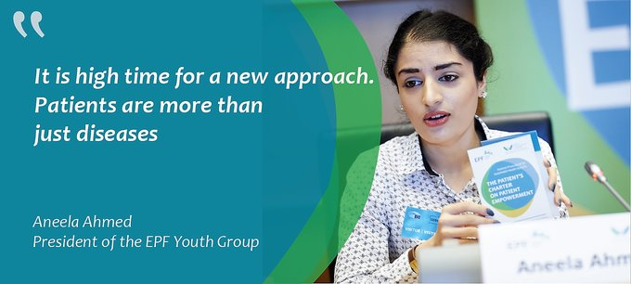
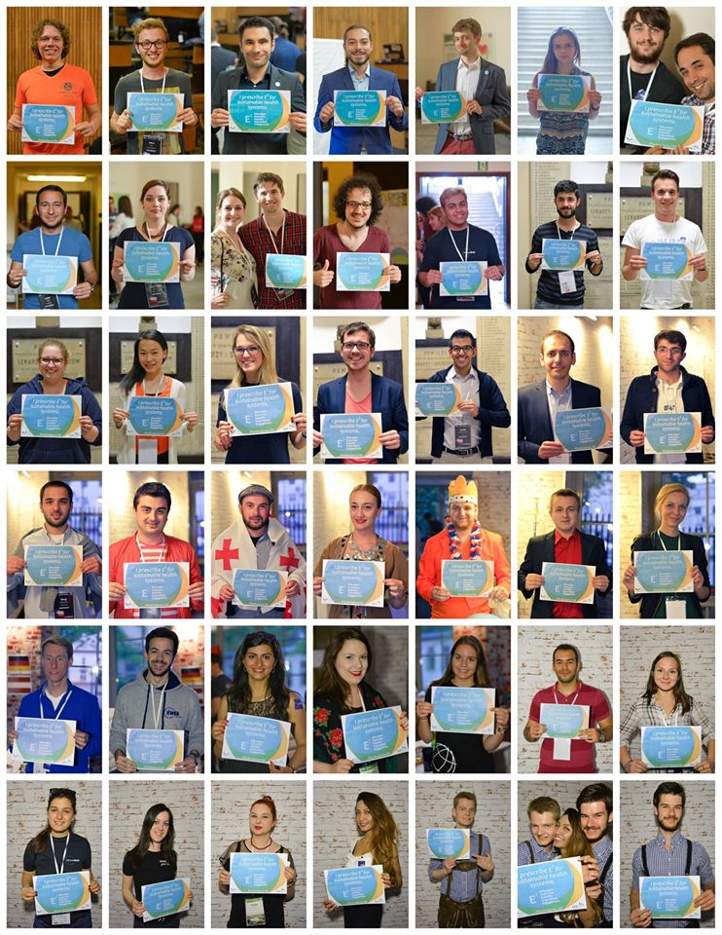
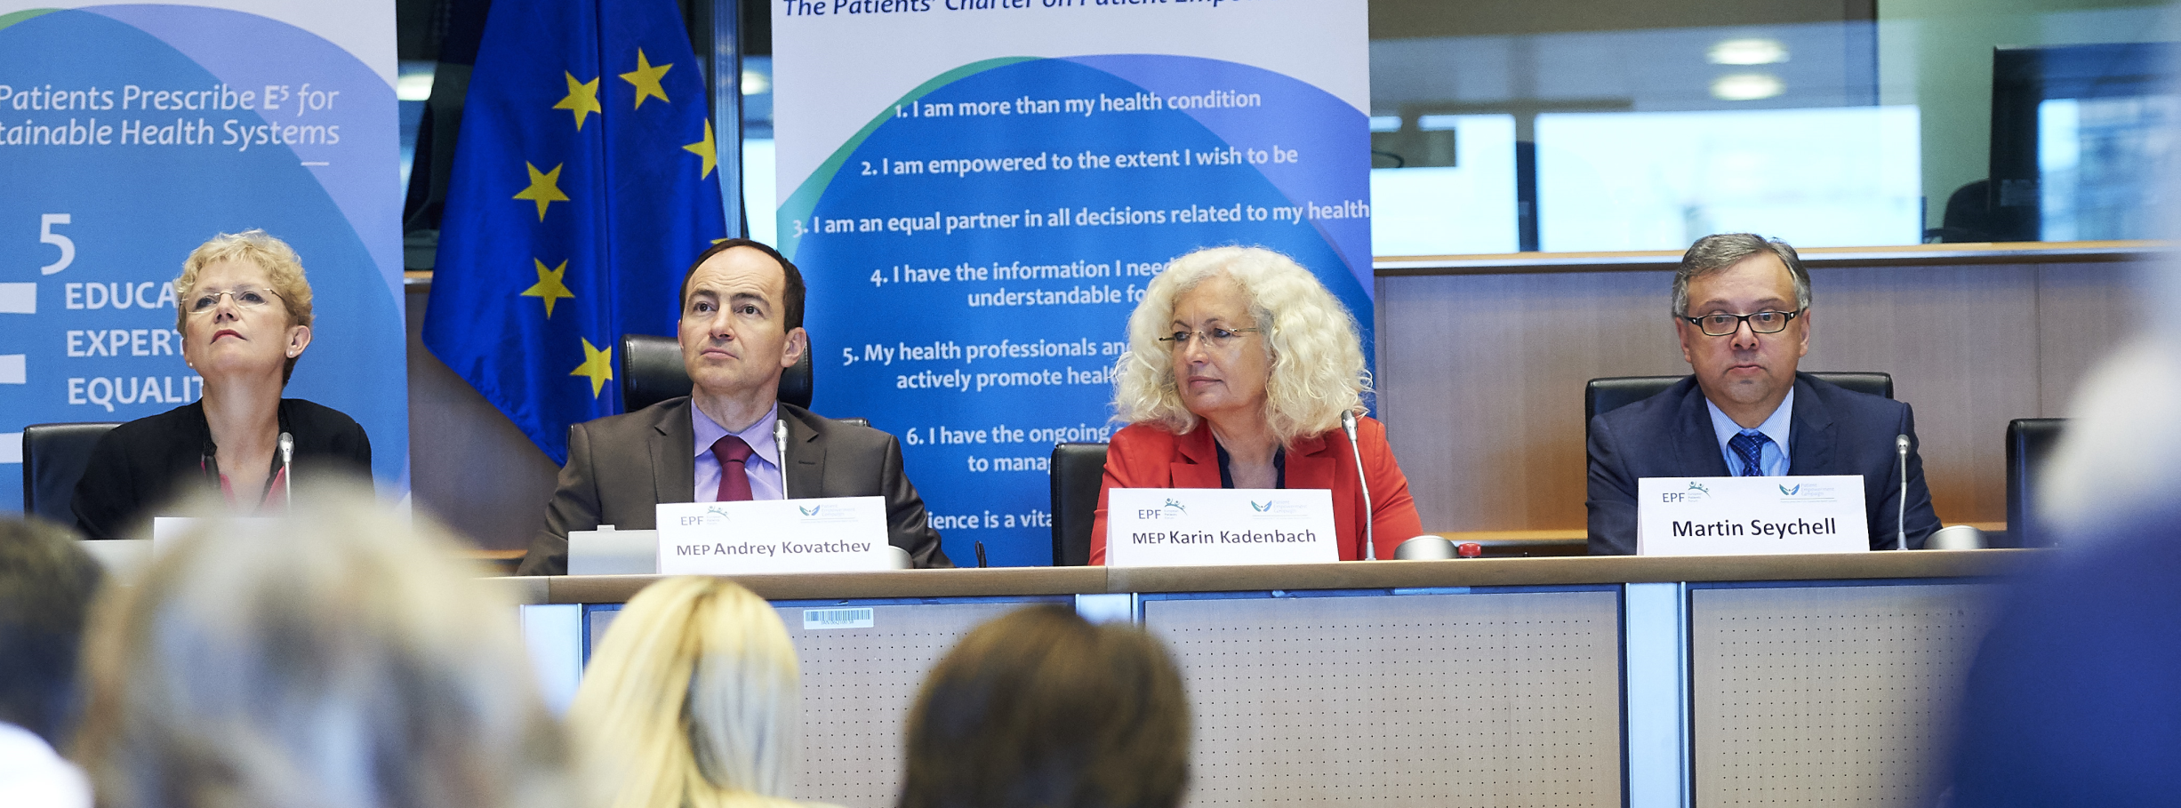
Highlight: Empowerment Campaign

Slide 10

Highlight: Clinical trials
Informed Consent Position paper
  Need guidance at EU level – core elements, quality of informed consent process
  Call for systematic patient involvement in ethics reviews
  EC should monitor ethics committees’ practice
  Patient organisations:
  Experience and expertise should be better used
  and shared
  Recognised as expertise and resourced
  Patient involvement should start much earlier
Lay summaries guidance: participation in drafting EU Guidelines
based on key messages from EPF’s position paper

Slide 11
… and the rest!
EPF Working group: Draft position on patients' rights and responsibilities
Health literacy:
  Outreach with informal coalition – STOA; personalised medicine, eHealth…
  EMA event on risk communication
  Review of “core quality criteria” (2008): survey with patients and stakeholders to understand current awareness and use (S2-2016)
Taking empowerment to patient safety:
  Briefing paper with our vision and overview of policy engagement
  Capacity-building workshop for members
  Conference “Patient & Family empowerment for Better Patient Safety”
Self-management: ongoing tender studies PISCE and PRO STEP

Slide 12

EUPATI
By the end of 2016, this unique EUPATI public private
partnership has pioneered a paradigm shift towards patient
involvement in medicines R&D:
Established a true, trustful, unpolitical partnership between
patient organisations, science and industry
Developed and delivered a Patient Expert Training Course in two cycles,
trained ~100 Patient Experts
Deployed “EUPATI Toolbox” and “EUPATI Internet Library” in 7 languages to more than 50.000 individuals
Released EUPATI material under “Creative Commons”
Established ~18 EUPATI National Platforms
(launched in AT, FR, DE, IE, IT, MT, ES, CH, UK, additionally emerging in DK, SL, SR, NL, PT, GR, under construction in BE, LUX, PO)
Developed guidance and identified best practice
Established EUPATI as quality brand for patient education

Slide 13
Highlights on Sustainable patient organisations

Slide 14









Membership
Regional Advocacy Seminars: making the link between the grass-root level, the national level and the European level, strengthening patients’ capacity
Facilitating the development of national coalitions:
  Exploratory meeting in Portugal
  Discussions in the Czech Republic
  Publication: toolkit on national coalitions
Structured dialogues with umbrella organisations: Medtech Europe, EFPIA, Medicines for Europe. Cooperation with COCIR
2015
Nordic countries
2016
BE, NL, DE

Slide 15
The EPF Capacity Building Programme (CBP)
The CBP is a long- term programme launched in 2012 to support the development of organisational capacities and advocacy skills of patient organisations, to enable them to be more effective in:
The programme consists of 2 strands:
  National pillar: national patient organisations & their members
  European pillar: Pan-European disease specific group and national coalitions from: countries where no national programme is available
  The CBP was first implemented in Hungary and Romania (2012) and 4 countries have since joined the programme: Bulgaria & Slovakia (2013), Cyprus (2014) and Poland (2016)
1. Baseline assessment
6. Evaluation workshop & planning phase ahead
3. Coaching: project & strategy development
4. Training workshop
2. Training workshop
5. Finalise projects & strategies
Notes:
The programme is delivered by local experts, except in Cyprus where EPF was directly involved.

Slide 16
2012 – 2016 CBP activities
Country | Phase I & II | Thematic training
Bulgaria | Strategic planning (2013) | Communication (2015-2016) Fundraising (2016)
Cyprus | Strategic planning (2014) Operational planning (2015) | Participates in modules for European organisations
Hungary | Strategic planning (2012) Operational planning (2013) | Fundraising (2015) Communication (2016)
Poland | Preparatory phase (spring 2016) | Strategic planning module (fall 2016)
Romania | Strategic planning (2012) Operational planning (2013) | Fundraising (2015)
Slovakia | Strategic planning (2013) | Fundraising (2015) Advocacy, campaigning & media relations (2016)
European organisations | Needs assessment (2013) | Fundraising (2014) Communication (2015) Transparency & ethics (2016) Patient safety (2016)
CBP evaluation | November 2014 – March 2015 | ongoing
Notes:
The programme is delivered by local experts, except in Cyprus where EPF was directly involved.

Slide 17
Impact and outcomes of Phase I & II
An evaluation of the programme was conducted at the end of Phase I & II and thematic training on fundraising – European members, to measure the extent to which the programme objectives were attained.
Key outputs and outcomes were identified as follows:
40 organisations (33 national and 7 pan-European patient groups) received training and successfully completed the CBP activities
Organisations developed strategic, operational and fundraising plans, most of them for the first time: activities provided organisations with the skills and tools to develop plans in the future
Activities helped organisations to re-think approaches to work: the activities provided the organisations with an opportunity to re-think their activities, assess the needs of the organisation and set priorities
Notes:
Examples per country:
In Romania one representative noted that, following the operational planning process, they felt more ‘courageous’ and applied to more funding opportunities.
In Hungary, it was noted that the plans are an important tool for applying for funding and approaching new donors.
In Cyprus, the plans have contributed to strengthen dialogue with key institutions, such as the Ministry of Health and the Parliament, on the on-going reforms in the health sector. During the evaluation of Phase I, organisations in Romania also noted that policy makers and other health stakeholders really appreciate the effort Romanian patient organisations are making to become more professional through the EPF CBP and are gaining more recognition as equal partners in healthcare.
In Hungary, following the fundraising module, some organisations have expressed an interest in participating in each others’ activities. Participants also feel that they now have a network of colleagues they can contact when they have problems.
17

Slide 18
Impact and outcomes of phase I & II
The plans developed increased credibility vis-à-vis external stakeholders, such as donors and policy-makers: the strategic & operational plans show that organisations know what they want to do and how
The planning process increased collaboration and involvement of members into the work of the organisations
The training strengthened collaboration between organisations: the activities encourage the exchange of experiences and practices, and helped generating synergies between organisations’ work
Increased understanding of patient organisations needs has led some of the trainers to identify opportunities for future work and to continue to work with the organisations outside the CBP framework
The evaluation summary of findings can be found here:
http://www.eu-patient.eu/globalassets/who-we-are/transparency/cbp_evaluation_summary-of-findings_2015.pdf
Notes:
Examples per country:
In Romania one representative noted that, following the operational planning process, they felt more ‘courageous’ and applied to more funding opportunities.
In Hungary, it was noted that the plans are an important tool for applying for funding and approaching new donors.
In Cyprus, the plans have contributed to strengthen dialogue with key institutions, such as the Ministry of Health and the Parliament, on the on-going reforms in the health sector. During the evaluation of Phase I, organisations in Romania also noted that policy makers and other health stakeholders really appreciate the effort Romanian patient organisations are making to become more professional through the EPF CBP and are gaining more recognition as equal partners in healthcare.
In Hungary, following the fundraising module, some organisations have expressed an interest in participating in each others’ activities. Participants also feel that they now have a network of colleagues they can contact when they have problems.
18

