Slide 1
Access to medicines: can differential pricing be an answer?
Jo DE COCK, CEO NIHDI
European Parliament

Slide 2
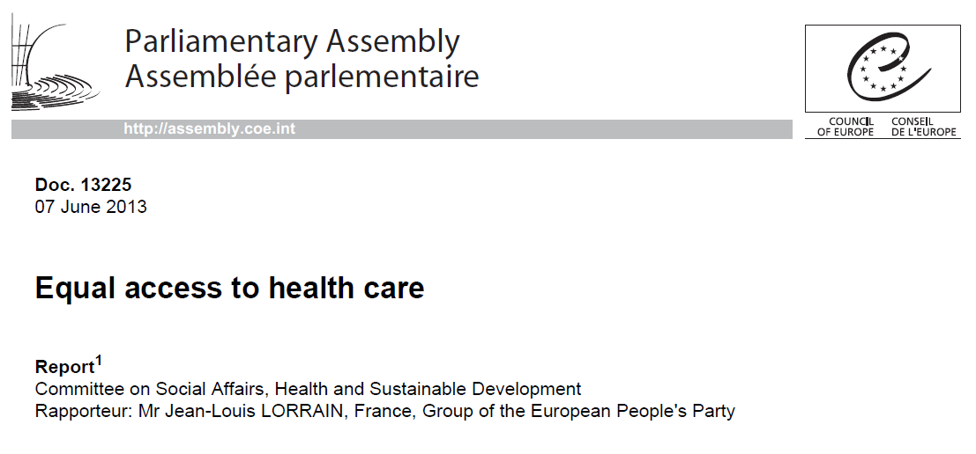



Access to medicines: a major concern

Slide 3
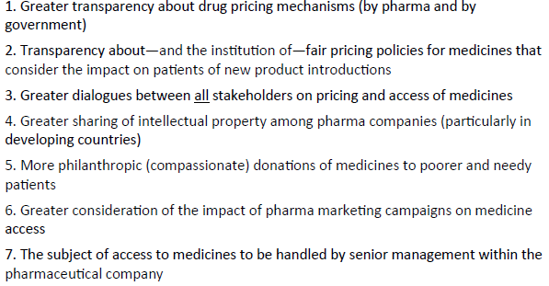
Access to medicines: a major concern
How to obtain greater access to medicines in recession-hit and poorer countries
Bron: PatientView, 2013

Slide 4

BELGIAN PRESIDENCY 2010

Slide 5
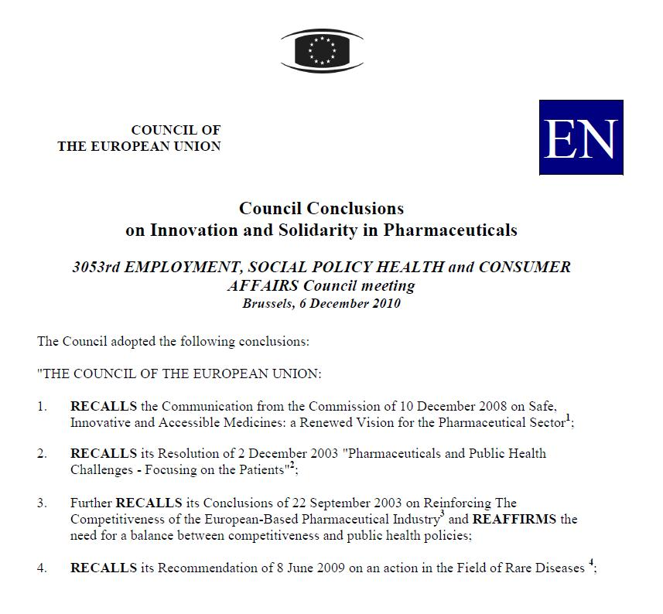
Council conclusions on innovation and solidarity in pharmaceuitcals

Slide 6
Council conclusions 6.12.2010 (nr.24)
Examine, based on the principles of solidarity, economically viable and efficient approaches to facilitate availability and access to valuable innovative medicinal products throughout the EU, while respecting the principle of subsidiarity and the competencies of Member States, e.g. on affordability and sustainability of health systems.

Slide 7
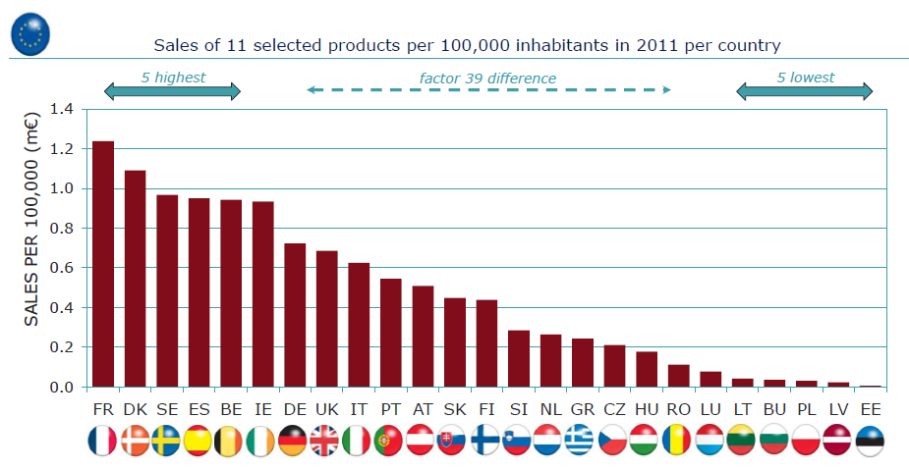
Analysis of 2011 sales for 11 valuable medicines launched in the EU in the period 2005- 2007

Slide 8
A QUESTION OF SOLIDARITY
The sense of fairness and equity between Member States is being eroded. And without equity between Member States, how can there be equity between European citizens
  State of the union, 11 sept 2012, by Jose Manuel Barroso, President of the European Commission

Slide 9
CROSS-COUNTRY: EUROPEAN INITIATIVES
CAVOD – Clinical Added Value of Orphan Drugs
  Information needed to make (informed) decisions
  Approaches to understand what that information means

Slide 10
CROSS-COUNTRY: EUROPEAN INITIATIVES
2. MOCA – Mechanism of Coordinated Access to Orphan Drugs
  Way to understand and make value judgments at time of pricing & reimbursement
  Project managed by Belgium (NIHDI)
  Final report published I/2013

Slide 11
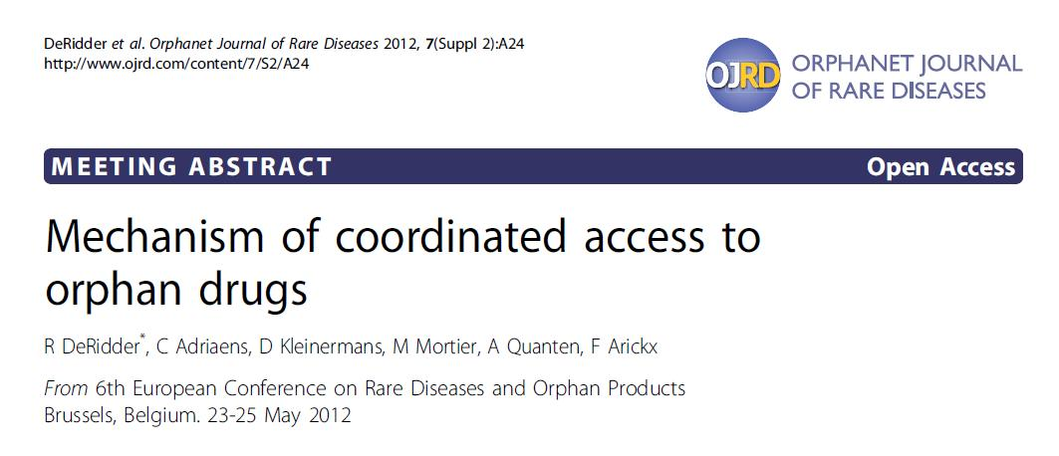
MOCA

Slide 12
MOCA
Consensus on added value of cooperation between member states and stakeholders, supported by European Commission
Launching of a pilot to identify eligible drugs and initial common steps in assessment and appraisal.

Slide 13
MOCA
Development of transparent value framework adding the societal value to the scientific evaluations.
Willingness to further discuss pricing and financial issues (e.g. differential pricing …)

Slide 14
Differential Pricing
Differential pricing implies that the manufacturer establishes a higher price for the drug in a richer country and agrees upon a lower drug price in a country where consumer demand is more responsive to price changes (Ramsey pricing – see WHO).

Slide 15
Differential Pricing
The basic objective of price differentiation is to improve equality of access to innovative pharmaceuticals for unmet medical needs across Europe.

Slide 16
Differential Pricing
Companies in turn achieve a reasonable ROI and a higher volume as compared to today.

Slide 17
REFLECTION ON DIFFERENTIAL PRICING
Scope: unmet medical needs
Problem statement:
  Equal prices in all countries imply unequal access
Differential pricing:
  Price reflects ability/willingness to pay of a country

Slide 18
CODE OF CONDUCT – SOFT LAW APPROACH FOR ACCESS TO INNOVATIVE DRUGS
VOLUNTARY BASIS, protocol agreement between INDUSTRY and MEMBER STATES

Slide 19
CODE OF CONDUCT – SOFT LAW APPROACH FOR ACCESS TO INNOVATIVE DRUGS
SCOPE for the application of the principle : “VALUABLE MEDICINES”
  High added value
  Unmet medical need
  Market Authorization granted

Slide 20
CODE OF CONDUCT – SOFT LAW APPROACH FOR ACCESS TO INNOVATIVE DRUGS
“LIKE FOR LIKE” Principle
  PRICING
    Transparent Ex factory price
    Acceptable Return On Investment
    Confidentiality of net prices
    Price differentiation (no IRP nor ERP)

Slide 21
CODE OF CONDUCT – SOFT LAW APPROACH FOR ACCESS TO INNOVATIVE DRUGS
  WEIGHING
    Clustering of countries with similar GDP, average income per capita
    No linking to % spent on healthcare
    Prevalence
    Elasticity of the demand
    Willingness to pay (incremental and marginal value)

Slide 22
CODE OF CONDUCT – SOFT LAW APPROACH FOR ACCESS TO INNOVATIVE DRUGS
Transparency of timelines : EUROPEAN MARKET ENTRY PLAN (max. 2 years from MA)
CURRENCY STABILITY : prices in EURO - 24 months fixed exchange rates
EXTERNAL VERIFICATION BODY : independent Third Party

Slide 23
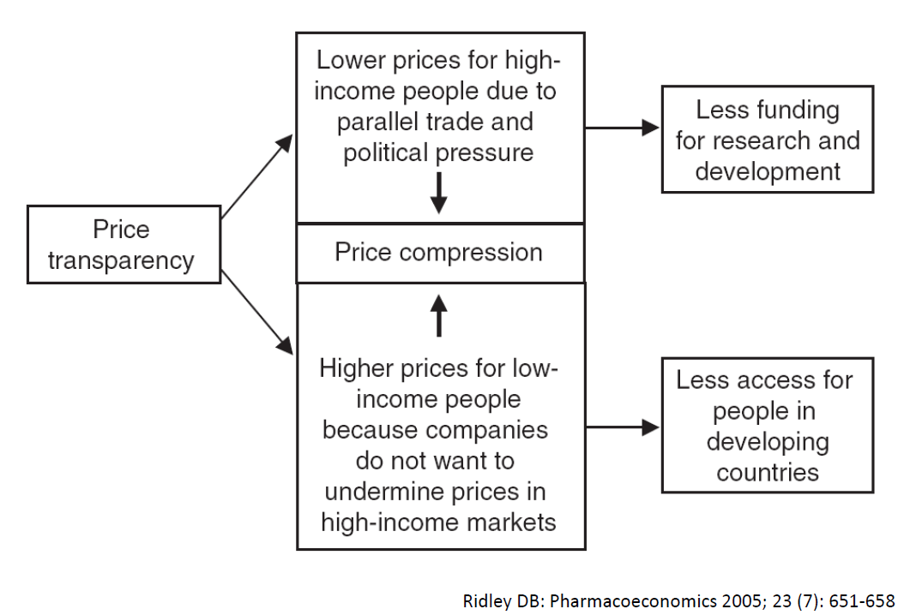
External reference pricing: impact

Slide 24
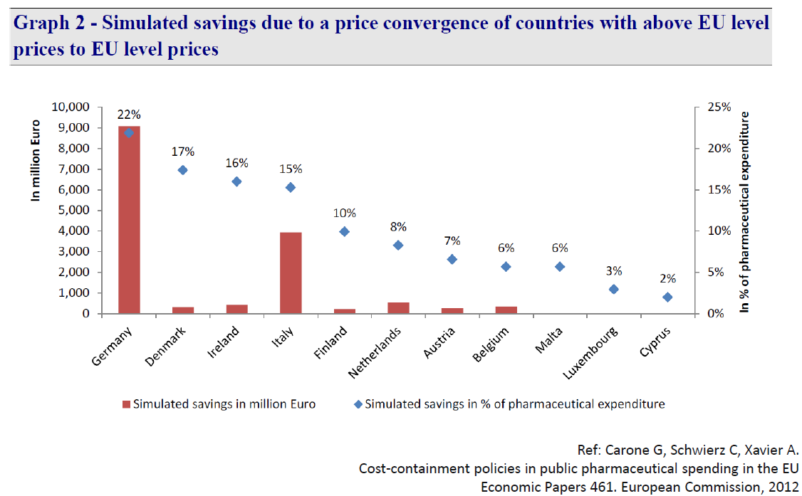
External reference pricing: impact

Slide 25
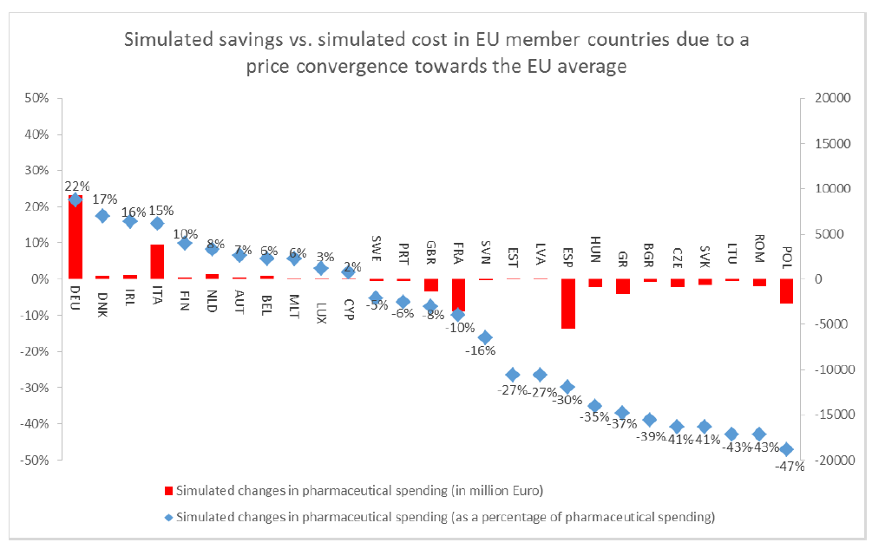
External reference pricing: impact

Slide 26
External reference pricing (ERP)
ERP is not compatible with differential pricing
  Prices determined ifo prices in other countries rather than ability/willingness to pay of a country

Slide 27
External reference pricing (ERP)
Participating countries need to agree not to implement ERP as a method of setting prices or to limit ERP to other member states of cluster

Slide 28
Parallel trade
Would lead to unwillingness of companies to step into the process, as ROI seriously reduced by parallel trade
Introduction of possibility for public health exceptions for parallel trade

Slide 29
Transparent market entry plan
Commitment of participating countries to apply differential pricing principles
Commitment of companies to launch medicines within 2 years of market access approval

Slide 30
THANK YOU!

