Slide 1
‘‘Patients at the Centre of Patient Safety ’’
EPF workshop on patient safety
21 November 2013, Brussels
Kaisa Immonen-Charalambous

Slide 2
Overview
What is patient safety?
Overview of the EU legislative framework and opportunities for patients’ involvement
The patients’ role in patient safety
Part III: EPF member survey on the Council Recommendation on patient safety
Conclusions & key messages

Slide 3
What is Patient Safety?
“The absence of preventable harm to a patient during the process of health care. (WHO)
In simple terms: “When things go right, nothing bad happens.” (NHS Scotland)
(process or discipline of patient safety): “the coordinated efforts to prevent harm, caused by the process of health care itself, from occurring to patients” (WHO)
“Patient safety incident”: any healthcare-related event that was unintended, unexpected and undesired and which could have or did cause harm to patients. (Incl. adverse events, near misses)

Slide 4
Some terminology (ii)
“Harm”: a patient’s health or quality of life is negatively affected by any aspect of their interaction with health care.
Some incidents of harm are preventable, while others are recognised as complications of care.
Examples:
  allergic reaction to a medication
  incision made in the wrong place on a patient scheduled for surgery
Severity and impact of unintentional harm can range from a brief inconvenience to a prolonged hospitalisation, disabling injury or even death.
Source: NHS Scotland, http://www.evidenceintopractice.scot.nhs.uk/patient-safety/what-is-patient-safety.aspx

Slide 5
Some terminology (iii)
Errors vs violations:
Error = unintentional action
  Example of incorrectly executed plans as a result of attention failure: an anaesthesist wants to adjust the airflow to a patient but turns the wrong dial.
  Example of a plan that is not executed: a GP forgets to issue her promised prescription for a patient after finishing her other home visits.
  Example of the wrong plan: initial misdiagnosis and wrong treatment.
Violation = deliberate action, including negligence , medical malpractice.
  Example: deliberately inadequate record-keeping because you are “too busy”
  Deviation from accepted standards of practice (by action or omission)
Source: NHS Scotland, http://www.evidenceintopractice.scot.nhs.uk/patient-safety/what-is-patient-safety.aspx

Slide 6
System vs individual?
The “Swiss cheese model”
Serious patient safety incidents are usually caused by multiple systems failures
- only rarely by frontline hcp errors
But hcp must be vigilant for even seemingly unimportant errors
Any incident even “trivial” can be learned from
Patient safety needs a system approach – building patient safety culture in organisations, no-blame no-shame reporting and learning systems
Source: NHS Scotland, http://www.evidenceintopractice.scot.nhs.uk/patient-safety/what-is-patient-safety.aspx

Slide 7
Why is Patient Safety important
WHO estimates:
“As many as 1 in 10 patients is harmed” while receiving hospital care in developed countries
“At any given time, 1.4 million people worldwide suffer from infections acquired in hospitals.” “Ten facts about patient safety”, at www.who.int
Medical errors and health-care related adverse events occur in between 8-12% of EU hospitalizations (Conklin, A. Room for improvement; Strong patient safety systems could limit health, social and economic harms from medical error. RAND Europe, 2009 http://www.rand.org/content/dam/rand/pubs/research_briefs/2009/RAND_RB9472.pdf)
EU citizens’ perceptions of healthcare:
50% think there is a risk of patients being harmed by hospital care and 36% in primary care. (Special Eurobarometer 327, Patient safety and quality of healthcare, April 2010. European Commission, http://ec.europa.eu/public_opinion/archives/ebs/ebs_327_en.pdf )

Slide 8


EPF involvement in Patient Safety
EC Patient Safety & Quality Working Group
  EC Communication (2008) and
  Council Recommendation (2009)
  Reflection paper on quality
Advocacy: EU legislation
  Directive on patients’ rights in cross-border healthcare
  Pharmacovigilance
  Falsified medicines
EU Projects on patient safety
  EUNetPas (2008-2011)
  Joint Action PaSQ (2012-2015)
Building partnerships and collaboration with WHO, health professionals, other stakeholders

Slide 9
EU legislative framework in patient safety
Health: EU has limited competence – Article 168 TFEU
  Responsibility for organisation of health systems and delivery of healthcare is with the Member States
  Principles of subsidiarity & proportionality
  Union action shall complement national policies
  → “Soft law” & collaboration for exchange of best practices
Binding legislation (Reg & Dir) to harmonise MS laws in some areas of exception, e.g. safety of medicines and devices, cross-border healthcare:
  Article 168(4)(c) TFEU – “measures setting high standards of quality and safety for medicinal products and devices for medical use”
  Article 114 TFEU – internal market

Slide 10
Council Recommendation (2009)
“
2. Empower and inform citizens and patients by:
(a) involving patient organisations and representatives in the development of policies and programmes on patient safety at all appropriate levels;
(b) disseminating information to patients on:
(i) patient safety standards which are in place;
(ii) risk, safety measures which are in place to reduce or prevent errors and harm, including best practices, and the right to informed consent to treatment, to facilitate patient choice and decision-making;
(iii) complaints procedures and available remedies and redress and the terms and conditions applicable;
(c) considering the possibilities of development of core competencies in patient safety namely, the core knowledge, attitudes and skills required to achieve safer care, for patients.
”

Slide 11

Joint Action PaSQ (2012-2015)
Following EUNetPas project (2008-2011)
Developing permanent collaboration between EU Member States and stakeholders in the field of quality of care, incl. patient safety:
  support MS in implementing the Council Recommendation
  enhanced cooperation between MS in the field of quality
  sharing of good practices in patient empowerment and involvement
EPF is involved as Associate Partner in all core WPs
Looking at good organisational practices (GOP) and good clinical practices (SCP) involving patients
www.pasq.eu

Slide 12
EU Pharmacovigilance legislation
Directive 2010/84 and Regulation 1235/2010
  Rules apply from: 2/12 July 2012
  NEW: 2 patient representatives in EMA PRAC (Pharmacovigilance Risk Assessment Committee)
  Marco Greco / EPF, Albert van der Zejden / IAPO
  NEW: direct patient reporting of ADRs in all EU MS – web + other forms
  EPF 2012 toolkit on pharmacovigilance: guidance and recommendations
    Feedback indicates: not much patient engagement, and low awareness
    Potential for strengthening patients’ involvement & trust

Slide 13
Directive on Cross-Border Healthcare
Directive 2011/24/EU requires Member States to:
  Make publicly available their safety and quality standards & guidelines;
  cooperate with each other on improving safety and quality standards;
  ensure information on health professionals’ right to practise is given to other Member States
National Contact Points must provide patients all relevant info “to enable them to make an informed choice”
EU legal basis for future actions in: safety & quality, eHealth, HTA, European Reference Networks → closer cooperation between Member States, more transparency, more patient involvement.

Slide 14
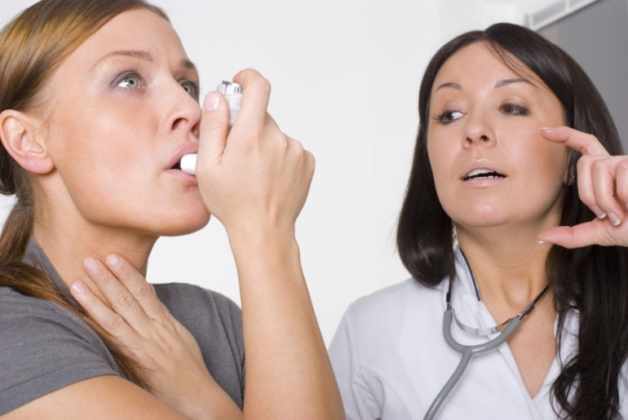
The changing role of patients
Patients moving from passive recipients of healthcare to active, involved & politicised actors
Patient-centredness is a key operating principle of EU health systems
But big gap between theory and practice …
EPF: involvement of patients in patient safety needed both at individual and collective levels

Slide 15
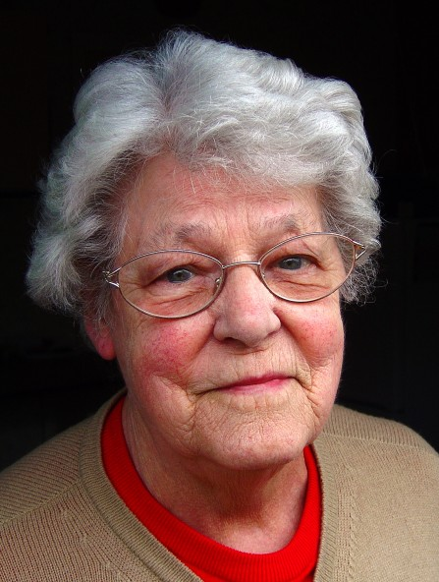
“Patient safety – everyone’s business”
1. Individual level:
Individual patient’s experience of his/her healthcare “journey”
Rich resource of information about gaps and failures in the system
Patients can contribute themselves – by getting actively involved in their treatment
Important to support and empower:
  Information to patients
  Health literacy
  Communication with health professionals
  Professionals' attitudes
  Patient-friendly healthcare environment

Slide 16
“Patient safety – everyone’s business”
Important caveats:
Respect patients’ willingness to get involved – or not
Do not over-estimate patients’ capacity to get involved
Patients in vulnerable situation – no shifting of burden of “responsibility” on them
Patients already observe much – healthcare staff need to listen more, take their views seriously
Appropriate support and enabling environment is key

Slide 17
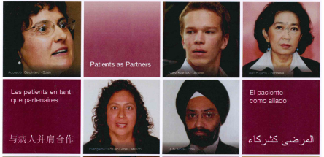
“Patient safety – everyone’s business”
2. Collective level:
Patient organisations – role in informing & educating patients and health professionals
Effective advocacy through access to the community
WHO Patients for Patient Safety programme
Involvement in co-designing healthcare services to make them more patient-centred & meet real-life needs and preferences of patients
  Important to involve patient organisations at policy level
  International, EU and Member States

Slide 18
EPF survey on Council Recommendation
Autumn 2012 - 2013
Exploring perceptions and knowledge of EPF member organisations
Focus on awareness of EU recommendations, patient organisations’ involvement at MS level, assessing priorities
Ongoing online survey
Work in progress: interim results!

Slide 19
Survey status (November 2013)
Responses received: | Responses not received:
Belgium | Austria
Bulgaria (2) | Denmark
Czech Republic | Germany
Cyprus | Lithuania
Estonia | Luxembourg
France | Malta
Greece | Portugal
Hungary | Finland
Ireland
Italy
Latvia
Netherlands
Poland (2)
Romania
Slovenia
Slovakia
Spain (2)
Sweden
United Kingdom
International organisations (2)
European based organisations (2)

Slide 20
Awareness of the CR
Did you know about the Council Recommendation before this survey?
Yes | 53,8% | (14)
No | 46,2% | (12)
answered question |  | 26

Slide 21
Awareness (2)
If yes, how did you find out about the Council Recommendation?
from the news | 6,3% | 1
from the European Patients’ Forum | 75,0% | 12
from an information campaign dedicated to the Council Recommendation developed in my country | 0,0% | 0
information from the organization I represent | 18,8% | 3
Other (please specify) | 18,8% | 3
answered question |  | 16

Slide 22
Implementation
Which aspects of the Council Recommendation are in place in your country, as far as you know? (25 answers)
Answer Options | Yes | No | I do not know
national/regional policy/programme on patient safety | 15 | 5 | 5
designation of a national authority or body responsible for patient safety | 15 | 3 | 7
patient safety as a priority issue in health policies | 12 | 8 | 5
development of safer systems, processes and tools | 12 | 3 | 10
regular update of patient safety standards | 8 | 7 | 10
involving health professional organisations in patient safety | 13 | 5 | 7
promotion of safe practices | 14 | 5 | 6
empowering and informing citizens and patients | 7 | 9 | 9
creation of blame-free reporting and learning systems on harmful events | 7 | 9 | 8
education and training of health care workers on patient safety | 11 | 6 | 7
working with European Commission and other member states to measure patient safety | 7 | 2 | 15
working with European Commission and other member states sharing knowledge and best practices | 6 | 2 | 16
national research initiatives on patient safety | 5 | 6 | 13

Slide 23
Patient organisation involvement

Slide 24
Information
The 3 main sources of information about patient safety available in your country:
Mentioned as a source
Not mentioned as source

Slide 25
Information (2)

Slide 26
Priorities
In your opinion which 3 actions out of 13 from the Council Recommendation are the most important?
national/regional policy/programme on patient safety | 12 | 3 | 2 | 70.58%
patient safety as a priority issue in health policies | 10 | 3 | 5 | 55.55%
empowering and informing citizens and patients | 12 | 6 | 1 | 63.15%

Slide 27
Key competences for patients
    “Information, guidance, empowerment, health literacy”
    “Knowledge about patients rights and conviction about their enforceability”
    “Better communication about p. safety to patients via all media forms”
    “More information in the hospitals, in primary care”
    “Information on patient safety and the possibility to report on side effects”
    “Understandable information and control body/mechanisms”
    “Education, seminars”
    “A genuine partnership with patient input made from the start”

Slide 28
Key competences for patients

Slide 29
Requests from EPF members

Slide 30
EPF survey shows:
46% of respondents are unaware of the CR…
… but many respondents had some role in developing patient safety information or participating in consultations
Patient involvement poorly implemented
EPF by far the most common source of information (75%) followed by patient organisation at national level (18.8%)
Patient organisations = important source of capacity-building for patients
56% recommend involving patients and citizens more in promoting patient safety in their country

Slide 31
Conclusions & key messages
New EU legislation and initiatives = a need and an opportunity to increase patients’ engagement with PS and patients’ collective involvement at policy level
Foster PI and patient-health professional collaboration → cultural shift towards more patient-centred health systems, public trust
More research needed to define best practices in patient involvement in PS
Need to activate EPF membership & create awareness of this priority area
Need to formulate a strategy for EPF – objectives & priority actions
Integrated approach: policy, projects, membership & communications

Slide 33
Patient/public empowerment
“
A multi-dimensional process that helps people gain control over their own lives and increases the capacity of people to act on issues that they themselves define as important.
(Luttrell et al. (2009), Understanding and operationalising empowerment. Overseas Development Institute working paper.)
A process through which individuals and social groups are able to express their needs, present their concerns, devise strategies for involvement in decision-making, and take political, social, and cultural action to meet those needs.
(Deepening our Understanding of Quality improvement in Europe; http://www.duque.eu/)
Elements: Information – Informed consent – feedback loop – enabling and supportive healthcare environment – health professional’s training
”
“
”

Slide 34
Patient/public involvement
“
The extent to which patients and their families or caregivers, whenever appropriate, participate in decisions related to their condition (e.g. through shared decision-making, self-management) and contribute to organisational learning through their specific experience as patients (e.g. patient reporting of adverse events or participation in root cause analysis related to their care).
Collective patient/public involvement is the extent to which patients and citizens, through their representative organisations, contribute to shaping the health care system through involvement in health care policy-making, organisation and delivery.
(European Patients Forum for PaSQ, adapted from the Value+ project: http://www.eu-patient.eu/Initatives-Policy/Projects/EPF-led-EU-Projects/ValuePlus/
Levels: Consultation → Collaboration → User-Led
”

