Slide 1

EPF Annual General Meeting
19 May 2010
A STRONG PATIENTS’ VOICE TO DRIVE BETTER HEALTH IN EUROPE

Slide 2
HIGHLIGHTS
WORK PLAN 2010

Slide 3
Strategic Plan
VISION – high quality patient-centred healthcare throughout the EU
MISSION – to present a strong and united patients’ voice
5 GOALS
  Equal Access
  Patient Involvement
  Patients’ perspective
  Sustainble patient organisations
  Patient Unity

Slide 4
Work Plan 2010
Building Capacity within the governance structures, the secretariat, and through reinforcing and extending the membership, and diversifying/ solidifying funding (GOAL 1-5)
Strengthening Our Policy Impact (GOAL 1-3)
Developing Project and Patients’ Evidence and Expertise to feed into policy (GOAL 1-3)
Building Powerful and Effective Communications and Partnerships (GOAL 1-5)

Slide 5
Meeting Europe’s Patients
The EPF Annual General Meeting and Health Technology Assessment Seminar, May 2010
EPF Joint Meeting with the European Generics Medicines Association, September
EPF European Parliament event, September 2010 – direct patient reporting
EPF Regional Advocacy Seminar, Hungary, October 2010
EPF event on quality and safety under the patronage of the EU Belgian Presidency, December 2010

Slide 6
Governance and finance
Board meetings x 4
Officers’ meetings x 6
Policy Advisory Group x 3
42 – 45 members
Patients’ Manifesto
Diversifying funding – Operational Grant Proposal, Foundation ?, new projects, new industry partners

Slide 7
Policy Impact
Promotion of patients’ rights
Involvement of patients in all areas of EU policy, programmes and projects with an impact on health
Promoting equity of access, addressing health inequalities and the sustainability of equitable healthcare systems from the patients’ perspective

Slide 8
Specifics
Cross Border Healthcare,
Patient Safety and Quality of Care,
Health Literacy, ICT and Health (e-health),
Pharmaceutical Package (Counterfeiting, Pharmacovigilance, and Information to Patients)
Health Inequalities, particularly in relation to the use of EU structural funds.
Health Technology Assessment, Medical Devices, Clinical trials will continue throughout 2010.

Slide 9
Influence
EU Presidencies
(Spain, Belgium, Hungary, Poland)
Commission
(new Commission, new players – SANCO and other DGs)
European Parliament
European Medicines Agency
European Union Health Policy Forum
Other think tanks and agencies

Slide 10
Building evidence
Value + : patient involvement
EUNETPAS: safety
RESPECT: young patients
CALLIOPE: interoperability
INTERQUALITY: quality
Renewing Health: telemedicine pilot
STRUCTURAL FUNDS: patient involvement
Chain of Trust: eHealth

Slide 11

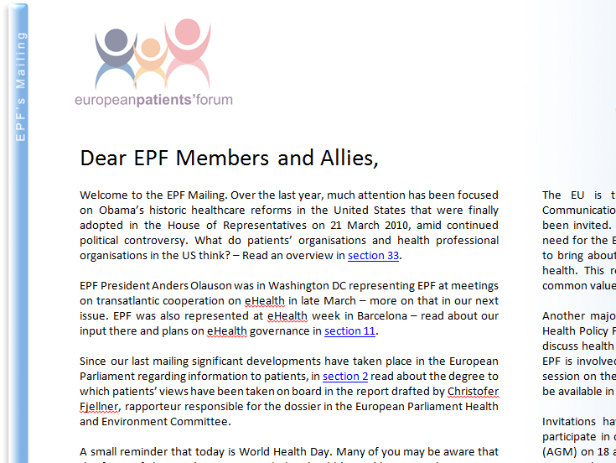


Powerful Communications
New website
Revamped EPF Mailing
Prudent social media strategy
Partnerships – Health Professionals, Industry Federations, Insurers, Consumers etc

Slide 12
Evaluation
e.g Strategic Goal 5
Performance Indicator: The perceived success and impact of the Autumn Regional Advocacy Meeting taking place in Budapest, Hungary.
Target: Participation by 50 patients’ leaders from the region in subsequent EPF work on EU health policy issues.

Slide 13
Conclusions
Ambitious goals for 2010
Increasing external demands.........
.....And increasing proactive work
Need to be as efficient and as effective as possible
Testing our foundations and building on achievements

