Slide 1
Culture Change and Leadership Marc M. Boutin, JD
November 13, 2019

Slide 3
Access & Affordability Challenges
Utilization Management
High Deductibles
Co-pays
Co-insurance
Formulary Placement
Step Therapy
Prior Authorization

Slide 4
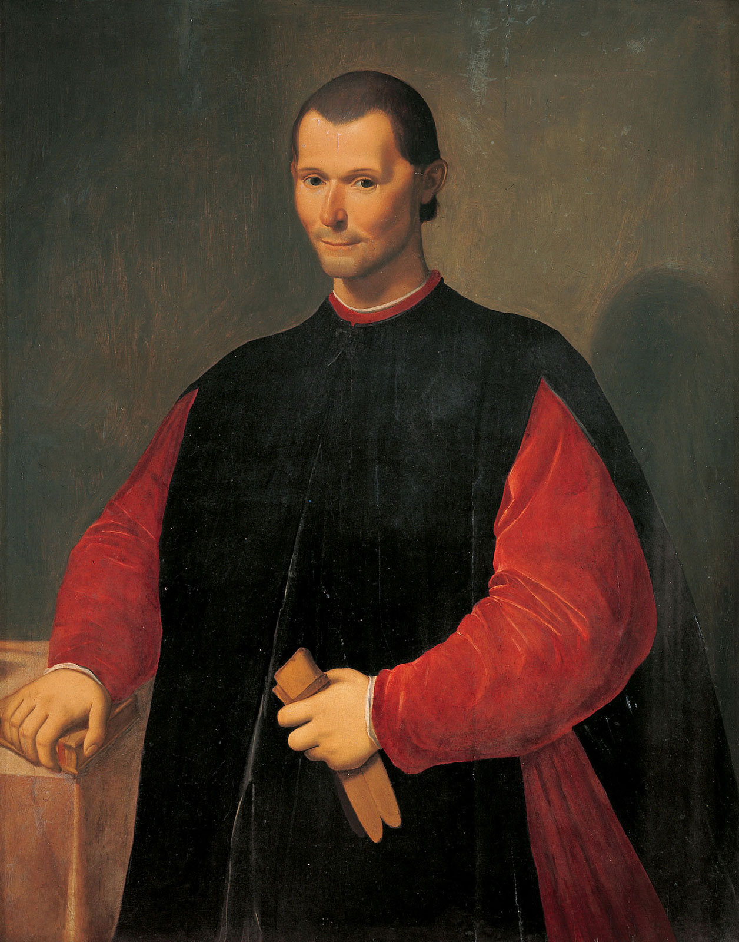
Culture Change
“For the reformer has enemies in all those who profit by the old order, and only lukewarm defenders in all those who would profit by the new order.”
- Machiavelli

Slide 5
Trend: Chronic Conditions

Slide 6
Trend: Science

Slide 7
Trend: Data

Slide 8
Personalized Health
Fusion of Data & Behavioral Science

Slide 9
Culture Change
INSPIRATION
INFORMATION
INTIMIDATION
Persuasion
Storytelling
Role modeling
Incentives
Measurement systems
Operating procedures
Threats
Punishments
Coercion
https://www.forbes.com/sites/stevedenning/2011/07/23/how-do-you-change-an-organizational-culture/#4ac8922639dc

Slide 11
Living Your Best Life Possible

Slide 12
Thank you!
Marc M. Boutin, JD
Chief Executive Officer
www.nationalhealthcouncil.org

