Slide 1


Slide 2
Why patient involvement
Sara Riggare, doctoral student living with Parkinson’s disease Karolinska Institutet, Stockholm, Sweden
12/11/2019
#EPFCongress19

Slide 3

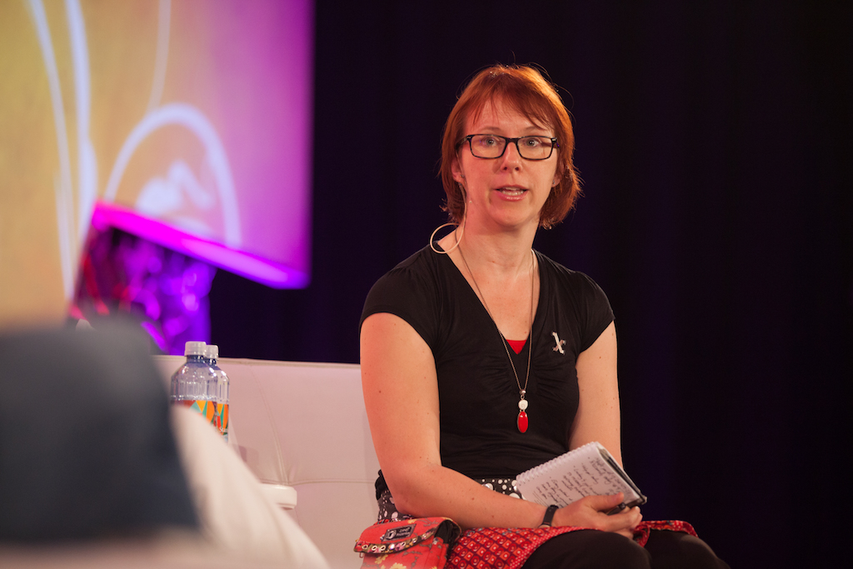
My journey from scared and insecure patient to proud Patient Activist and Patient Researcher
Notes:
My life has been a journey since a very young age and today I want to tell you about my patient journey: From a scared and insecure patient to the proud Lead User Patient that I am today.

Slide 4
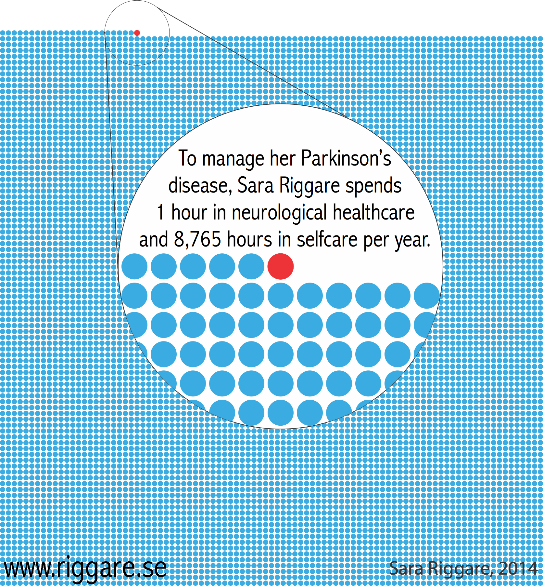

Slide 5
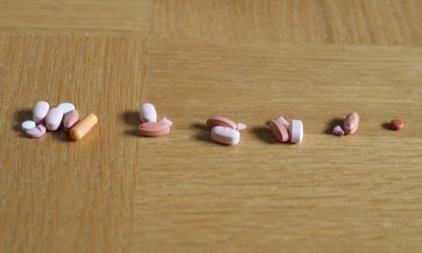

Slide 6
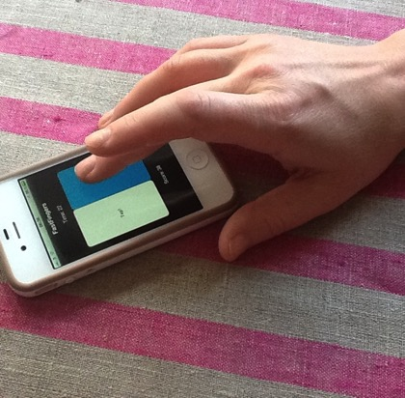

Slide 7
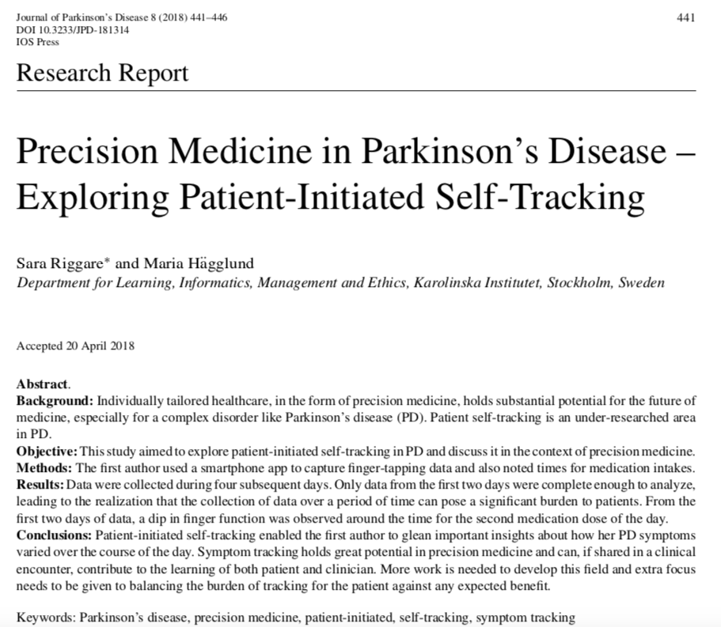
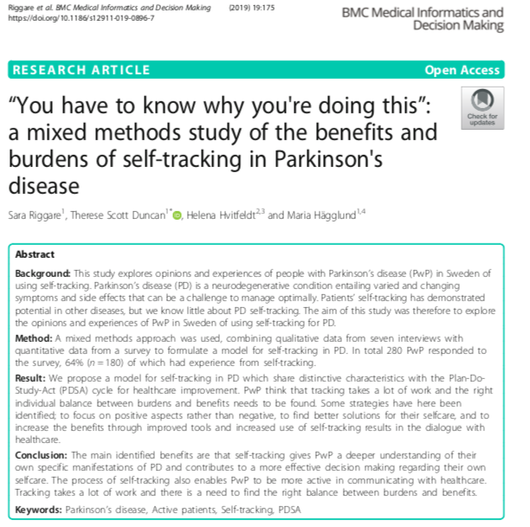

Slide 8
Adapted from: S. A. Schroeder, “We Can Do Better - Improving the Health of the American People,” N. Engl. J. Med., vol. 357, no. 12, pp. 1221–1228, 2007.
Individual circumstances (genetics, social, environment) 50%
Health
Behavioural patterns (selfcare) 40%
Healthcare 10%
Research
Notes:
Sara: Som ni säkert känner till så

Slide 9
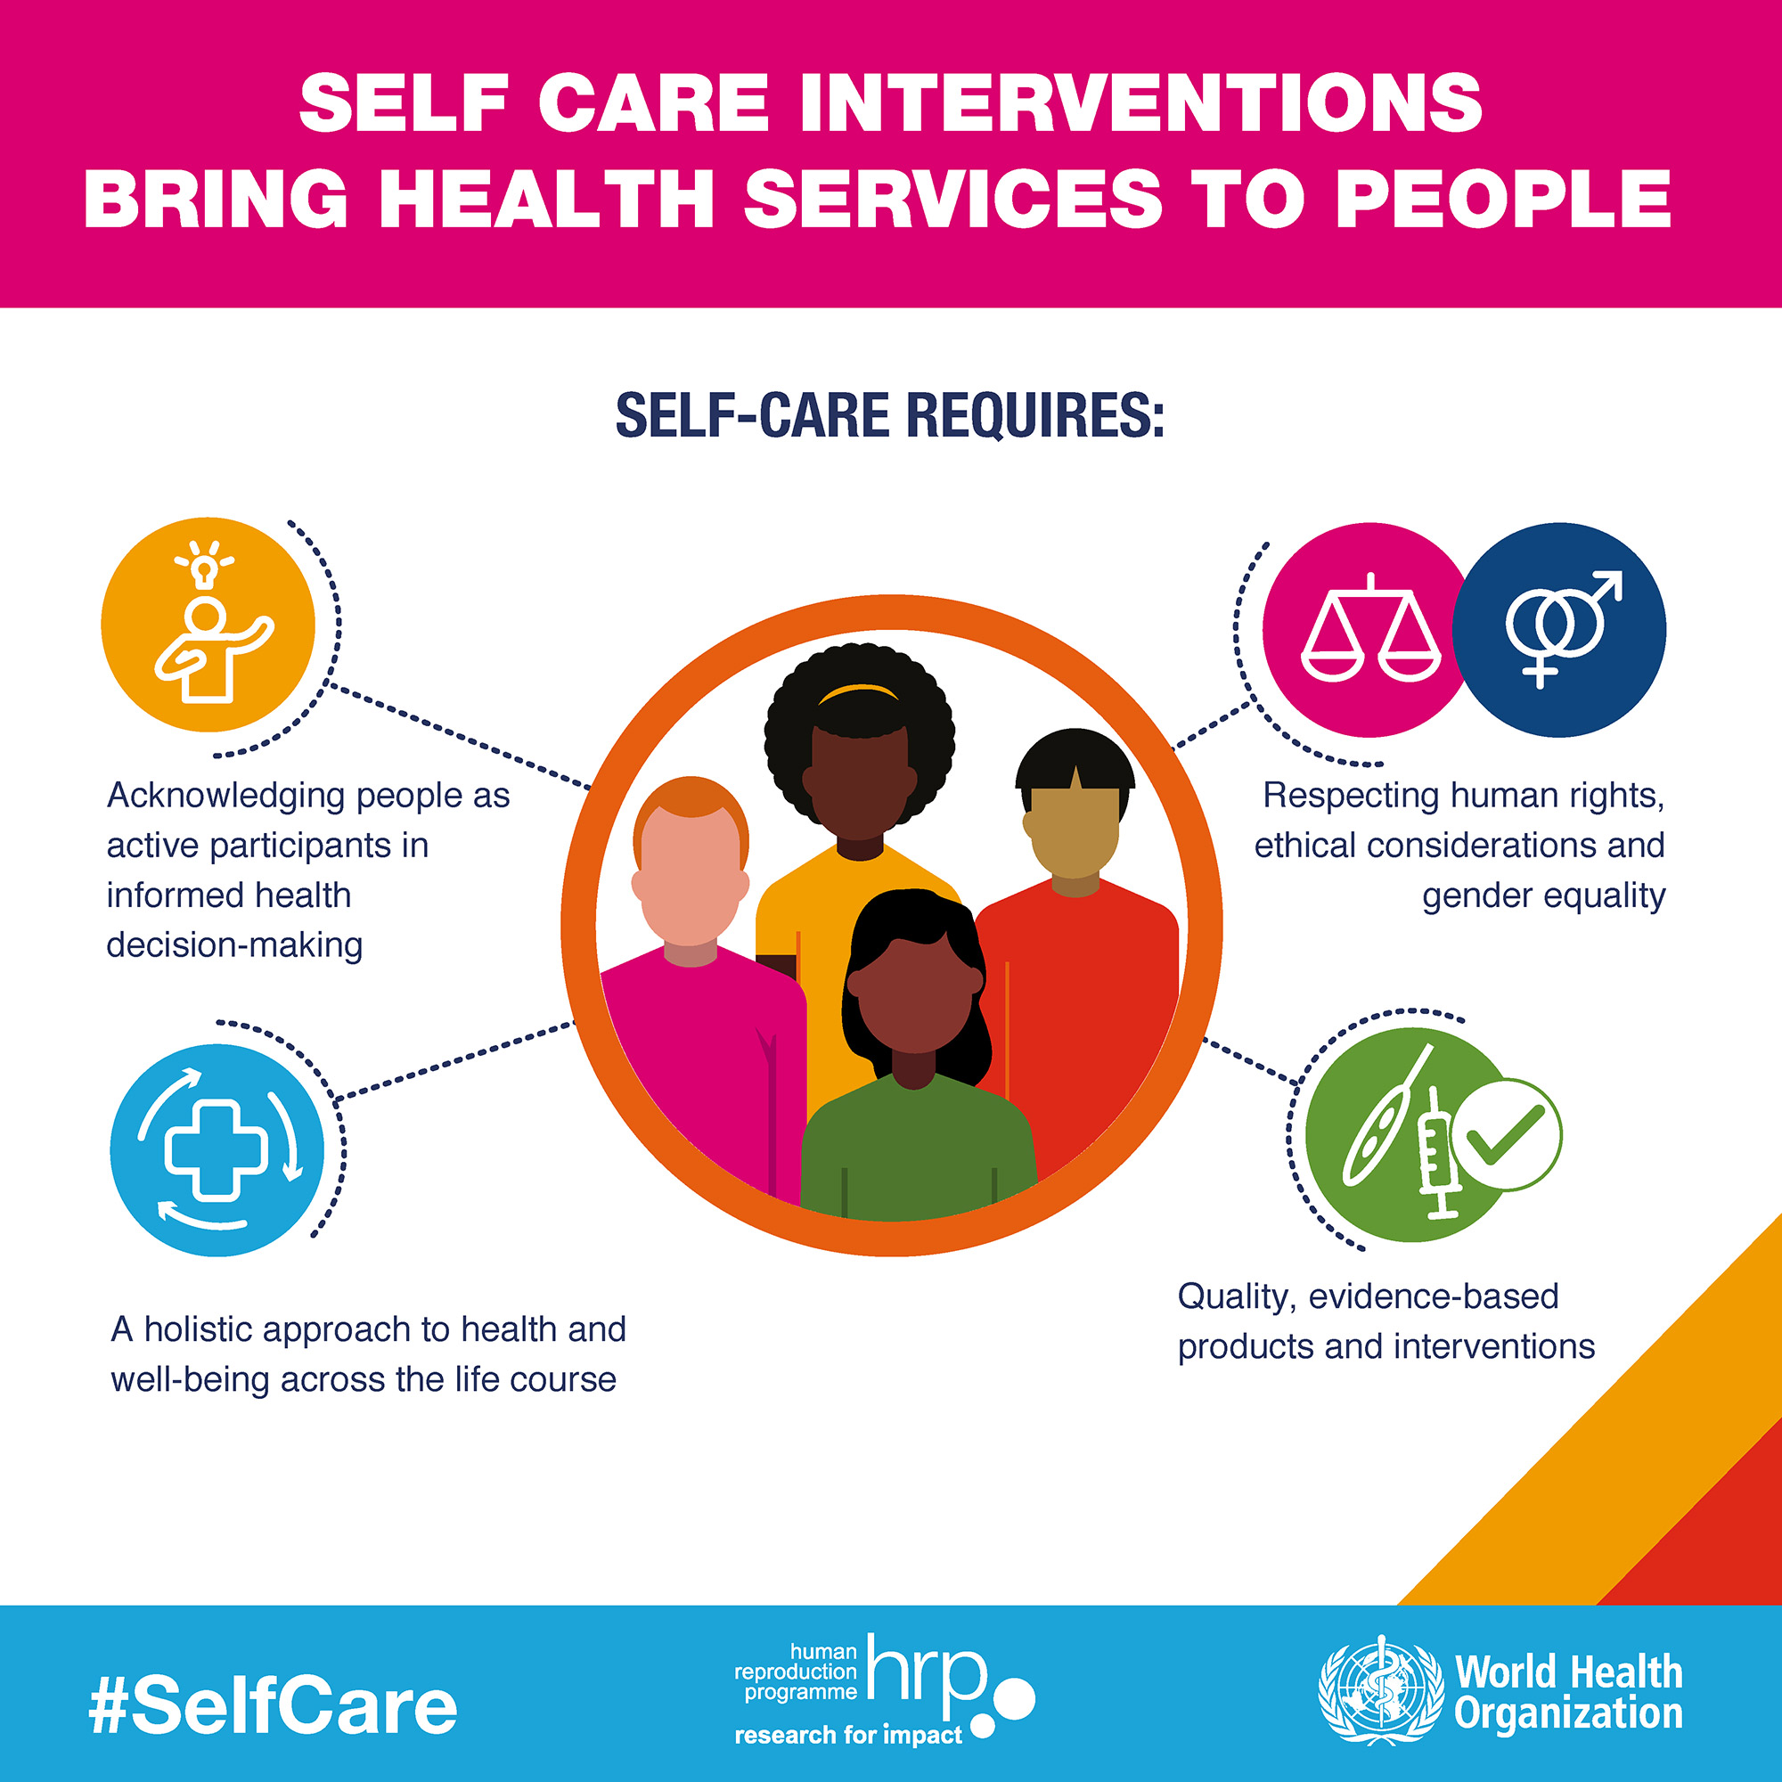
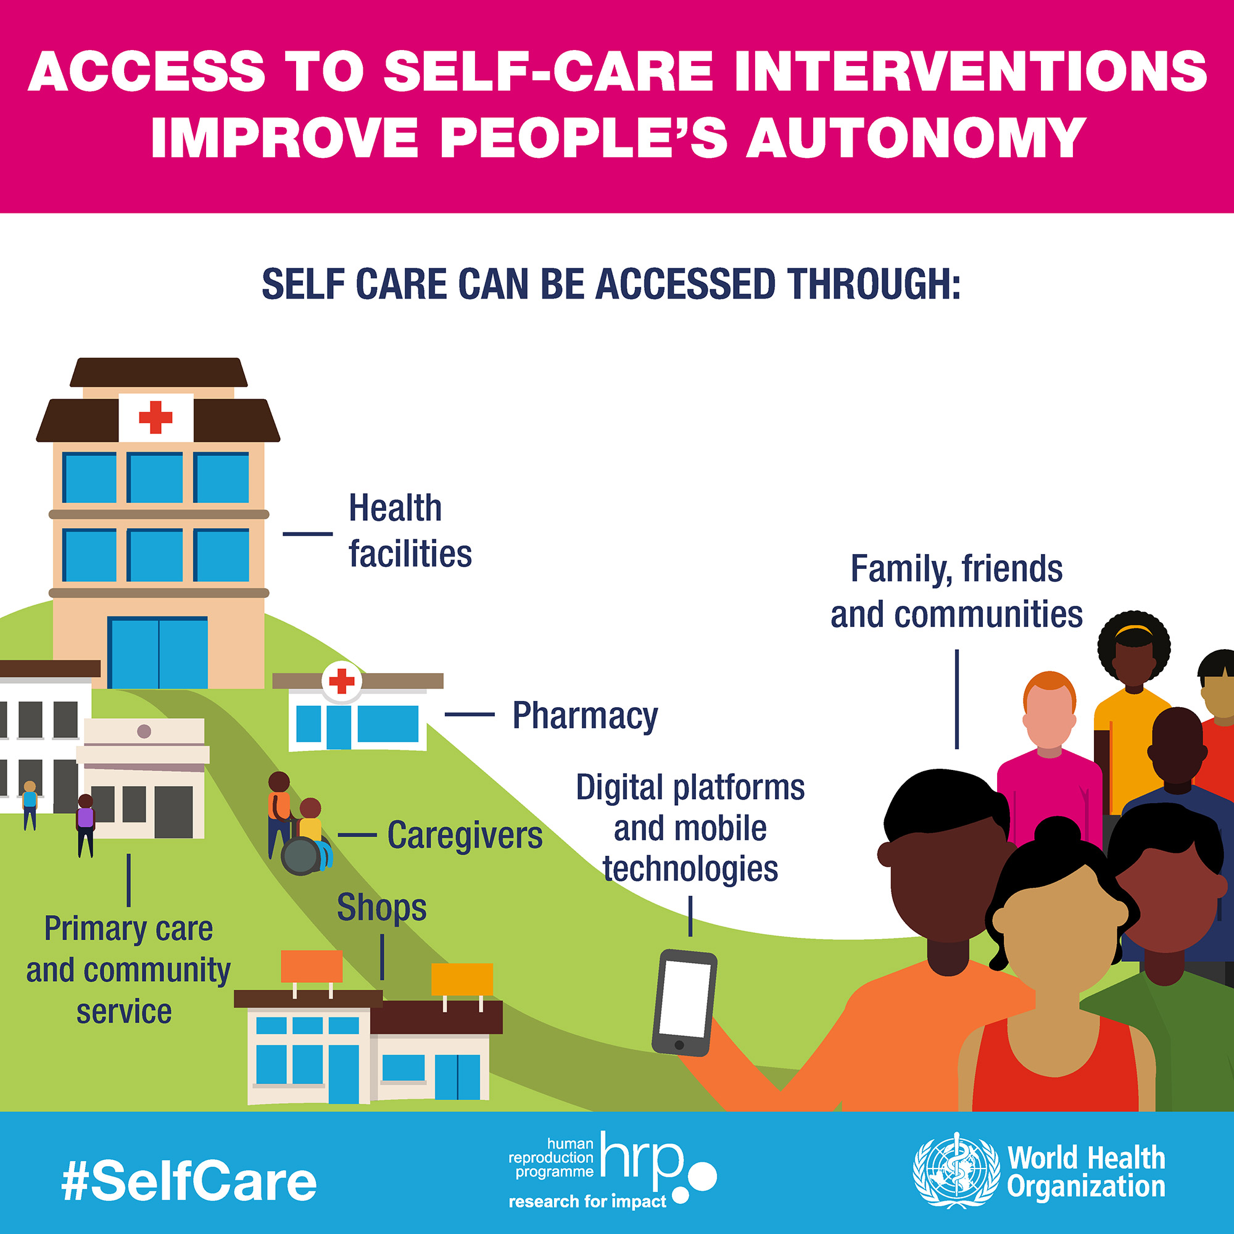
“Self-care is the ability of individuals, families and communities to promote health, prevent disease, maintain health, and to cope with illness and disability with or without the support of a healthcare provider”. [World Health Organization]

Slide 11




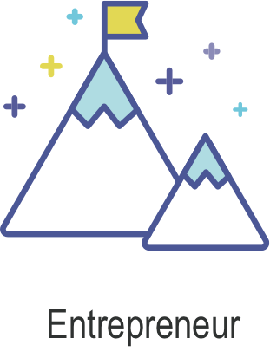

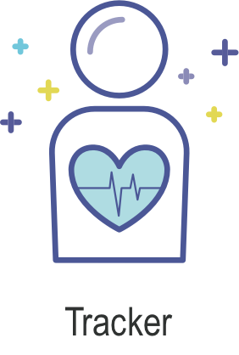
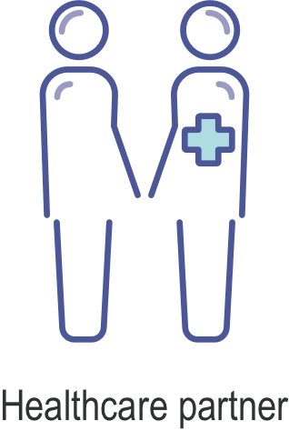

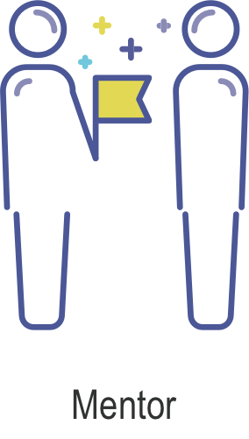
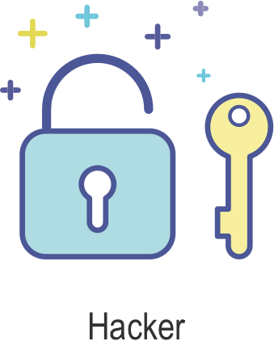
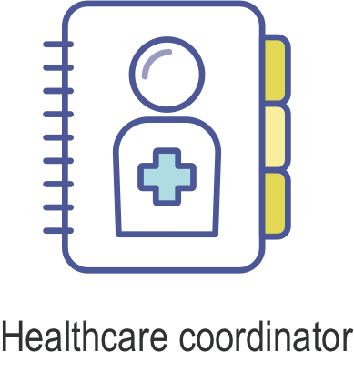
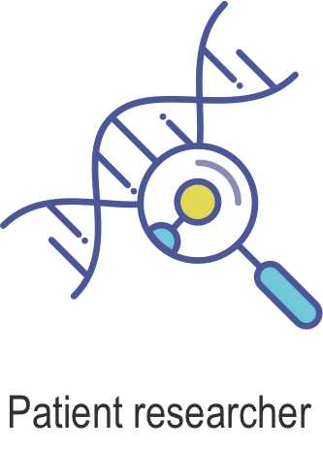
Framework of patients’ & carepartners’ lead user competences (preliminary findings)
Idea-driven
Supported by technology
Healthcare related
Research driven

Slide 12
Email: sara@riggare.se
Website: www.riggare.se

Slide 13
Thank you!

