Slide 1

Medical journals as "trailblazer's" for promoting patient and public involvement in medical education, clinical practice, health research, and policy making
Tessa Richards, Senior Editor /Patient Partnership BMJ

Slide 2
What shapes my views?
Work: General physician and rheumatologist, primary care doctor, BMJ editor
Patient experience: Stage III Adrenal cancer, pernicious anaemia, hyperparathryroidism
Caring role: family members with rheumatoid arthritis , dementia , blindness & heart failure
Clinician, researcher, editor
Carer
Patient

Slide 3
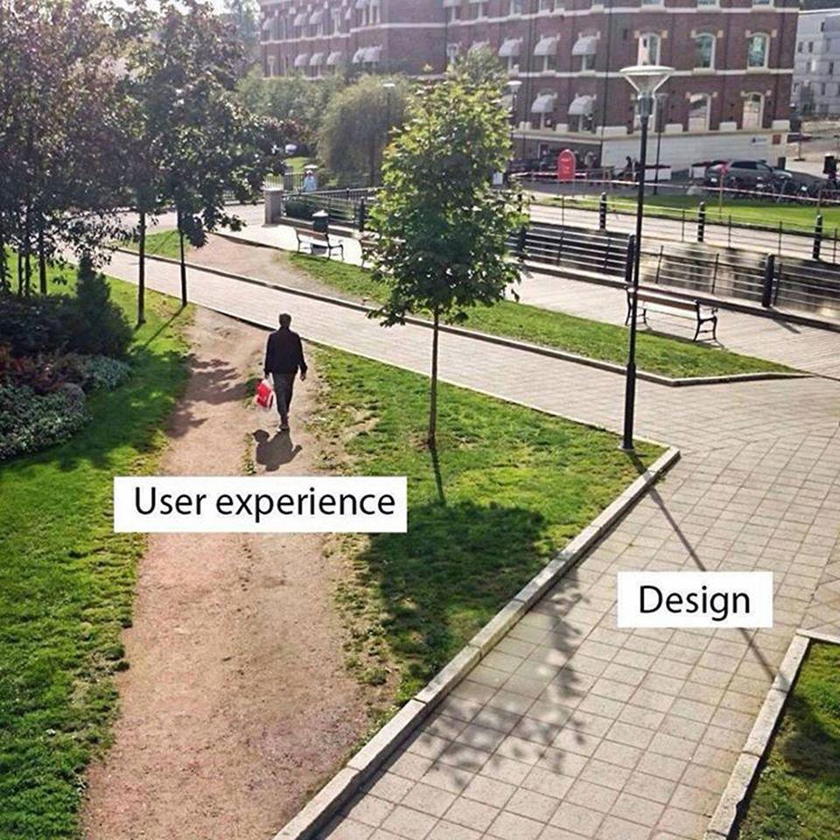
Disease and doctor centric
Care fragmented,
wasteful
and inefficient
Poor understanding of patients experience, priorities. preferences and resources
What outcomes and services they value

Slide 4
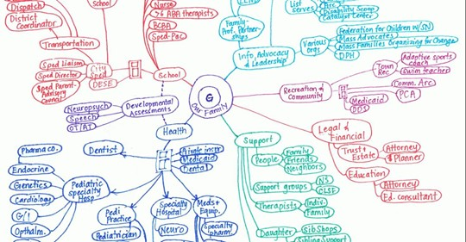
Gabe's care map - what it takes for one boy with special needs. Cristin Lind

Slide 5
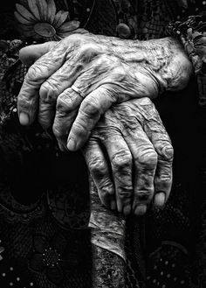
Value in healthcare : learning with and from patients

Slide 6
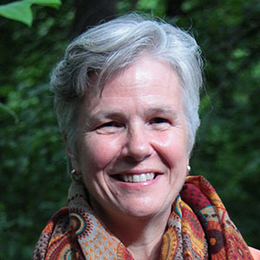


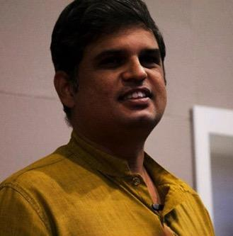


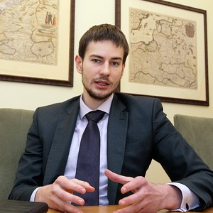
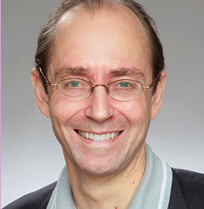
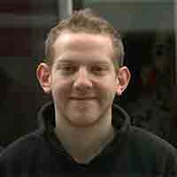
Notes:
International patient advisory group members: chosen for leadership role in advancing PCC (#WEARENOTWAITING)_

Slide 7

"Walking the talk” on co production in our editorial processes
To advance debate + spread best practice on the science and art of learning from, and with, patients, families and communities, and making partnership working the "norm" in research, policy making, clinical practice and medical education.

Slide 8
Co-production of content
RESEARCH Mandatory #PPI statement.
Patient alongside peer review(database of P & Previewers)
EDUCATION Patient contributors/authors/co authors. Patient review
Patient led + co created series "WYPITS," P'ship in Practice
NEWS & VIEWS Patient perspectives/Editorials/BMJ Opinion/essays/ podcasts
EVENTS & AWARDS #Patients Included
Patient Editors embedded with each section + regular input from international patient advisory panel + P & P on Edit. Board

Slide 9
Advocacy for co-production of research
Were patients/public involved ? if so how and when?
How were the research questions and choice of outcome measures informed by their priorities, experience, and preferences?
How did you involve patients in the design, conduct and recruitment to the study?
Were they asked to assess the "burden" of participation in the study
How will the results be disseminated to study participants and linked communities?
Requirement for PPI statements taken up by BMJ portfolio of 70 specialist journals - and others

Slide 10
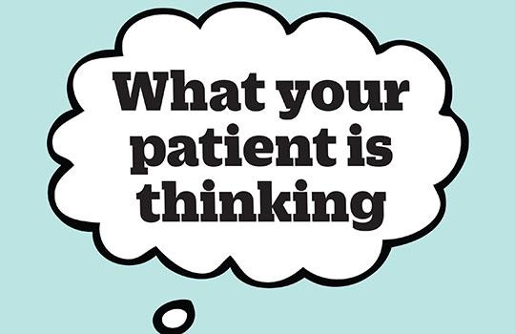
What Your Patient Is Thinking (and doing...)
Since January 2015
CPD for clinicians. Actively teaches (patient to doctor) rather than just telling a ‘patient journey story’

Slide 11

PATIENTS INCLUDED : MORE SEEN THAN HEARD? : flag and foster advances
Providers
Regulators
Research/academic bodies
# PI in conferences
# PI Medical journals

Slide 12
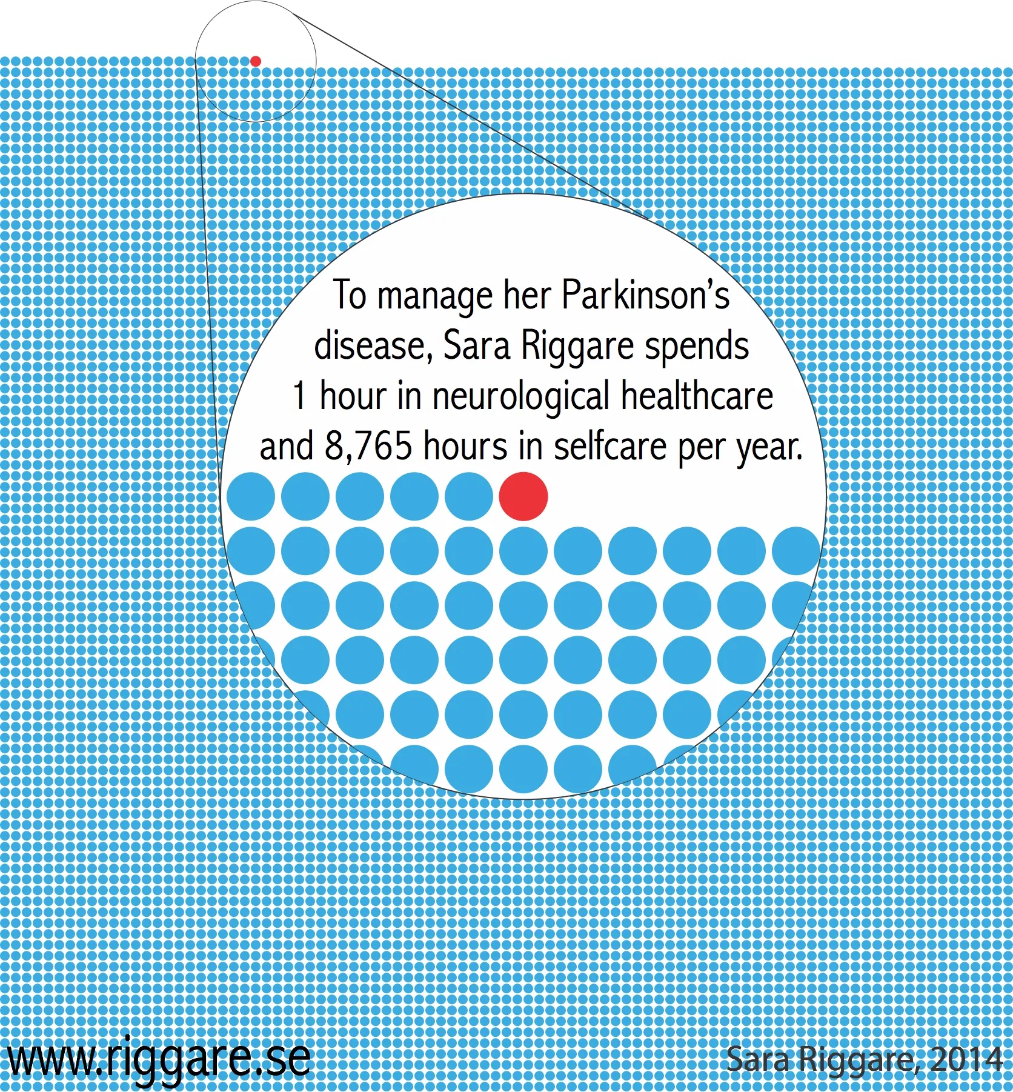
We have much more to learn, not least from from patients with long term conditions
Non-communicable diseases account for over two thirds of deaths worldwide and significant premature disability, morbidity and mortality
"When I got diabetes the people who taught me how to cope with it were fellow patients" UK GP

Slide 13
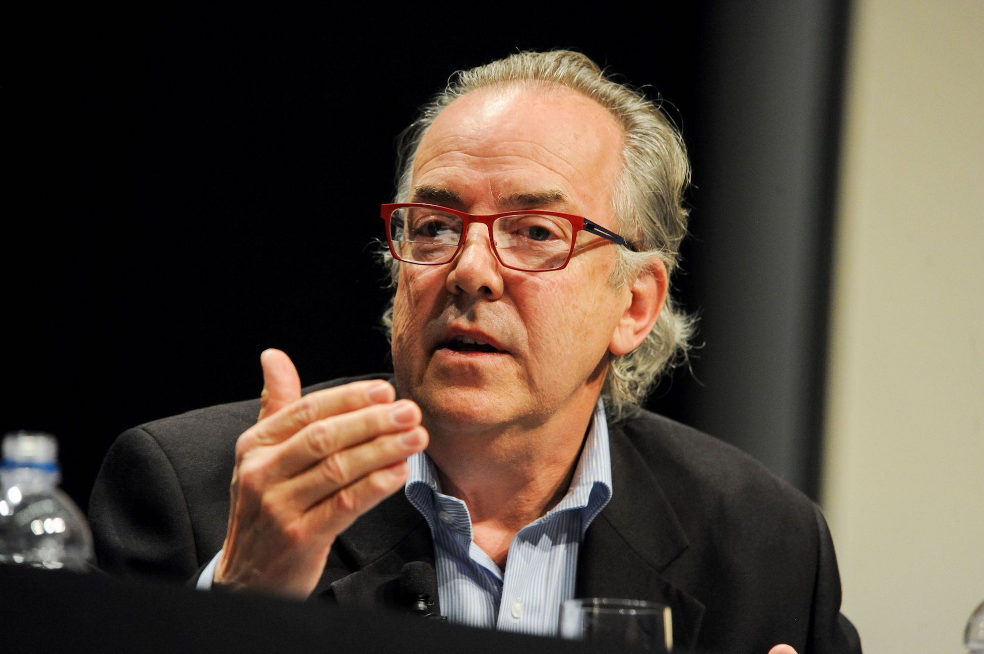
Mike Gill "Dragon Claw" https://vimeo.com/user34258932/download/371306046/10b0045485

Slide 14
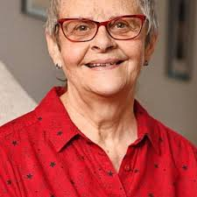
Wendy Mitchell "Someone I once knew"
https://www.youtube.com/watch?v=k4pAaI11QeE

Slide 15
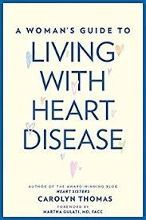
Carolyn Thomas - Heart Sisters https://myheartsisters.org
I wrote about how women heart patients are treated differently in the back of the ambulance en route to hospital compared with men with the same symptoms...a senior American paramedic who teaches emergency medicine wrote to me
“Carolyn, this stops today. With me! I'm changing my teaching curriculum to reflect the study findings you have written about.

Slide 16
Patient + public involvement in academic publications is growing + academics promoting learning from patients
Research Involvement & Engagement patient co-editor/patient editorial board/patient +peer review
Cochrane Collaboration https://www.cochrane.org/join-cochrane/patients-and-carers
CMAJ Open: patient review/requiring #PPI statements for POR collection.
J.Med.Internet Research + J. Participatory Medicine : patient editorial board
Brit.J. O&G : PPI statements, patient written content/co led theme issues, strong input from Women's Network
J Renal Care, Lancet Psychiatry. Brit J Dermatology
http://yalepodcasts.blubrry.net/tag/never-delegate-understanding/

Slide 17

From "God," to guide, to partner in care - patients must help lead the way

Slide 18

bmj.com/patients
Tessa Richards, trichards@bmj.com
Twitter @tessajlrichards, @BMJPatientEd

