Slide 1



Hello Healthcare
A danish initiative on engaging patients and family and breaking down structural barriers
MD Ove Gaardboe, Danish Society for Patient Safety
@OveGaardboe - #PatientsprescribE

Slide 2
Aim – Hello Healthcare
To increase patient’s impact on their own care and treatment by reducing barriers for patient and family involvement
To put patients and families at the heart of every decision by inviting them to ask more questions and express what matters to them

Slide 3
Why….?
Basically because it is safe
  Fewer ’ordinary’ errors (ie. wrong medicine)
  And especially fewer silent misdiagnosis (ie. treatment not suited for the patients wishes or living conditions)
And of course because it is decent and everything else would be out of time

Slide 4

The People’s Meeting in Bornholm this weekend:
ie. ”Thanks You are here”

Slide 5


Slide 6
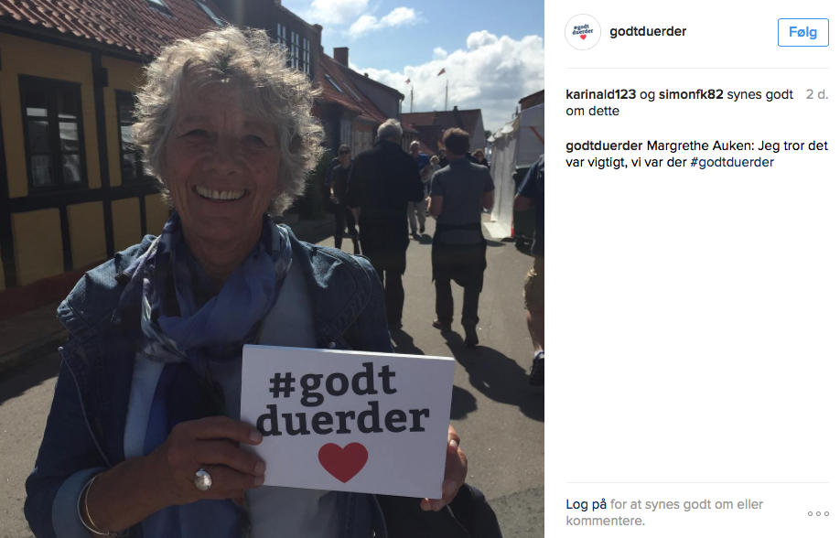
Reducing barriers - results
Plain danish:
  Health care personal must speak and write in plain danish
  When you leave hospital, you must know where to go or call for supplement information
  Important talks must be planned, so that family can participate

Slide 7
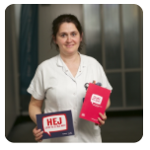


Tools for patients – and for family
hejsundhedsvaesen.dk

Slide 8
Reducing barriers
3 most important subjects from patients in a new study (not published yet):
  Health care personal must speak and write in plain danish
  When you leave hospital, you must know where to go or call for supplement information
  Important talks must be planned, so that family can participate (especially for the elderly)

Slide 9
Reducing barriers - results
All 5 danish regions are now running projects on converting language in written messages to plain and ordinary danish
New national focus on transitions between primary and secondary care and viceversa
(We hope to get funding to run a national project on safe transitions)
In 2 of 5 regions family is invited to be in the hospital whenever it is convenient (24/7)

Slide 10
Visiting hours

Slide 11
Patient engagement
Recently published study*:
53% of the danes think they need to be active to get the right treatment
Almost everyone want decissions about their treatment to be taken in cooperation (except in emergencies)
Most danes are willing to take part in the treatment – also when it comes to family
*mandagmorgen/TrygFonden: Sundhedsvæsenet – ifølge danskerne

Slide 12
Healthcare personal engagement
All professional groups wish to engage patients and family and share decisions
When you ask them more than 95% agree
But when you ask patients and family, it is not the reality

Slide 13
Conclusions
Patients as well as family are more ready than ever to be engaged
Healthcare professionals are positive in thinking - but not in reality
Leaders in health care, unions and patient forums are calling for action
In PS! and Hello Healthcare we will continue the work with all the healthcare professions and in public to increase engagement and invitations
…and to gather the stakeholders to get commitment on action on central subjects

Slide 14
Thank You everyone
Please support action on EU as well as national level…..
MD Ove Gaardboe, Danish Society for Patient Safety
@OveGaardboe - #PatientsprescribE

