Slide 1

EPF Campaign on Patient Empowerment
Laurent Louette
Communications Officer
#PatientsprescribE
@eupatientsforum
@laurentlouette
21/06/16
Brussels

Slide 2
Patient Empowerment Campaign
Launched in May 2015
What were our objectives?
Raise awareness of PE
  What is Patient Empowerment?
  Critical role of patients
  Collective patients’ involvement
To call for an EU Strategy on Patient Empowerment
  Advocate for integration at all levels
  Share good practices
  Propose concrete actions
01
02
03
04

Slide 3
Outputs
Campaign reach out
The campaign was presented at 32 events in 11 countries
EPF and supporters of the campaign helped raise awareness of the campaign with publications in different media. In total, the EPF campaign was mentioned in 35 articles/publications

Slide 4

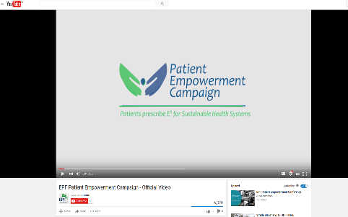


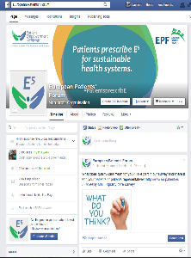





The campaign in numbers
205 pledge supporters
37.368 views in total for 8 campaign videos
1,992 tweets from 563 handles
Leaflet available in 18 different languages
2,260,962 Impressions

Slide 5
Events
Kick-off Conference – May 2015
High-level Policy Roundtable 22/06
Closing Exhibition 29/06

Slide 6


Thank you
@eupatientsforum
/EuropeanPatientsForum

