Slide 1
The patient’s perspective:
Why empowerment matters?
Aneela Ahmed, EPF Youth Group, National Voices, UK
Brussels, 22 June 2016
Notes:
Introduction: Aneela should briefly introduce herself (and EPF unless this is done by chair).

Slide 2
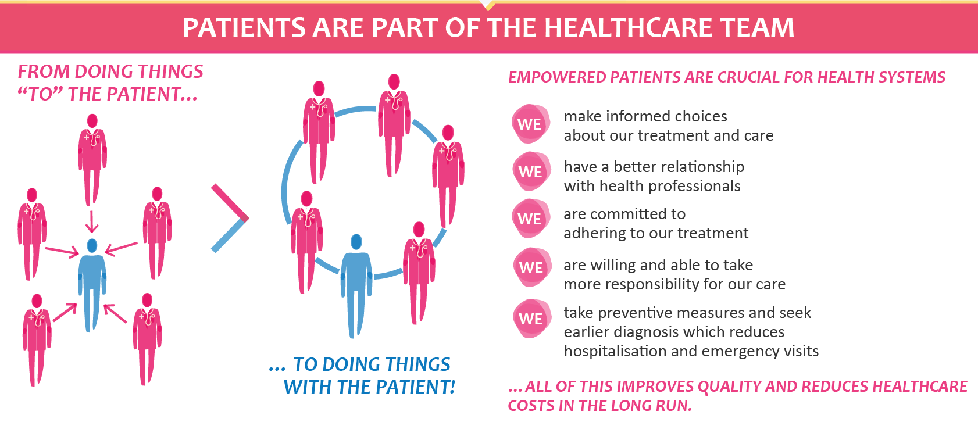
Patient Empowerment
What is patient empowerment?
What does it mean to us, patients?
What is the added value to the healthcare system?
Notes:
Patient empowerment is a process that helps people gain control over their own lives and increases their capacity to act on issues that they themselves define as important.
There is also a collective dimension to empowerment – the patient community – and empowerment is conditional on various external factors that patients encounter, be it the attitudes and skills of health professionals or the way health systems are structured.
At EPF, our vision of patient empowerment is based on the 5 E’s and that’s why we structured our campaign around them. In fact, they also appear in the slogan of the campaign: “Patients prescribe E5 for better health systems”:
Education: patients can make informed decisions about their health if they are able to access all the relevant information, in an easily understandable format.
Expertise: patients self-manage their condition every day so they have a unique expertise on their health and on healthcare which needs to be supported
Equality: patients need support to become equal partners with health professionals in the management of their condition
Experience: individual patients work with patient organisations to represent them, and channel their experience and collective voice.
Engagement: patients need to be involved in designing more effective healthcare for all, and in research to deliver new and better treatments and services.
Empowerment, to patients, to us, it means being able to be in charge of our own lives, to play an active and important role in the relationship with our healthcare professionals but also collectively in the healthcare system.
The added value of patient empowerment to the healthcare system and society is potentially enormous.
There is increasingly good evidence that empowered patients who become active players in their treatment have a better relationship with health professionals, ensuring a more coherent and shared decision-making process and better adherence to treatment. Empowered patients also have higher health literacy, better health outcomes and more appropriate use of health services, including preventive services and early diagnosis – all of which has potential for improving the quality of healthcare, population health and cost-efficiency of the healthcare system.

Slide 3

Patient Empowerment
Why do we need policy-makers and stakeholders to adopt a strategy?
We need to implement policies and practices for Patient Empowerment/involvement at national and EU levels.
Notes:
I said that patient empowerment has potentially enormous value for the sustainability of health systems. Unfortunately, at the moment this potential is largely unused.
Whilst there are many interesting initiatives happening and “pockets” of innovation here and there – one of which we will hear about today – there is no coherent approach to patient empowerment at EU level.
It is now high time for a European strategy on patient empowerment. Making it a reality is possible, but we need commitment and investment from policy makers, both at EU and national level. Strategies to foster patients’ empowerment and involvement as key actors in the health system at all levels – from the individual medical practice, to the hospitals, to the tables where policy is made - need to be developed in partnership with patients.
With the various pressures being put on our social and healthcare systems, we must think outside the box.
Well, here it is, I hope that our campaign at EPF will help bring in a new era, gaining political support and recognition that patient empowerment is not only a “nice to have” but a fundamental and integral route towards ensuring that we, patients, and all of society will enjoy high quality healthcare in a system that is effective, efficient and sustainable and increases the well-being of everyone.
Let us all work together to make that change.

