Slide 1
EPF Members Call: Discussion on common actions to support the patient community during the Ukrainian crisis
Thursday, March 24°, 15:30-17:00 on Zoom

Slide 2
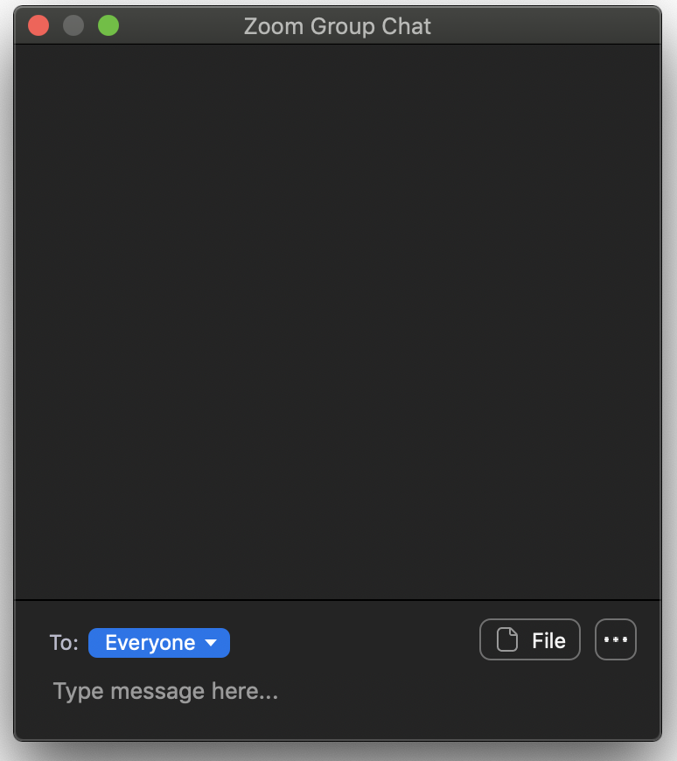
Housekeeping rules
Please note:
Attendees are automatically muted when joining Zoom.
Please name your self first-last name + name of your org
Keep your microphones on mute and cameras on unless speaking.
Slides will be sent to you together with any further communications from EPF
The session will be recorded only for internal purposes
Do you have any questions?
You can leave your comments or questions in the chat box.

Slide 3
Speakers
Anca Toma– EPF Executive Director
Elena Balestra – EPF Head of Governance, Membership and Capacity Building

Slide 4
A week ago, EPF sent you a survey to investigate the EPF members’ community current activities and needs to support the patient community during the Ukrainian crisis.
Let’s see your responses…

Slide 5
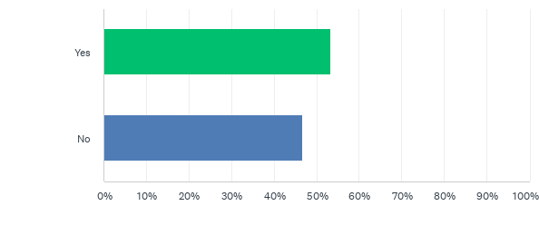
1) Is your organisation having or coordinating initiatives to support Ukrainian chronic patients either in Ukraine or abroad?

Slide 6
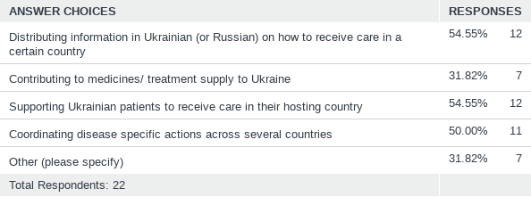
2) What is your organisation doing?

Slide 7
A few of the other actions you are taking:
Connecting with pharma industries and urging them to make sure specific medications are available on the spot
Collecting donations to support patient organizations hosting refugees
Supporting your members and partner organizations
Creating a documentary of patients affected by the Ukrainian war
Raising awareness and communicating with Ukrainian organisations about their needs
Releasing a document with recommendations on mental health care and support.

Slide 8
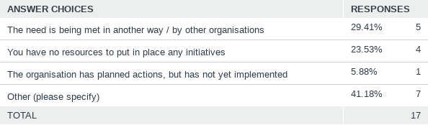
3) If you are not taking actions, it’s because:

Slide 9
Other reasons why your organisation is not taking actions:
You are not sure what you can do and what your role could be
You are still internally discussing potential actions

Slide 10
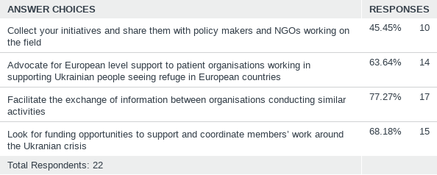
4) How can EPF support your organisation in these circumstances?

Slide 11
5) What (further) initiatives your organisation is planning or would like to conduct if had more resources/support? 1/2
Organizing transport of medicines and equipment to families in Ukraine and Russia
Supplying medication and medical devices to those in need.
Help the Ukrainian refugees to receive a proper treatment in hosting countries.
Increase insulin and other medicines supplies to patients in need. Coordinate families to accept refugees (especially children) for shelter and help

Slide 12
5) What (further) initiatives your organisation is planning or would like to conduct if had more resources/support? 2/2
Translation support in hosting countries
Reaching out to industry partners for providing medicine supplies to national organisations in the neighbouring countries of Ukraine.
Launch of a campaign to provide financial support to all the members in our neighbouring countries. The amount collected through crowdfunding channel will be distributed to the members of Poland, Romania, Slovakia, Hungary and Moldova
Reaching out to our current sponsors for emergency support
Providing information to refugees based on the country they stay or pass by

Slide 13
Q&A

Slide 14
info@eu-patient.eu
www.eu-patient.eu

