Slide 1
ECPC Initiatives: collaborating with scientific societies for the production of cancer patient guidelines
Isabelle Manneh, RPh , MPH
Head of EU Health and Research programmes

Slide 2
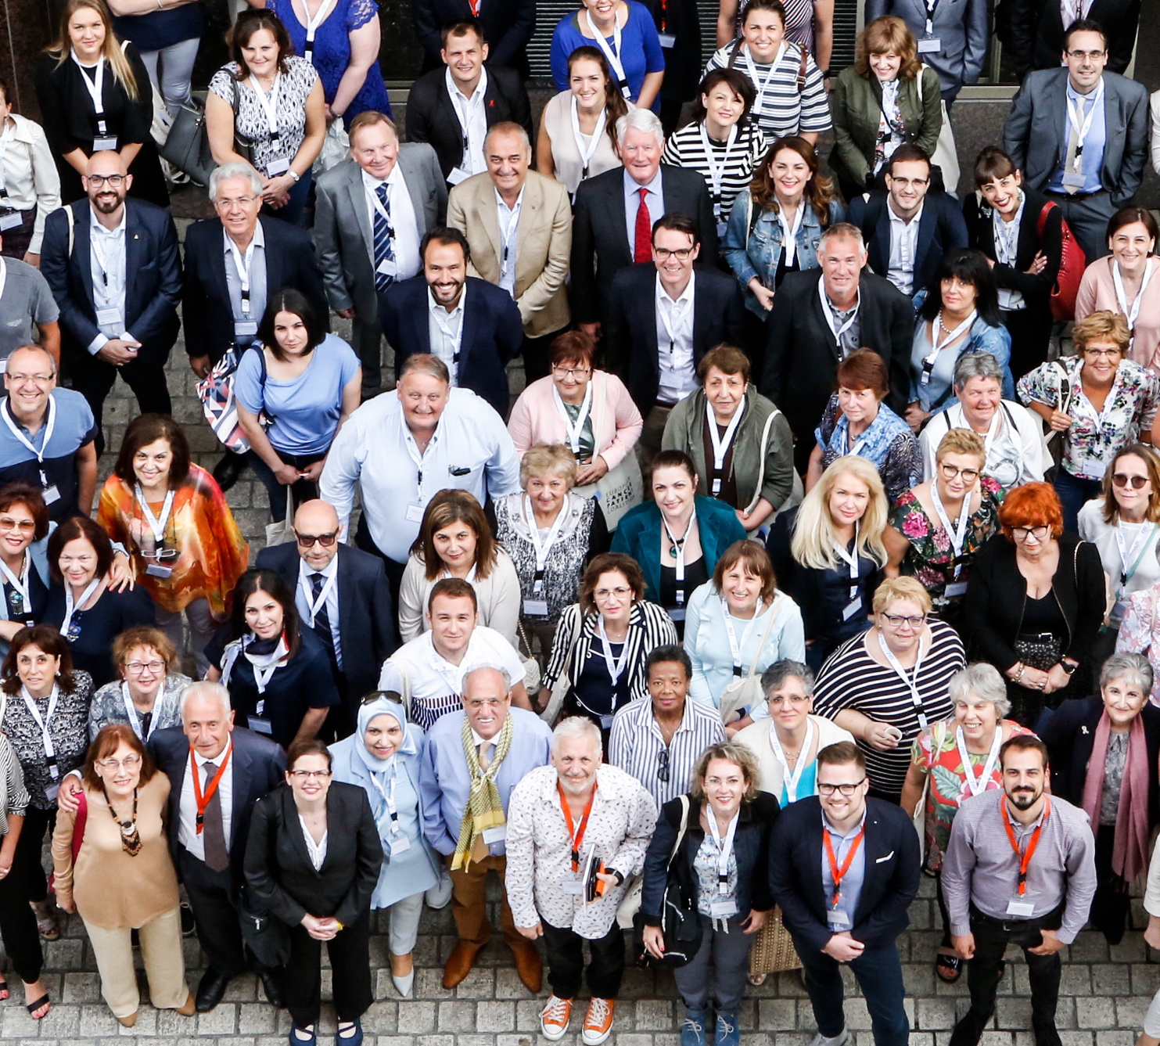
Introduction
Largest European cancer patients' umbrella organisation established in 2003
Almost 450 Members in 46 countries
Advocate for patients to be acknowledged as equal partners & co-creators of their own health
We work for a Europe of equality, where all Europeans with cancer have timely & affordable access to the best treatment and care available, throughout their life

Slide 3

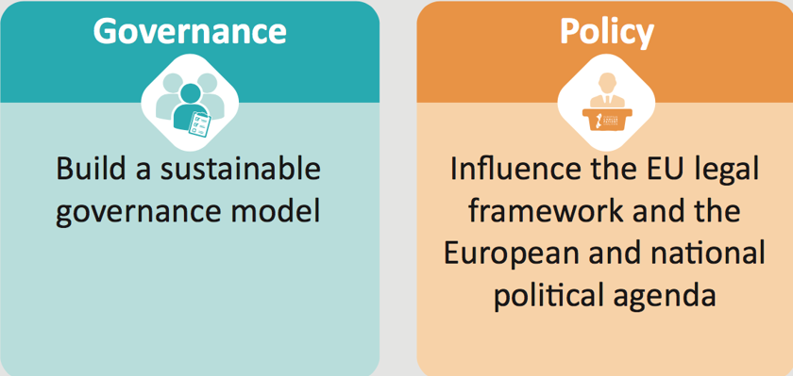
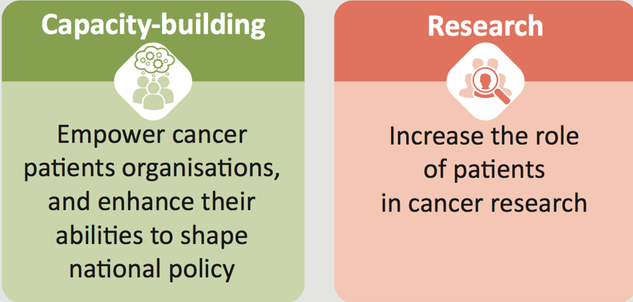
Nothing about us, without us!
ECPC Multi-annual Strategy increases impact and long-term aspirations throughout the EU

Slide 4
The European Cancer Patient Coalition (ECPC) works for a Europe of equality, where all European cancer patients have timely and affordable access to the best treatment and care available, throughout their life.
ECPC believes that cancer patients are the most important partners in the fight against cancer and against all the cancer-related issues affecting our society.
Policy makers, researchers, doctors and industry should recognise cancer patients as co-creators of their own health.
The European Cancer Patient Coalition draws on fundamental knowledge and understanding of the patients' situation by working through our Members.

Slide 5
ECPC’s "on the field" engagement enhances our capacity to truly represent patients at the EU level, providing irreplaceable first-hand understanding of the issues revolving around cancer patients.
Furthermore, EU funded Health and Research projects allow us to be on the forefront of scientific developments on cancer by providing the patient's perspective while draining fundamental knowledge on the science behind cancer.
ECPC participates in the EU's Third Health Programme, as well as several European Union Research and Innovation framework programmes: this includes the Seventh Framework Programme (FP7) and Innovative Medicines Initiative (IMI) 1 and IMI 2 under Horizon 2020 (H2020).

Slide 6
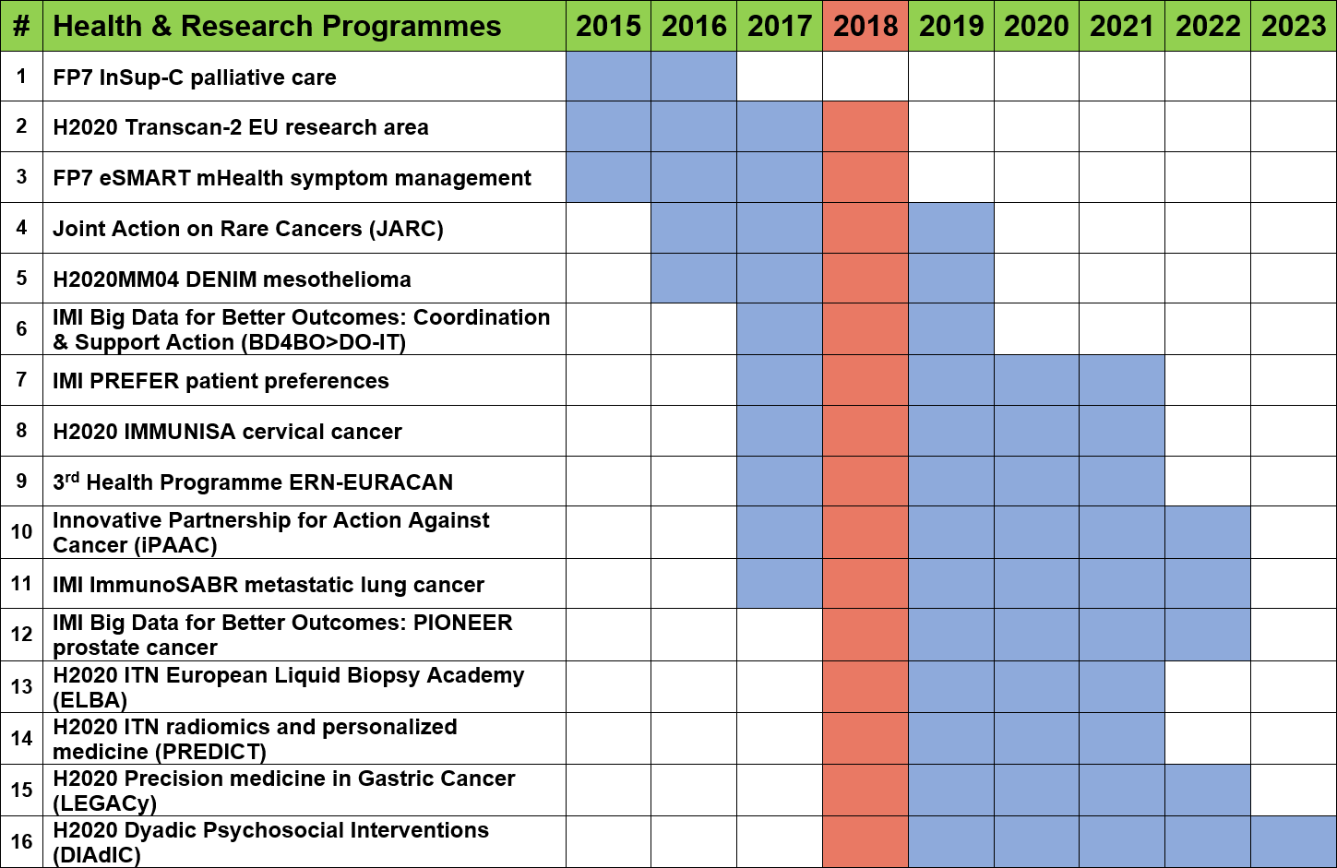
ECPC emphasises the importance of involving patients as co-researchers and strongly advocates for the best partnership model between both researchers and patients, allowing patients to contribute their unique experience working towards a more patient-centric study while participating in crucial project decisions.

Slide 7

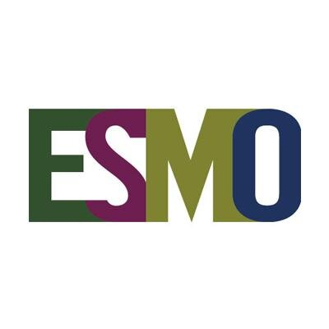
The European Cancer Patient Coalition (ECPC) and the European Society for Medical Oncology (ESMO) have signed a Memorandum of Understanding, with the aim of enhancing the existing cooperation and increasing the efforts to achieve their common goals and objectives in the field of cancer to satisfy the new needs and new rights of cancer patients across Europe.
The Memorandum establishes a legal framework for current and future collaborations, leaving complete freedom and discretion to the partners. In this respect, the Memorandum works alongside existing ECPC and ESMO agreements with third parties, avoiding duplication and enriching existing initiatives

Slide 8
What we are doing on our part?
ECPC – ESMO Memorandum of Understanding signed in May 2016, 2018.
Not only formal agreement, but also practical collaboration on concrete projects:
              Update of the ESMO Guidelines
              Update of the Patients Guides
              Survivorship
              The first topic on which ECPC and ESMO started collaborating was survivorship care.
              ECPC is routinely and directly involved in the drafting of the Survivorship chapters of the new ESMO Clinical Practice Guidelines.

Slide 9
The Memorandum formalises a long established partnership.
ECPC and ESMO have collaborated on a large range of key policy issues related to cancer, including: Rare cancers: Data protection and Immuno-Oncology
ECPC and ESMO decided to partner up to include more patient-friendly and solid survivorship care provisions in the guidelines, reflecting cancer patients’ growing needs for structured follow up after the acute treatment phase.
In the coming years, each updated ESMO Guideline will contain a reviewed, patient-oriented survivorship chapter.
Check the ESMO Guides for Patients, an invaluable source of information. ECPC and ESMO will also ensure that the Guides for Patients will include updated provision on survivorship care, in line with the Clinical Guidelines.

Slide 10
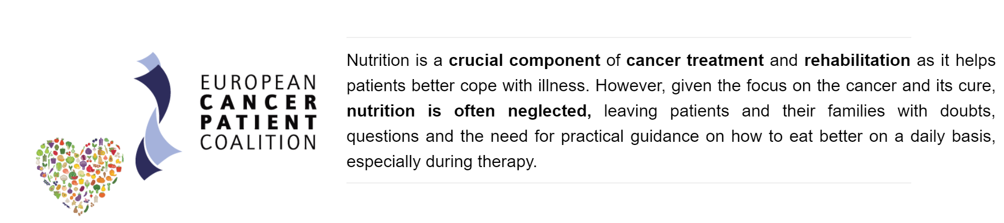
In 2015 ECPC sent out an extensive survey on nutrition and its importance on the treatment and life of cancer patients.
The preliminary data obtained from the survey suggested that discrepancies still existed between patients’ expectations and the answers they may get from physicians about the metabolic and nutritional issues in cancer.
Building up on the pilot survey, in 2016 the European Cancer Patient Coalition continued its efforts with a second round of the survey in order to have enough data and maximise the impact of the answers received.

Slide 11
The new version of the 2016 survey was adapted in order to directly address individual cancer patients and cancer survivors.
It aimed to describe and understand the perception of the importance of metabolic and nutritional problems among patients and cancer survivors. The study was conducted by a survey of cancer patients and survivors.
A structured questionnaire was designed to analyse the importance of nutrition for people with cancer.
A total 907 patients and survivors, distributed in 10 European countries (Finland, Italy, Spain, Czech Republic, Greece, Denmark, Slovenia, Romania, Poland, Bulgaria) answered the questionnaire.

Slide 12
Results showed a substantial gap in terms of need for information and practical management of cancer-related nutritional problems for people with cancer.
More than half of physicians (54.3%) did not pay attention to weight loss
Almost 2/3 of the patients (69.4%) knew that persistent loss of appetite could be caused by the tumour.
More than 70% of the participants experienced feeding problems during the disease and/or therapy and all the responders declared to be aware about feeding importance.
Almost 30% of the sample had no information on nutritional support, including artificial nutrition.
The majority of physicians (53.9%) did not check the nutritional status of their patients, including their body weight, or did not refer patients with feeding problems to a nutrition specialist.

Slide 13
On the 9 November, 2017 MEP Daciana Octavia Sârbu (S&D, Romania) in collaboration with the European Cancer Patient Coalition (ECPC) hosted an event in the European Parliament on the important topic of the Role of Nutrition in Cancer Care.
The results of a study conducted by the European Cancer Patient Coalition (ECPC), Sapienza University of Rome, and Healthcare International to analyse the importance of nutrition for people with cancer was at the heart of today’s discussions following an abstract of the study that was presented the European Society of Medical Oncology (ESMO) 2017 Congress in Madrid.

Slide 14
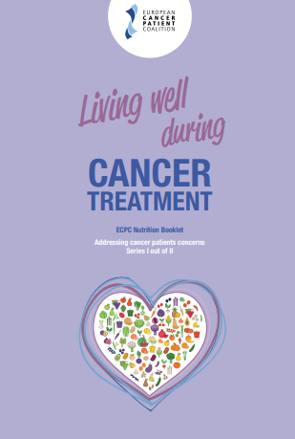
Living Well Booklet
Endorsed by ESSO, and presented by EONS at ESMO 2018 Congress Nutrition Session.
The Living Well Booklet: addressing cancer patients' concerns is based on the ESPEN guidelines on nutrition in cancer patients and the ESMO Handbook of Nutrition and Cancer.
Contents: European Survey, Living Well, Screening, Body mass index, HSPH Nutrition Guide, WCRF/AICR Recommendations, 8 Questions to ask your Oncologist, Key Messages, a proposed Cancer Patient’s Charter of Rights for Appropriate and prompt nutritional Support, and Glossary.

Slide 15


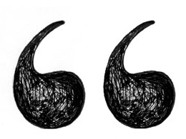
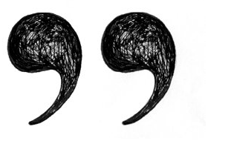
Living healthy during cancer treatments is a combination of good nutrition, which consists of an adequate and well balanced diet, and regular physical activity. However, the nutrient needs of each individual may vary, consult with your cancer care team can help you identify your nutrition goals.
It is not intended to offer medical advice or replace advice given by your healthcare team.

